Slide 1

Faculty of Law
Reserve Transparency and Redemption Risk in Stablecoin Regulation
Jingru Chen
    May 28, 2026 International financial law
Notes:
封面还未修改

Slide 2
The Trust Foundation-Stability is a Trust Relationship
Stablecoin stability
The promise to users
People use stablecoins because they believe:
The issuer holds enough reserves behind the token
They can redeem at par when they want to
depends on
Trust
Reserve transparency
Are reserves real and sufficient?
Stablecoin stability
The promise to users
if insufficient
if unreliable
If either fails → trust collapses

Slide 3
The FSB treats these as core concerns
TerraUSD collapse (2022) → FSB response
FSB core emphasis:
Sound reserve asset management
Redemption at par in a timely manner
Transparency about reserve composition

Slide 4
Why It's Hard-The Real Test Comes Under Pressure
 | Banks | Stablecoins
Central bank backstop | √ | ×
Deposit insurance | √ | ×
The system depends on one thing: whether reserves are real and liquid, and whether redemption still works when demand suddenly rises.

Slide 5
The Verification Gap-Disclosure is Not the Same as Verification
Framework
Reserve disclosure required
Periodic audit
quarterly or annually
Market stress
moves in hours
verified by
The gap
By the time a problem is confirmed, redemption may already have failed.

Slide 6
Conclusion
To understand stablecoin regulation, start from:
Reserve transparency
Redemption risk
Without credible backing and reliable redemption, the promise of stability is very difficult to sustain.

Slide 7
Thank you!
Thank you

Slide 8

Is deposit insurance adequate today?
The collapse of Silicon Valley Bank
as a stress test for the financial safety net
International Financial Law
28 May 2026
Rosalie Mottard

Slide 9
Key facts
$209B
$250K
~94%
< 48h
SVB total assets at collapse
US FDIC deposit coverage limit
SVB deposits uninsured
Duration of the bank run
What is deposit insurance — and why does it exist?
Banks borrow short and lend long — a structurally fragile model
US FDIC: $250,000 per depositor, risk-based premiums since 1991
Depositors lack information to assess bank risk (asymmetric information)
EU DGS Directive 2014: €100,000 per depositor, ex-ante funded
Without insurance, even rational depositors run at the first rumour
UK FSCS: £85,000 — Northern Rock (2007) exposed pre-crisis gaps
Diamond–Dybvig (1983): bank runs are self-fulfilling equilibria
All sit within a wider safety net: LOLR + resolution regimes (BRRD, OLA)
Universität Zürich
International Financial Law | Is deposit insurance adequate?
28.05.2026
1

Slide 10
SVB — anatomy of a collapse
2019–2021
Explosive growth fuelled by uninsured VC/tech deposits. Total assets surge from ~$70B to $211B. SVB piles into long-duration US Treasuries and MBS (~$120B) at low yields.
2021
Federal Reserve privately flags inadequate liquidity and interest rate risk management. The Chief Risk Officer post goes vacant — unfilled for 8 months.
2022
Rapid Fed rate hikes erode the value of HTM securities. Unrealized losses mount but are hidden by accounting rules. Tech downturn accelerates deposit outflows.
8 Mar 2023
SVB discloses a $1.8B loss on $21B securities sale and announces a capital raise. Social-media panic ignites. $42B is withdrawn in a single day.
10 Mar 2023
FDIC places SVB in receivership: the 16th-largest US bank and the largest bank failure since 2008. The FDIC, Fed and Treasury backstop all deposits to prevent systemic contagion.
Universität Zürich
International Financial Law | Is deposit insurance adequate?
28.05.2026
2

Slide 11
Where deposit insurance failed at SVB
The 94% uninsured problem
Social-media-driven bank run
The vast majority of SVB deposits exceeded the $250K FDIC limit: corporate accounts of startups and VC firms. Insurance was simply irrelevant to nearly every depositor who mattered.
$42B fled in under 24 hours, faster than any historical run. Traditional DI assumes slow, orderly withdrawals. Digital banking + social media collapsed that assumption entirely.
Regulatory arbitrage (EGRRCPA 2018)
HTM accounting opacity
SVB CEO Becker lobbied Congress to raise the SIFI threshold from $50B to $250B. SVB escaped stress testing, LCR and living-will requirements; despite holding $209B in assets.
Over 40% of assets were classified Held-to-Maturity, shielding massive unrealized losses from capital ratios. DI premiums were calibrated to reported capital not true market-value risk.
Universität Zürich
International Financial Law | Is deposit insurance adequate?
28.05.2026
3

Slide 12
Theoretical lens — what theory says, where SVB breaks it
Diamond–Dybvig (1983)
Bank runs are rational equilibria. Deposit insurance eliminates the 'bad' equilibrium — but only for insured depositors. SVB's uninsured majority had every rational reason to run first, and fast.
Moral hazard
Flat or inadequate DI premiums reward excessive risk-taking. SVB's HTM strategy was rational if costs of failure fell on the public. Hellmann, Murdock & Stiglitz (2000): capital requirements alone do not suffice.
Wharton/Goldstein (2024)
Optimal DI must balance run-prevention against moral hazard incentives. The blanket backstop used after SVB stops runs but distorts risk incentives for all future banks; the coverage question remains open.
Digital-age failure mode: Al-Sari (2025) : social-media-driven runs depart entirely from the traditional liquidity risk framework. Basel III's LCR assumes a 30-day stress window; SVB's run took under 48 hours. Deposit insurance cannot stop what it was never designed to anticipate.
Universität Zürich
International Financial Law | Is deposit insurance adequate?
28.05.2026
4

Slide 13
What needs to change — reform agenda
1
Restructure coverage tiers
Targeted higher limits for business transaction accounts (payroll etc.) without unlimited backstops that maximise moral hazard. Distinguish retail from wholesale depositors.
2
Risk-based premiums
Price DI to reflect actual interest rate risk, uninsured deposit concentration and HTM ratios. Not just Basel capital ratios, which SVB gamed via accounting rules.
3
Reverse the 2018 tailoring rules
Reinstate stress testing, LCR, and living-will requirements for banks with $100B–$250B in assets. The regulatory gap created by the EGRRCPA directly enabled SVB's risk accumulation.
4
Real-time digital monitoring
AI-driven liquidity surveillance and social-media sentiment tools to detect deposit flight signals before they become unstoppable runs -> a structural regulatory gap today.
Universität Zürich
International Financial Law | Is deposit insurance adequate?
28.05.2026
5

Slide 14
Verdict: is deposit insurance adequate?
Not adequate
Partially adequate
Could be adequate
For concentrated, uninsured, institutional depositors in niche banks. The $250K cap was irrelevant when 94% of deposits were above it.
For ordinary retail depositors : DI works as designed for small savers. The blanket backstop prevented contagion, but created moral hazard.
With targeted reform: smarter coverage tiers, risk-based premiums, stronger supervision, and digital-age liquidity tools.
Key takeaway for International Financial Law
Deposit insurance is only one pillar of the financial safety net. SVB demonstrated that without robust prudential supervision, meaningful stress testing, and governance standards, DI merely shifts the cost of failure onto the public. The IMF's 1999 insight remains valid: DI without adequate safeguards is 'destined to fail'. The digital era adds urgency -> social-media-driven runs require regulatory tools that do not yet exist in any major jurisdiction.
Sources: Al-Sari (2025, Journal of Banking Regulation) · Warren–Becker letter (2023) · Alexander, Principles of Banking Regulation ch. 6 · Domanski et al., BIS QR (2015) · IMF F&D (1999) · Diamond & Dybvig (1983) · Goldstein/Wharton (2024)
Universität Zürich
International Financial Law | Is deposit insurance adequate?
28.05.2026
6

Slide 15
Climate Finance Risks
and Banking Regulation
Nikolas Hayo

Slide 16
Four tools – but disclosure dominates
Disclosure
Governance
Risk Management
Regulatory Capital
Why disclosure has become the dominant lever
Most developed: Basel III Pillar 3, TCFD, EU CSRD/SFDR/Taxonomy already in place
Politically the lightest: No direct lending restrictions
Builds on familiar market discipline: Extends Pillar 3 market discipline
Leaves pricing to markets: Allocation remains market-based

Slide 17
Limits of disclosure and strategic asymmetries
Structural Limits
Strategic Asymmetries
Markets do not process ESG information sufficiently
ESG reporting can reward presentation over substance
ESG labels may diverge from real impact
Companies disclose
Investors struggle to verify credibility
Capital shifts to blunt exclusions

Slide 18
Disclosure can enable Greenwashing
The mechanism
ESG frameworks create reputational incentives
Companies can selectively highlight sustainability efforts
Regulatory standardization increases credibility
Appearance may diverge from substance
Empirical Finding
ESG labels attract capital inflows

Slide 19
Transition finance and additionality
Static ESG logic
Transition finance logic
Companies classified as 'sustainable' or 'non-sustainable’
Capital flows toward already-green companies
Transition dynamics remain invisible
Climate impact comes from transformation
High-emission companies require transition capital
Investor influence becomes central
Additionality
Would the transition take place without the investment?

Slide 20
Disclosure is necessary – but not sufficient
Disclosure improves transparency
But transparency alone does not ensure transformation
Real benefits, structural limits
Beyond static labels
Transition finance is central
Transition finance must become central
Markets could reward labelling over substance
Static ESG labels do not reflect transition dynamics

Slide 21
Banks vs. Insurance Companies:
Capital Requirements and Risk Comparison
Topic 7:
—— Likun Shi
University of Zurich ｜ Faculty of Law

Slide 22
Banks vs. Insurance Companies: Capital Requirements and Risk Comparison
Questions:
Comparison between insurance companies and banks regarding capital requirements？
How are the risks similar and different？
Capital

Slide 23
1. Capital
  In Financial Regulation:
  -- Ensure that a financial institution has sufficient "Own Funds" to absorb losses
  -- Protecting creditors (depositors or policyholders) and maintaining systemic stability
Banks vs. Insurance Companies: Capital Requirements and Risk Comparison

Slide 24
1. Capital
Bank capital
  Loss-absorbent buffer
  Credit risk: defaults on loans
  Ensure systemic liquidity and solvency.
Insurance capital
  Excess of assets over liabilities
  Underwriting risk: claims exceeding reserves
  Ensure policyholder payouts over long durations
Banks vs. Insurance Companies: Capital Requirements and Risk Comparison

Slide 25
Banks vs. Insurance Companies: Capital Requirements and Risk Comparison
Questions:
Comparison between insurance companies and banks regarding capital requirements？
How are the risks similar and different？
Capital reuirements

Slide 26
2. Capital requirements
The mandatory minimum amounts of high-quality funds that a financial institution must hold by law
To ensure it can absorb losses and remain solvent
Banks vs. Insurance Companies: Capital Requirements and Risk Comparison

Slide 27
2. Capital requirements
Banks
  Basel III
    Common Equity Tier 1 (CET1)
    Additional Tier 1 (AT1)
    Tier 2 capital
Insurance companies
  Solvency II
    solvency capital requirement
    minimum capital requirement
Banks vs. Insurance Companies: Capital Requirements and Risk Comparison

Slide 28
Banks vs. Insurance Companies: Capital Requirements and Risk Comparison
Questions:
Comparison between insurance companies and banks regarding capital requirements？
How are the risks similar and different？
Risks

Slide 29
3. How are the risks similar and different？
Similar Risks：
  Market risk
  Credit risk
  Operational risk
Different Risks：
  Banks
    Liquidity risk
  Insurance companies
    Underwriting risk

Slide 30
Thanks！
University of Zurich ｜ Faculty of Law

Slide 31
Rechtswissenschaftliche Fakultät
International Financial Law
  The implementation of Basel III in Switzerland and Credit Suisse crisis
    Prof. Dr. Kern Alexander
    Presented by: Hugo Vermeeren
    11 May 2026

Slide 32
What is Basel III
1
2
3
Minimum Capital Requirements
Supervisory Review
Market Discipline
How much capital a bank must hold against its risks, and what kind of capital counts.
Regulators assess whether internal governance and risk management processes are sound.
Banks publicly disclose risk exposures so investors can hold management accountable.
Key innovation:
Basel III asked not just how much capital, but what kind, and what else (liquidity).

Slide 33
Capital & Liquidity Requirements
Capital
Liquidity
4.5%
6%
8%
LCR (Liquidity Coverage Ratio)
Enough HQLA to cover 30 days of net cash outflows under stress.
NSFR (Net Stable Funding Ratio)
Long-term assets must be funded by stable sources over 1 year.
Min CET1
(Risk-Weighted)
Total Tier 1
Capital
Total Capital
Requirement
Additional Buffers
Capital Conservation Buffer: +2.5%
Countercyclical Buffer: up to +2.5%
G-SIB Surcharge: +1% - 3.5%
Leverage Ratio Backstop: Tier 1 ≥ 3% of total exposure

Slide 34
Credit Suisse: A Collapse in Slow Motion
1856
2021
2022
Jan 2023
Mar 2023
Founded
Twin Disasters
Confidence Collapses
Emergency Line
UBS Takeover
One of the world's most prestigious banks, a global G-SIB.
$5.5B loss from Archegos + Greensill Capital scandal.
Espionage scandal, repeated CEO changes, client outflows.
SNB announces CHF 50 billion emergency liquidity facility.
Forced sale to UBS at CHF 3B
a fraction of book value.

Slide 35
Where the Framework Fell Short
Capital Ratios
Funding Stability
Credit Suisse met its ratios - but they were being eroded by large operating losses that markets could see, even if regulators were slow to act.
NSFR was meant to reduce short-term funding risk. Yet CS remained dependent on volatile institutional deposits that fled at the first sign of trouble.
Governance (Pillar 2)
Disclosure (Pillar 3)
Pillar 2 required robust internal oversight. CS had serial management failures, board inaction, and a culture where risk warnings were ignored.
Pillar 3 was meant to let markets price risk. By the time the market fully priced it in, regulatory intervention could not stop the bank run.

Slide 36
Lessons & Swiss Regulatory Response
01
SWISS REFORM PROPOSALS
Capital ≠ Survival
Meeting every ratio does not protect against a confidence-driven collapse.
+$24B Capital
UBS required to fully deduct foreign subsidiary investments from CET1.
02
Liquidity is the Acute Risk
CS was technically solvent - but a bank run made it unviable within weeks.
Senior Managers Regime
03
Governance Failures are Fatal
Individual accountability and clawback mechanisms on executive bonuses.
Repeated scandals destroyed franchise value no capital buffer could restore.
04
Too-Big-To-Fail Unsolved
Timeline
When a G-SIB faces collapse, governments intervene regardless of Basel III.
Legislative process through 2026-27, implementation no earlier than 2028.

Slide 37
Key Takeaways
What worked
Better capital quality
New LCR/NSFR liquidity tools
Leverage ratio backstop
What failed
Governance culture
Model-risk in RWA calculations
Soft-law fragmentation risk
What is next?
Basel IV output floor (72.5%)
US questioning framework · Swiss Senior Managers Regime
Central finding: Basel III raised the bar, but regulation cannot substitute for governance.

Slide 38
Rechtswissenschaftliche Fakultät
International Financial Law
  The implementation of Basel III in Switzerland and Credit Suisse crisis
    Prof. Dr. Kern Alexander
    Presented by: Hugo Vermeeren
    11 May 2026

Slide 39
Faculty of Law
    Is deposit insurance adequate today
    to address banking risks problems?
    By Pepijn Zigterman
    28 May 2026

Slide 40
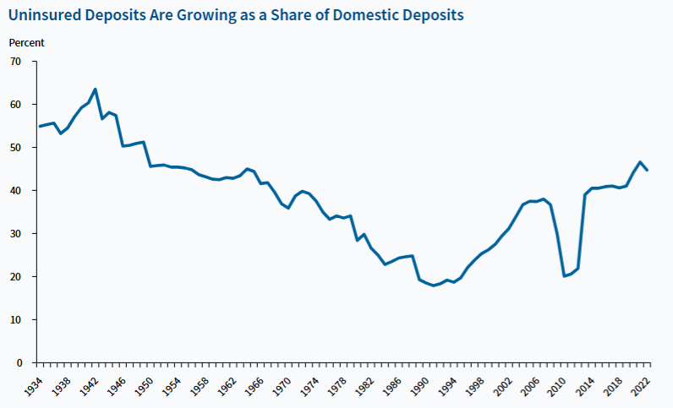

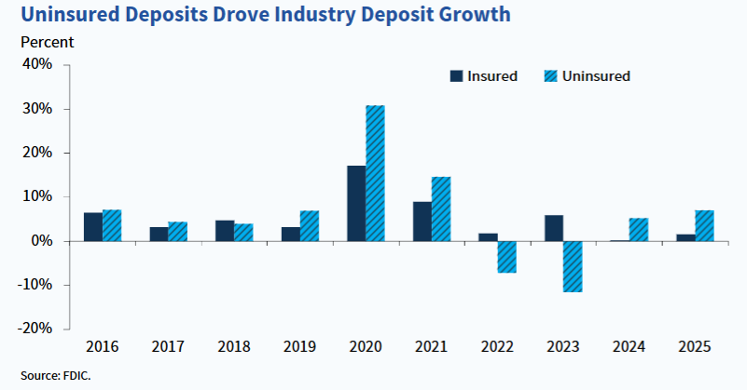
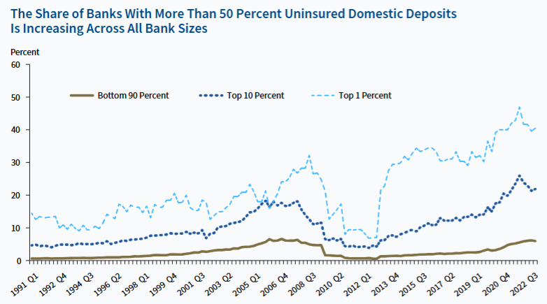
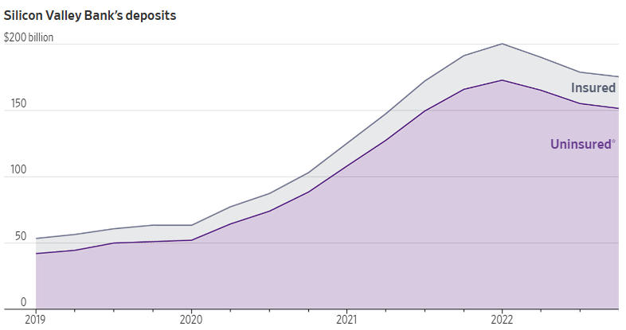
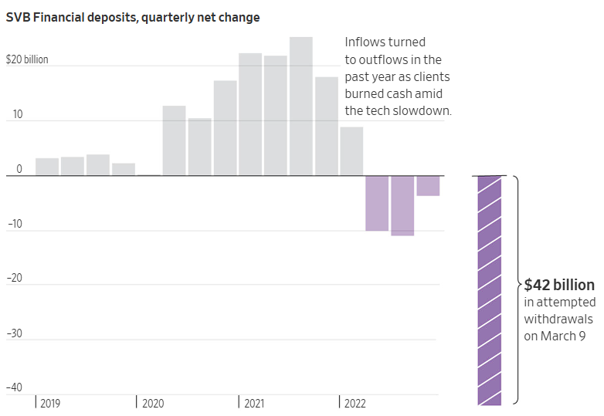
$250,000
Checking, savings, money market deposit accounts and CDs
Stocks, bonds, mutual funds, crypto assets, or safe deposit boxes
57% of deposits were uninsured
Limited Coverage
Limited effect on Moral Hazard
Financial Stability concerns from uninsured deposits
Unlimited Coverage
Eliminates Bank Runs
Clear understanding of insurance status for depositors
Targeted Coverage
Increases financial stability
Increased Complexity of resolutions
Limited disruption in other markets
Simplifies resolution
Eliminates depositor discipline
Decrease in Transparency
Limited Decrease in depositor discipline
Protection
Limit
Uninsured Deposit as a share of Domestic Deposits
Coverage
Scope
Excluded
Assets
Current System
2023
Insurance
Scope
The future system?
Source: FDIC
U.S. DEPOSIT INSURANCE
Source: FDIC
Deposit Insurance
In SVB Case
SVB Collapse
Bought a lot of Treasury Bonds
Surge in Interest Rate
Digital Bank Run
Collapse March 10, 2023
Deposit Insurance in SVB’s Case
90% of deposits were uninsured
ALL deposits of both SVB and Signature Bank were guaranteed by FDIC
In the FDIC’s report on May 1, 2023, they urged lawmakers to raise the limit
The report also established the possibility of unlimited insurance
Source: WSJ

Slide 41
$250,000
Checking, savings, money market deposit accounts and CDs
Stocks, bonds, mutual funds, crypto assets, or safe deposit boxes
57% of deposits were uninsured
Protection
Limit
Uninsured Deposit as a share of Domestic Deposits
Coverage
Scope
Excluded
Assets
2023
Insurance
Scope
Source: FDIC

Slide 42
$250,000
Checking, savings, money market deposit accounts and CDs
Stocks, bonds, mutual funds, crypto assets, or safe deposit boxes
57% of deposits were uninsured
Limited Coverage
Limited effect on Moral Hazard
Financial Stability concerns from uninsured deposits
Unlimited Coverage
Eliminates Bank Runs
Clear understanding of insurance status for depositors
Targeted Coverage
Increases financial stability
Increased Complexity of resolutions
Limited disruption in other markets
Simplifies resolution
Eliminates depositor discipline
Decrease in Transparency
Limited Decrease in depositor discipline
Protection
Limit
Uninsured Deposit as a share of Domestic Deposits
Coverage
Scope
Excluded
Assets
The future system?
Current System
2023
Insurance
Scope
Source: FDIC
U.S. DEPOSIT INSURANCE
Source: FDIC
Deposit Insurance
In SVB Case
SVB Collapse
Bought a lot of Treasury Bonds
Surge in Interest Rate
Digital Bank Run
Collapse March 10, 2023
Deposit Insurance in SVB’s Case
90% of deposits were uninsured
ALL deposits of both SVB and Signature Bank were guaranteed by FDIC
In the FDIC’s report on May 1, 2023, they urged lawmakers to raise the limit
The report also established the possibility of unlimited insurance
Source: WSJ

Slide 43
Bought a lot of Treasury Bonds
Surge in Interest Rate
Digital Bank Run
Collapse March 10, 2023
Source: WSJ

Slide 44
$250,000
Checking, savings, money market deposit accounts and CDs
Stocks, bonds, mutual funds, crypto assets, or safe deposit boxes
57% of deposits were uninsured
Limited Coverage
Limited effect on Moral Hazard
Financial Stability concerns from uninsured deposits
Unlimited Coverage
Eliminates Bank Runs
Clear understanding of insurance status for depositors
Targeted Coverage
Increases financial stability
Increased Complexity of resolutions
Limited disruption in other markets
Simplifies resolution
Eliminates depositor discipline
Decrease in Transparency
Limited Decrease in depositor discipline
Protection
Limit
Uninsured Deposit as a share of Domestic Deposits
Coverage
Scope
Excluded
Assets
The future system?
Current System
2023
Insurance
Scope
Source: FDIC
U.S. DEPOSIT INSURANCE
Source: FDIC
Deposit Insurance
In SVB Case
SVB Collapse
Bought a lot of Treasury Bonds
Surge in Interest Rate
Digital Bank Run
Collapse March 10, 2023
Deposit Insurance in SVB’s Case
90% of deposits were uninsured
ALL deposits of both SVB and Signature Bank were guaranteed by FDIC
In the FDIC’s report on May 1, 2023, they urged lawmakers to raise the limit
The report also established the possibility of unlimited insurance
Source: WSJ

Slide 45
Deposit Insurance in SVB’s Case
90% of deposits were uninsured
ALL deposits of both SVB and Signature Bank were guaranteed by FDIC
In the FDIC’s report on May 1, 2023, they urged lawmakers to raise the limit
The report also established the possibility of unlimited insurance

Slide 46
$250,000
Checking, savings, money market deposit accounts and CDs
Stocks, bonds, mutual funds, crypto assets, or safe deposit boxes
57% of deposits were uninsured
Limited Coverage
Limited effect on Moral Hazard
Financial Stability concerns from uninsured deposits
Unlimited Coverage
Eliminates Bank Runs
Clear understanding of insurance status for depositors
Targeted Coverage
Increases financial stability
Increased Complexity of resolutions
Limited disruption in other markets
Simplifies resolution
Eliminates depositor discipline
Decrease in Transparency
Limited Decrease in depositor discipline
Protection
Limit
Uninsured Deposit as a share of Domestic Deposits
Coverage
Scope
Excluded
Assets
The future system?
Current System
2023
Insurance
Scope
Source: FDIC
U.S. DEPOSIT INSURANCE
Source: FDIC
Deposit Insurance
In SVB Case
SVB Collapse
Bought a lot of Treasury Bonds
Surge in Interest Rate
Digital Bank Run
Collapse March 10, 2023
Deposit Insurance in SVB’s Case
90% of deposits were uninsured
ALL deposits of both SVB and Signature Bank were guaranteed by FDIC
In the FDIC’s report on May 1, 2023, they urged lawmakers to raise the limit
The report also established the possibility of unlimited insurance
Source: WSJ

Slide 47
Limited Coverage
Limited effect on Moral Hazard
Financial Stability concerns from uninsured deposits
Unlimited Coverage
Eliminates Bank Runs
Clear understanding of insurance status for depositors
Targeted Coverage
Increases financial stability
Increased Complexity of resolutions
Limited disruption in other markets
Simplifies resolution
Eliminates depositor discipline
Decrease in Transparency
Limited Decrease in depositor discipline
Source: FDIC

Slide 48
$250,000
Checking, savings, money market deposit accounts and CDs
Stocks, bonds, mutual funds, crypto assets, or safe deposit boxes
57% of deposits were uninsured
Limited Coverage
Limited effect on Moral Hazard
Financial Stability concerns from uninsured deposits
Unlimited Coverage
Eliminates Bank Runs
Clear understanding of insurance status for depositors
Targeted Coverage
Increases financial stability
Increased Complexity of resolutions
Limited disruption in other markets
Simplifies resolution
Eliminates depositor discipline
Decrease in Transparency
Limited Decrease in depositor discipline
Protection
Limit
Uninsured Deposit as a share of Domestic Deposits
Coverage
Scope
Excluded
Assets
The future system?
Current System
2023
Insurance
Scope
Source: FDIC
U.S. DEPOSIT INSURANCE
Source: FDIC
Deposit Insurance
In SVB Case
SVB Collapse
Bought a lot of Treasury Bonds
Surge in Interest Rate
Digital Bank Run
Collapse March 10, 2023
Deposit Insurance in SVB’s Case
90% of deposits were uninsured
ALL deposits of both SVB and Signature Bank were guaranteed by FDIC
In the FDIC’s report on May 1, 2023, they urged lawmakers to raise the limit
The report also established the possibility of unlimited insurance
Source: WSJ

Slide 49
References
Ackerman A. (2023, May 1). FDIC Signals Support for Narrow Changes to Deposit Insurance. https://www.wsj.com/finance/regulation/fdic-signals-support-for-narrow-changes-to-deposit-insurance-43e88530?mod=Searchresults&pos=4&page=1
Ensign, R. L. et al (2023, March 10). Silicon Valley Bank Closed by Regulators, FDIC Takes Control. The Wall Street Journal. https://www.wsj.com/articles/svb-financial-pulls-capital-raise-explores-alternatives-including-possible-sale-sources-say-11de7522?mod=Searchresults&pos=2&page=1
FDIC (2023, May 1). Options for Deposit Insurance Reform.
FDIC (2026). Risk Review.
Santilli P. et al (2023, March 11). Silicon Valley Bank’s Meltdown Visualized. The Wall Street Journal. https://www.wsj.com/articles/silicon-valley-banks-meltdown-visualized-3da2263b?mod=Searchresults&pos=8&page=1
Zuckerman G. et al (2023, March 18). ‘We Never Thought a Bank So Successful Could Collapse So Fast’. The Wall Street Journal. https://www.wsj.com/articles/silicon-valley-bank-collapse-ceo-management-cb75f147?mod=Searchresults&pos=3&page=1

Slide 50
INTERNATIONAL FINANCIAL LAW
What this covers
The Rationale
for Bank Capital
Regulation
Why
The market failures that make bank capital regulation necessary
How
The evolution of the Basel framework: I, II, and III
What
The three innovations Basel III introduced for the first time
and Basel III
Test
Washington Mutual, SVB, and Credit Suisse as live cases
Prof. Kern Alexander University of Zurich

Slide 51
I
THE RATIONALE
Why can banks not
regulate themselves?
01
02
03
Asymmetric Information
Negative Externalities
Financial Stability as a Public Good
Depositors cannot assess the riskiness of a bank's assets. This information gap means market discipline alone cannot protect retail depositors.
One bank's failure cascades to other banks and the wider economy through interbank markets. The cost falls not just on the institution but on society at large.
Regulation is necessary because markets fail. Financial stability requires state intervention to internalise the social costs that bank risk-taking imposes on the broader economy.

Slide 52
"Most large global
banking groups operated
with less than
What this means
Losses of only 3% on total assets would have left these banks with no equity capital and thus insolvent.
3%
When the crisis hit, many systemically important banks could not borrow in interbank markets. Taxpayer bailouts and central bank liquidity schemes were necessary to avoid a collapse of the banking system.
This is the core argument for mandatory capital regulation. Without minimum requirements, banks hold too little equity and the cost of failure falls on the public.
equity capital as a percentage of total assets."

Slide 53
II
THE FRAMEWORK
How the Basel framework evolved
1988
2004
2010
Basel I
Basel II
Basel III
8% capital against risk-weighted assets in four crude categories. The first international standard, agreed because the 1980s sovereign debt crisis exposed the danger of undercapitalised banks.
Three pillars: internal models, supervisory review, and market disclosure. Banks could use their own models to calculate risk weights, intended to improve accuracy.
Higher quality capital in CET1. Capital buffers: conservation, countercyclical, and G-SIFI surcharge. New leverage ratio backstop. First ever binding international liquidity standards.
Blunt weights. SIV arbitrage. No trading book, no liquidity rules, no operational risk.
Basel II's heavy reliance on value-at-risk models resulted in banks holding inadequate regulatory capital, which contributed substantially to the severity of the financial crisis.
The response to every failure mode 2008 exposed: quality, quantity, leverage, and liquidity addressed together.

Slide 54
III
THE STRUCTURE
Basel III's capital stack: quality and quantity
Total minimum capital: 8%
CET1 Minimum Going Concern
4.5% Ordinary shares and retained earnings Absorbs losses while bank is still operating
The headline figure is the same as Basel I. What changed is the composition. Far more must now be genuine equity absorbing losses while the bank is still operating.
Additional Tier 1
1.5% Absorbs losses at point of non-viability
Tier 2 Gone Concern
2% Absorbs losses in resolution after the bank has formally failed
Going concern vs Gone concern
Capital Conservation Buffer
CET1 absorbs losses now, while the bank is operating. Tier 2 only absorbs losses after the bank has formally failed and entered resolution. AT1 sits in between, absorbing losses at the point of non-viability.
2.5% CET1 Every bank Distributions restricted if drawn down
Countercyclical Buffer
0 to 2.5% CET1 Activated by national supervisors in credit booms
G-SIFI Surcharge
Maximum CET1 for a G-SIB in a credit boom:
1 to 2.5% CET1 Systemically important banks only
12% CET1

Slide 55
IV
THE INNOVATIONS
Three things Basel III introduced for the first time
1.
Leverage Ratio
2.
Liquidity Coverage Ratio
3.
Net Stable Funding Ratio
At least 3% Tier 1 divided by total unweighted exposure
At least 100% High quality liquid assets divided by 30-day net outflows
At least 100% Available stable funding divided by required stable funding
Excessive leverage was a significant factor in the stress and failure of many banks in the crisis. The leverage ratio acts as a backstop to risk-based requirements. Banks cannot model their way around it.
Before Basel III, most large global banks operated with less than 3% equity capital. Losses of only 3% would have left them insolvent.
Basel I and II contained no liquidity regulation. In 2007, banks operated without sufficient cash flow to meet liabilities when funding dried up.
Northern Rock is the defining case: a liquidity crisis from over-reliance on wholesale funding. Banks must now hold high quality liquid assets covering 30 days of net outflows.
Illiquid long-term assets must be funded by stable long-term sources, not overnight wholesale borrowing. For residential mortgages the required stable funding is 65%.
This directly prevents the Northern Rock failure: you cannot fund 25-year mortgages with overnight money.

Slide 56
V
THE TEST
Has Basel III worked? Three cases.
BEFORE BASEL III
POST BASEL III
POST BASEL III
Washington Mutual 2008
Silicon Valley Bank 2023
Credit Suisse 2023
Largest US bank failure in history. $307bn assets.
2nd largest US bank failure. $209bn assets.
G-SIB. Forced merger with UBS.
Collapsed through excessive mortgage exposure with no liquidity buffer and no leverage backstop. The exact three gaps Basel III was designed to close. Resolved by the FDIC over one weekend. JPMorgan acquired banking operations for $1.9bn.
Capital compliant throughout. Basel III could not see the interest rate risk on its government bond portfolio, which carried 0% risk weight. The digital bank run happened in 48 hours. The LCR assumes 30 days. The CEO had lobbied to raise the SIFI threshold, exempting SVB from stress tests that might have caught the problem.
Basel III compliant throughout its crisis. Capital ratios cannot measure strategic flexibility. Selling subsidiaries worsened the capital position. Every exit was blocked. Approximately $17bn of AT1 bonds were written to zero while shareholders received compensation.
The case for Basel III
Capital compliance does not equal resilience
Structural problems invisible to capital ratios

Slide 57
Conclusion
01
Why capital regulation exists
02
What Basel III actually changed
Banks cannot regulate themselves. Asymmetric information means depositors cannot assess bank risk. One failure cascades through interbank markets. Financial stability is a public good that markets alone cannot provide.
It raised the quality of capital through CET1, introduced buffers to absorb stress, added a leverage ratio that cannot be modelled away, and for the first time imposed binding international liquidity standards through the LCR and NSFR.
03
Where the framework falls short
04
The political dimension
SVB was Basel III compliant and failed anyway. Interest rate risk on government bonds is invisible to risk-weighted capital. A digital bank run moves faster than any 30-day liquidity buffer. Credit Suisse was also compliant and structurally unresolvable.
SVB's CEO lobbied away the stress tests that might have caught the problem. The Basel IV Endgame was watered down under industry pressure. Capital regulation is not a technical exercise. It is a contest between public interest and institutional lobbying.

Slide 58
International Financial Law · University of Zurich · Lukas Escandon
Regulatory Issues
Regarding Stablecoins
Extra Credit Presentation

Slide 59



What Are Stablecoins?
Definition
Payments & Remittances
A crypto asset pegged 1:1 to a fiat currency (usually USD) via reserve assets like: US Treasuries. Designed to combine blockchain efficiency with price stability.
Emerging markets globally use stablecoins as a dollar substitute where local currency is volatile.
$250bn+
DeFi & Crypto Trading
total stablecoin market cap (2025)
67% of stablecoin use is in DeFi and trading. Provides liquidity without the volatility of Bitcoin or Ethereum.
$32 trillion
on-chain transactions in 2025 — surpassing Visa + Mastercard combined
Institutional Settlement
~90%
of the market held in just 2 coins: USDT (Tether) and USDC (Circle)
Banks and fintechs use stablecoins for 24/7 cross-border settlement - faster and cheaper than correspondent banking.
→ This market now exceeds the GDP of many countries yet remains largely outside traditional financial regulation.

Slide 60
The Wake-Up Call: TerraUSD Collapse (May 2022)
What happened in 72 hours
✗ No Real Reserves
UST was an "algorithmic" stablecoin backed only by a sister token (LUNA) and market confidence: not real assets. When confidence broke, nothing held the peg.
May 7
Whale withdraws $85M UST from Anchor Protocol peg starts slipping
May 9
UST falls to $0.35 officially "de-pegged" from the dollar
✗ No Redemption Rights
May 12
Blockchain halted twice. LUNA collapses from $119 to $0.000017
Users could not redeem their coins for dollars. The mechanism to do so destroyed LUNA's value in a death spiral, wiping out the peg entirely.
May 13
$45bn in market cap wiped out. 280,000 S. Korean investors affected
✗ No Regulatory Oversight
Dec 2025
Do Kwon sentenced to 15 years in US federal prison for fraud
Terraform Labs was incorporated in Singapore but not licensed. Regulators had no visibility, no tools, and no ability to intervene.
"The impact reverberated throughout crypto markets, costing the savings of countless investors." SEC Chair Gary Gensler

Slide 61
The International Response: FSB Framework & Global Implementation
FSB Core Principle: "Same Activity, Same Risk, Same Regulation"
Implementation (as of 2025, FSB Survey 35 jurisdictions)
1
Governance
2
Risk Management
EU (MiCA)
Full Framework
Clear accountability
& oversight
Reserve assets,
liquidity, operations
In force 2024 · ESMA & EBA · First complete regime globally. Circle (USDC) became first MiCA-licensed issuer July 2024. Tether (USDT) delisted for EU users.
UK
Advanced
FCA-authorised stablecoin regime implementing (2025). Part of wider crypto asset framework.
3
Redemption Rights
4
Transparency
At par, timely,
for all users
Public disclosure
of reserves
US
Partial
GENIUS Act 2025 passed: reserve & audit requirements. Criticised as too accommodating vs MiCA.
Switzerland
5
Cross-border
6
Comprehensive
Partial
Deliberately light-touch competing to attract business departing EU's strict MiCA.
Supervisory colleges
& info-sharing
No activity outside
the perimeter
China / India
Prohibited
State control concerns: stablecoins could displace sovereign currency & undermine monetary policy.

Slide 62
Remaining Gaps:
Regulatory Fragmentation
Live Case Study: USDT (Tether)
Differing definitions of "stablecoin" & "reserve asset" enables jurisdiction shopping
▸ Largest stablecoin: $180bn market cap larger than the GDP of Hungary
Cross-border Gaps
▸ Holds more US Treasuries than Canada, Norway or Taiwan (rank: 7th globally)
No common redemption or reporting standards users in one country may have no recourse
▸ S&P Global (Nov 2025): downgraded USDT reserve quality to 'WEAK' Bitcoin now 5.6% of reserves, exceeding its 3.9% overcollateralization buffer
▸ Operates from El Salvador (not MiCA compliant) delisted from EU exchanges in late 2024
Supervisory Capacity
Most regulators lack technical expertise to audit code, blockchain flows, and smart contracts
▸ Regulators found Tether fully backed only 27.6% of the time during an investigated period (CFTC)
Decentralisation Evasion
Some issuers deliberately structure as 'decentralised' to escape any single regulator's reach
FSB: "Stablecoin arrangements must not operate outside the perimeter of effective regulation." Harmonisation is urgent.

Slide 63
Sources
Market Data & Statistics
Tether / Reserve Risk
· NFT Evening (Jun 2025): 'The Rise of Stablecoins: 2025 Market Update' — nftevening.com
· CoinDesk (Nov 2025): 'S&P Downgrades Tether USDT Citing Bitcoin Exposure' — coindesk.com
· CoinLedger (Dec 2025): 'Stablecoin Market Share and Transaction Volume' — coinledger.io
· BlockApps (Dec 2024): 'Understanding USDT Backing Reserves' — blockapps.net
· CoinLaw (Jan 2026): 'Stablecoin Statistics 2025: Growth, Adoption, and Regulation' — coinlaw.io
· Eco.com: 'Inside Tether: USDT Reserves Explained' — eco.com
· TRM Labs (2025): '2025 Crypto Adoption and Stablecoin Usage Report' — trmlabs.com
Regulatory Frameworks
TerraUSD Collapse
· Baker Institute (Jul 2022): 'The Fall of Terra/LUNA: A Boost for Crypto Regulations' — bakerinstitute.org
· Harvard Law Corp Gov (May 2023): 'Anatomy of a Run: The Terra Luna Crash'
· Crystal Intelligence (Feb 2026): 'USDT vs USDC Q3 2025 Market Share Analysis' — crystalintelligence.com
· BlockApps (Dec 2024): 'What Caused the Depeg of TerraUSD?' — blockapps.net
· CoinLaw (Feb 2026): 'Stablecoin Market Share by Chain Statistics 2026' — coinlaw.io
· Elliptic (May 2022): 'TerraUSD: The Regulatory and Compliance Implications' — elliptic.co
· Netcoins (Dec 2025): Do Kwon 15-year sentence coverage — netcoins.com

Slide 64
Faculty of Law
The Basel III Reforms on Liquidity Risks
  International Financial Law
    Z. Robert Rypniewski
    28 May 2026

Slide 65

1. The Reasons For a Reform
Crisis in 2008 exposed that previous regulation was insufficient
Basel II risk-weighting capital requirements calculation models proved to be insufficient
Banks taking excessive risks
Basel I and II Regulatory capital in form of bonds not able to absorb excessive losses
Losses led to systemic instabilities – lack of liquidity
Undermining confidence in the system
Source: Kern Alexander/Rahul Dhumale/John Eatwell, Global Governance of Financial Systems, The International Regulation of Systemic Risk, Oxford University Press, Oxford 2006.

Slide 66
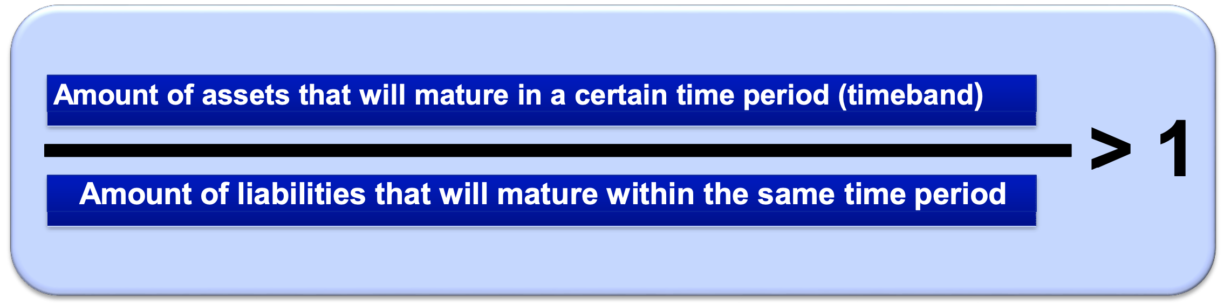
2. Liquidity
Bank capital as not the only source of the problem
Under Basel I and II no regulation of liquidity
Liquidity gap – ensuring cash flow satisfying the liabilities
Potential insolvency
Yet banks heavily reliant on liabilities (see Securitized notes)
Liquidity problem = spillover effect, bank runs
Source: Kern Alexander/Rahul Dhumale/John Eatwell, Global Governance of Financial Systems, The International Regulation of Systemic Risk, Oxford University Press, Oxford 2006.

Slide 67
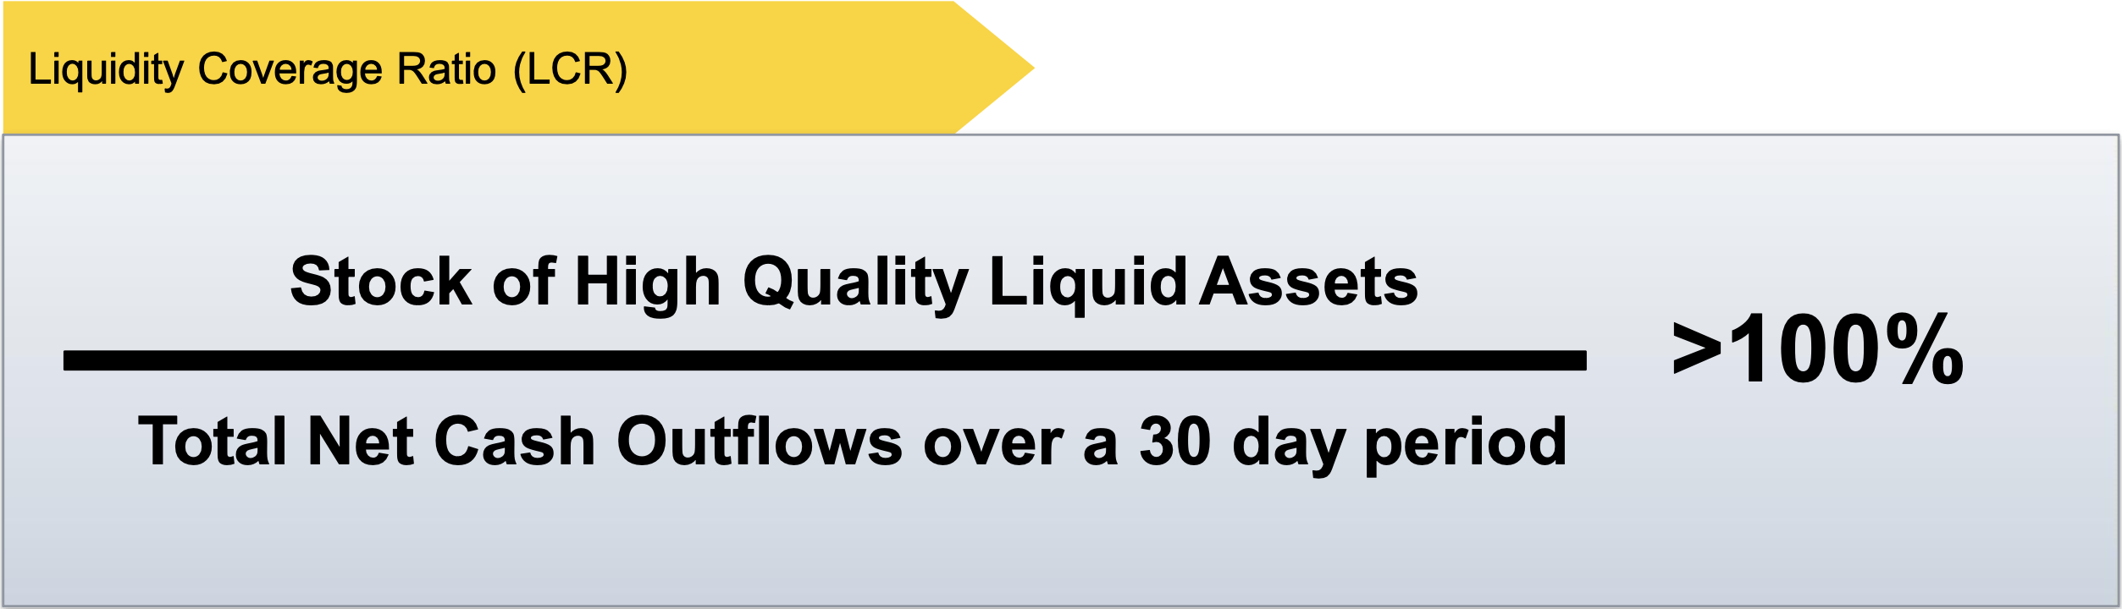
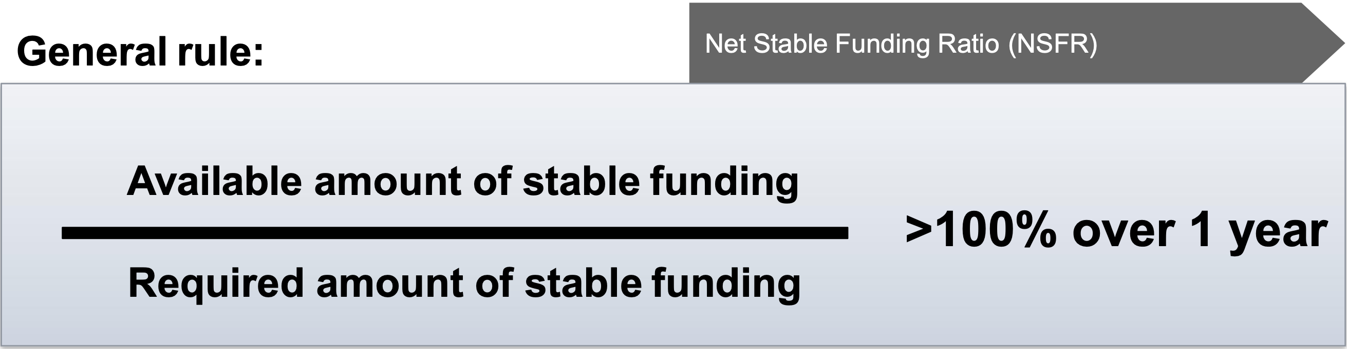
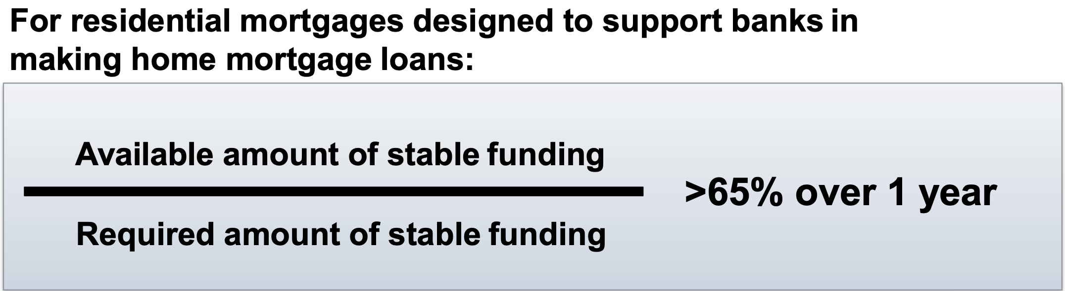
3. Basel III: Increasing Liquidity
2 New requirements introduced:
Liquidity Coverage Ratio (LCR)
  Focus on assets
  High Quality Liquid Assets
  Reducing reliance on short-term funding sources
Net Stable Funding Ratio (NSFR)
  Focus on liabilities
  General Rule vs Residential mortgages
Source: Kern Alexander/Rahul Dhumale/John Eatwell, Global Governance of Financial Systems, The International Regulation of Systemic Risk, Oxford University Press, Oxford 2006.

Slide 68

4. Discussion
Are the new liquidity requirements enough?
Liquidity comparability standards and risks still based on individual banks’ assessment models – lack of transparency
2023 ‘real’ stress test -> LCR deposit 30 days outflow assumptions wrong
The LCR may not capture the full liquidity (see: Credit Suisse)
Or are they too much?
LCR and NSFR produce high costs – opportunity costs
They can reduce… liquidity? (see: Banks liquidity creation)
Shadow banking
Source: Kern Alexander/Rahul Dhumale/John Eatwell, Global Governance of Financial Systems, The International Regulation of Systemic Risk, Oxford University Press, Oxford 2006.

Slide 69
Thank you for your attention
    Z. Robert Rypniewski
    28 May 2026

Slide 70



Climate Finance Risk
& Banking Regulation
International Financial Law — Oral Presentation – May 2026
Sancie Kergall-Gayet – Exchange student in Ms Finance UZH

Slide 71

Why Are We Talking About This?
Climate change as a systemic financial risk
Banks finance the real economy → exposed to climate consequences → potential for systemic crises
2015
2017
2022
Now
Mark Carney
«Tragedy of
the Horizon»
Creation of
NGFS
BCBS 18
Principles
Regulatory
Implementation
Stakes: Financial stability — Transition financing — Client & taxpayer protection

Slide 72



Climate-Related Financial Risks
Physical Risks
Transition Risks
Acute
Floods, storms, wildfires
Chronic
Sea-level rise, temperature increase, droughts
Regulatory
Carbon taxes, new obligations
Technological & Market
Obsolescence, shifting demand, reputation
ESG: Risk or Opportunity?
Risk view: brown assets = higher credit/market risk | Opportunity view: green assets = better long-term performance, cheaper financing

Slide 73
International Regulatory Framework
BCBS: Climate integrated into existing risk categories
BCBS 18 Principles (2022)
Climate ≠ new risk category → integrated into existing framework
Credit
Risk
Market
Risk
Operational
Risk
Liquidity
Risk
Voluntary framework — each jurisdiction implements at its own pace

Slide 74


EU vs. United States
Two radically different approaches
European Union — Leader
United States — Retreat
ECB Climate Guide (2020)
Climate Stress Tests (2022)
CRR III / CRD VI (2024-2025)
→ Governance requirements
→ Fossil exposure reporting
→ Mandatory transition plans
→ Capital integration
Interagency Principles (Oct. 2023)
Fed / OCC / FDIC guidance
2025: Regulatory slowdown and fragmentation
→ Principles withdrawn (Oct. 2025)
→ Withdrawal from NGFS (Jan. 2025)
→ Climate risks increasingly treated through traditional prudential frameworks
▲ Ambitious & Prescriptive
▼ Rollback & Fragmented

Slide 75




Focus: Switzerland
Risk-based and proportionate supervision
FINMA Circular 2026/1 — Nature-Related Financial Risks
Published Dec. 2024 — In force from Jan. 2026 (climate) → Jan. 2028 (all nature risks)
Governance
Scenario Analysis
Transition Plans
FINMA-SNB
Board & exec accountability for climate risk
Qualitative & quantitative stress testing
CO₂ Act & climate reporting ordinance
Joint climate scenario collaboration
Aligned with BCBS/NGFS · More advanced than US · Less prescriptive than EU

Slide 76



Conclusion & Perspectives
Data & Modelling
20-50 year horizons, immature models, lack of reliable data to calibrate capital requirements
Regulatory Fragmentation
EU/US divergence → regulatory arbitrage, banks shifting polluting activities to lenient jurisdictions
Capital Requirements
Green supporting factor vs. brown penalizing factor — should capital reflect climate policy goals?
"Climate banking regulation must find the right balance between
financial resilience and supporting the ecological transition."

Slide 77
Appendix
BCBS Climate Principles (2022)
NGFS Official Website
ECB Climate & Environmental Risk Guide (2020)
FINMA Circular 2026/1 — Nature-related Financial Risks
https://www.finma.ch/en/~/media/finma/dokumente/dokumentencenter/myfinma/rundschreiben/finma-rs-2026-01.pdf?sc_lang=en&hash=8D72D84C2DF2489DA571190B3C760C90

Slide 78
Faculty of Law
7. Capital requirements:
Banks and Insurance Companies,
how are the risks similar and different?
  Szymon Łyczko
    28 May 2026
    International Financial Law

Slide 79
Capital requirements visualised

Slide 80
Minimum Capital Requirements
Banks
  Switzerland (BankV)
    CHF 10 million
  European Union (CRD)
    EUR 5 million
Insurance (Absolute floor)
  Switzerland (AVO)
    Life
      CHF 5-12 million
    Non-Life
      CHF 3-8 million
  European Union (Solvency II)
    Life
      EUR 4 million
    Non-life
      EUR 2,7-4 million

Slide 81
Approaches to calculating capital requirements
Banks
  Standardised Approach
    Risk weighted assets are calculated as the product of the standardised risk weights and the exposure amount.
    Banks may use assessments by external credit assessment institutions that are recognised as eligible for capital purposes by national supervisors.
    The credit risk mitigation techniques that are permitted to be recognised under the standardised approach.
  Internal Rating Based Approach
    Banks assess the risk of the assets internally
    Internal Rating is made in line with the rules prescribed by Basel Framework
Insurance
  Standard Model
    Prescribed in the legislation
      Annex IV to Solvency II
  Internal Model
    Created by the Insurance Company in line with the regulatory principles
    Must be approved by the Supervisor

Slide 82
Risk-based approach to capital requirements
Banks
  Total risk exposure
  Types of risks
    Credit risk
    Dilution risk
    Position risk
    FX risk
    Settlement risk
    Commodities risk
    Operational risk
    Counterparty risk
Insurance
  Solvency Capital Requirement shall take into account all quantifiable risks, insurer is exposed to. (Total balance sheet)
  Types of risks
    Underwriting risk
    Market risk
    Credit risk
    Operational risk
    Asset-Liability Matching risk
    Environmental risk
    Etc.

Slide 83
Failure to meet the requirements
Banks
  Breaches of capital requirements lead to supervisory action when bank is failing or likely to fail
  Recovery or resolution plans may be triggered
Insurance
  Failure to comply with SCR leads to supervisory action aimed at protecting the interests of the policyholders
  Failure to comply with MCR leads to withdrawal of the authorisation to conduct insurance activities

Slide 84
Faculty of Law
Thank you for your attention

Slide 85

THE IMPLEMENTATION OF BASEL III IN SWITZERLAND AND THE CREDIT SUISSE CRISIS
INTERNATIONAL FINANCIAL LAW
MYRTE GHEYSEN
28/05/2026

Slide 86


Basel III - recap
01.
> Common Equity Tier I
< Hybrid Tier I
< Tier II
+ Captial Conservation buffer
+ Countercyclical buffer
+ G-SIFI surcharge
+ Leverage Ratio
+ Liquidity Coverage Ratio
+ Net Stable Funding Ratio
  Supervisory Review Evaluation Process (SREP)
  Internal Capital Adequacy Assessment Process (ICAAP)
  Stress testing
  Governance
  Enhanced reporting
  Market discipline
  Risk management
  Regulatory capital components
02.
03.
=> QUANTITY & QUALITY

Slide 87

Basel in Switzerland
FINMA & FEDERAL COUNCIL
  The Ordinance on the Trading Book and Banking Book and Eligible Capital of Banks and Securities Firms
  The Ordinance on the Leverage Ratio and Operational Risks of Banks and Securities Firms
  The Ordinance on the Credit Risks of Banks and Securities Firms
  The Ordinance on the market Risks of Banks and Securities Firms
  The Ordinance on the Disclosure Obligations of Banks and Securities Firms

Slide 88

Credit Suisse Collapse 2023
FROM CAUSES
TO EFFECTS
A bank can meet regulatory capital ratios and still fail if confidence disappears.
  Weak risk management
  Compliance failures
  Investors/ depositors uncertainty
  Global panic
  Digital banking
  Confidence failure
  Deposit outflows
  Liquidity stress
  Stock-price decline
  Emergency takeover by UBS
=> QUALITY?

Slide 89

“Thank you. Questions?"

Slide 90

The evolution and effectiveness of IMF conditionality
Topic 4
International Financial Law
University of Zurich – Faculty of Law
Author: Miriam Gonzalez Naharro and Fernando David Martínez Goás

Slide 91



Slide 92
CONTENTS
1
Introduction: concepts and evolution
2
Legal framework and mechanics
3
Discussion: effectiveness and critiques
4
Conclusion

Slide 93
Introduction
IMF established 1945, Bretton Woods.
Keynes-White debate: automatic entitlement vs. conditions
Conditionality= link between IMF financing and implementation of policy reform
Surveillance
Financial assistance
Technical assistance
Introduction
Framework
Discussion
Conclusion

Slide 94
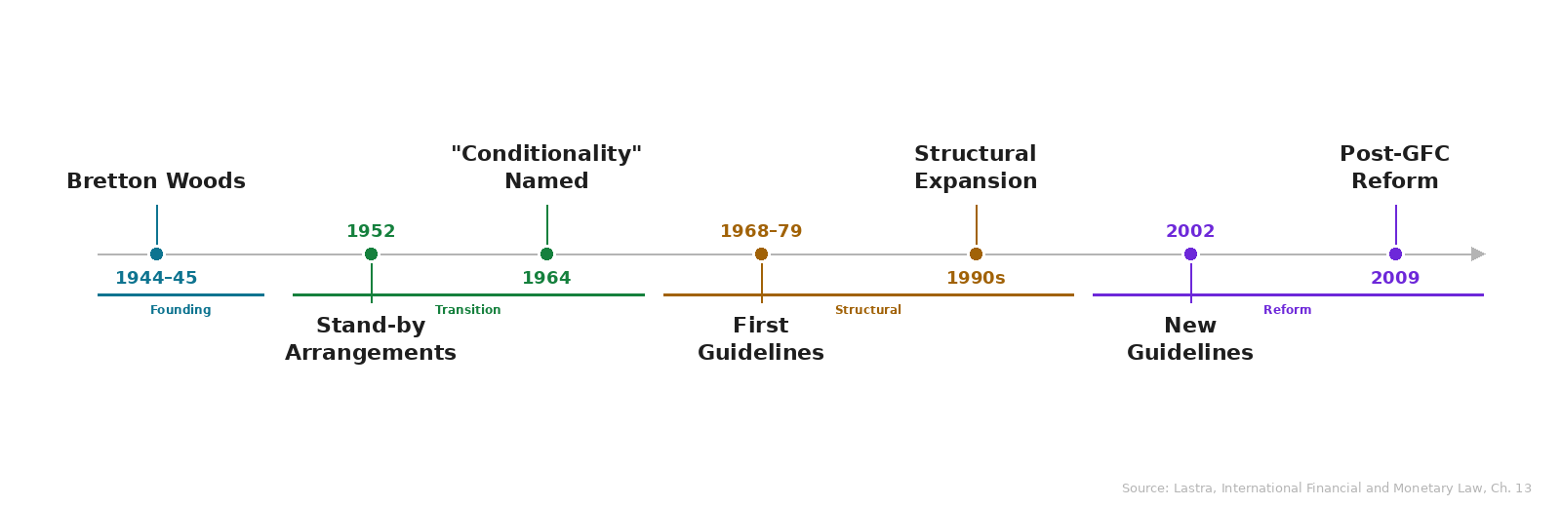
Evolution
Over time, the IMF has become more flexible in the way it engages with countries on structural reform as its approach to conditionality continues to evolve

Slide 95

Legal framework and mechanics
IMF´s power is a treaty-based = from the Articles of Agreement 1944
Legally, an IMF arrangement is a decision of the Executive Board
two main activities: lending assistance and conditionality
Monitoring tools:
1)Prior actions: Measures taken before funds are approved (e.g: tax reform, banking restructuring)
2)Performance criteria: Specific variables = if not met = funded can be suspended —-- e.g: debt targets, fiscal deficit ceilings.
3)Phasing: Money is released in installments (tranches) to ensure continued compliance.
Purpose
Introduction
Framework
Framework
Law reform?
Discussion
Conclusion
Conclusion

Slide 96
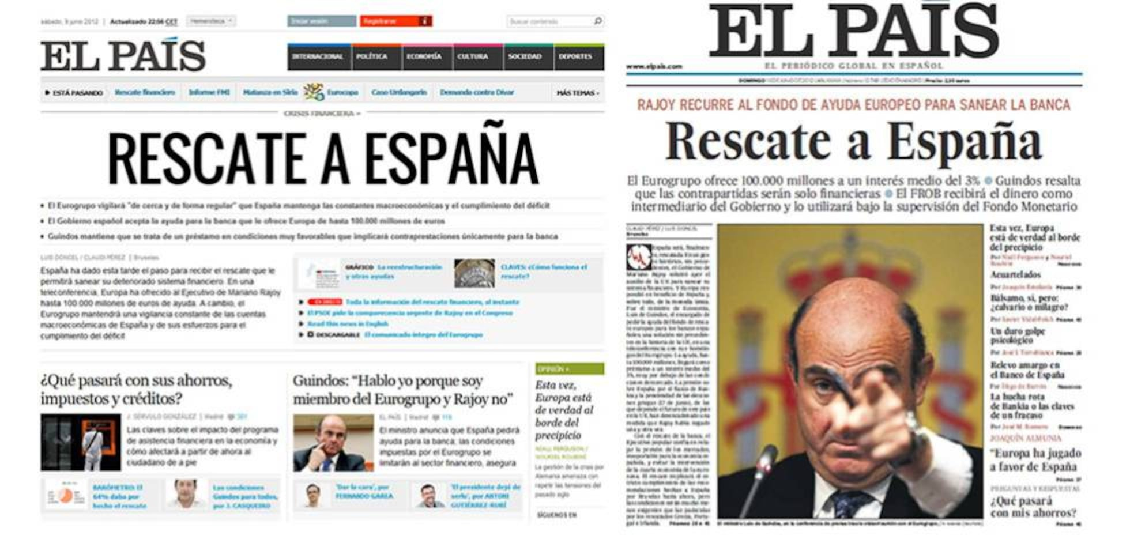
Spanish case: Bankia and IMF - May 2012
Purpose
Introduction
Framework
Framework
Law reform?
Discussion
Conclusion
Conclusion

Slide 97
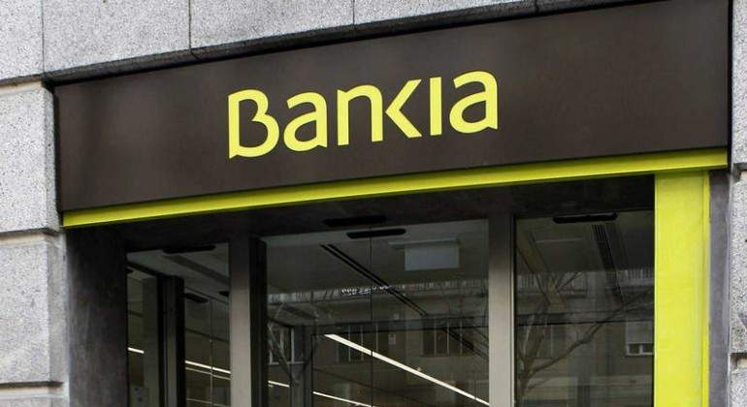
Purpose
Introduction
Framework
Framework
Law reform?
Discussion
Conclusion
Conclusion

Slide 98
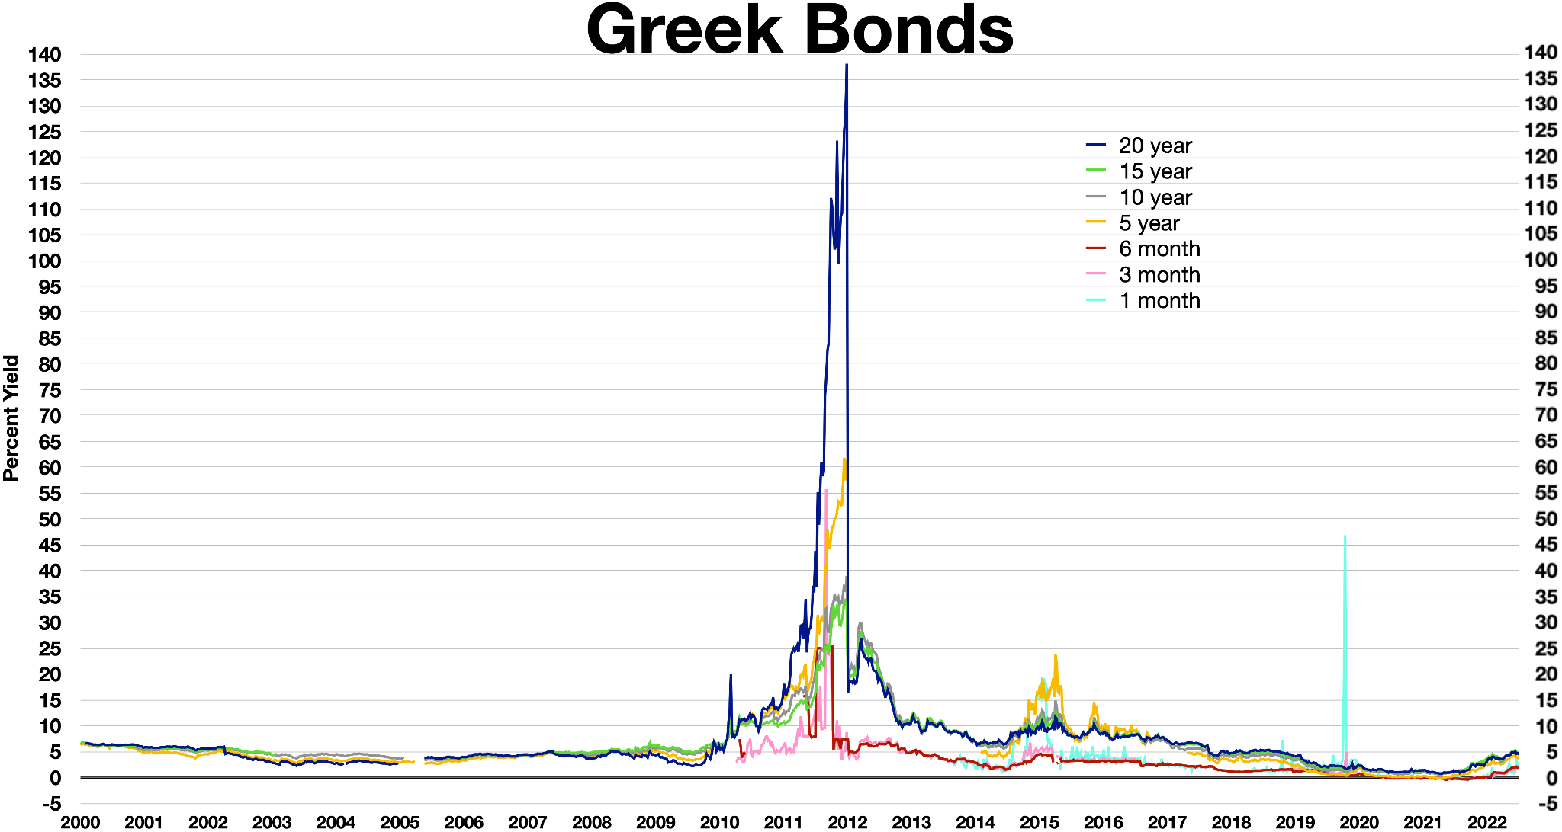
Discussion
Effectiveness
  IMF = most important institutions for global financial stability
Evolved from original Bretton Woods monetary role — to:
banking supervision
debt restructuring
financial-sector reform
sovereign debt crises
IMF effective in multiple cases
Art. 1 IMF UN
purpose
Purpose
Introduction
Definition
Framework
Law reform?
Discussion
Conclusion
Conclusion

Slide 99
Critiques
Scope creep: expansion into structural areas beyond Fund's expertise
Undermines national sovereignty and democratic processes (Meltzer Report)
"Washington Consensus" pressure on programme design
Excessive detail → micro-management concern
2002 reforms acknowledged but did not fully resolve these tensions.
2009 reforms emphasized parsimony and focused on critical measures
Purpose
Introduction
Definition
Framework
Law reform?
Discussion
Conclusion
Conclusion

Slide 100



Conclusion
Clear evolution: from a narrow monetary institution focused mainly on exchange-rate stability INTO broader financial governance institution.
YES - proven effective in restoring short-term financial stability and market confidence. HOWEVER = IMF´s conditionality mechanisms also place significant pressure on governments = generating important social and political costs.
IMF remains essential for crisis management, but its long-term effectiveness in creating a fair and stable global financial system continues to be debated.
Purpose
Introduction
Definition
Framework
Law reform?
Discussion
Conclusion
Conclusion

Slide 101
Sources
Kentikelenis, A. E., Stubbs, T. H., & King, L. P. (2016). IMF conditionality and development policy space, 1985–2014. Review of International Political Economy,23(4), 543-582. https://doi.org/10.1080/09692290.2016.1174953
Lastra, R. M. (2015). The Law of the International Monetary Fund. En R. M. Lastra (Ed.), International Financial and Monetary Law. Oxford University Press. https://doi.org/10.1093/law/9780199671090.003.0014
Mikesell, R. F. (2001). The Meltzer Commission Report on International Institutions. Economic Development and Cultural Change, 49(4), 883-894. https://doi.org/10.1086/452529

