Slide 1

The rationale for bank capital regulation and Basel III
Evelina Kanarska, 25-750-019

Slide 2

Why regulate banks?
Banks are essential for the economy:
Banks accept deposits and provide credit
They are highly interconnected
Failures can spread through the financial system
Confidence is essential for banking stability
Financial regulation aims to:
Protect depositors
Reduce systemic risk
Prevent financial crises
Maintain financial stability
Notes:
Banks are not ordinary businesses. They perform essential economic functions by accepting deposits, providing loans and facilitating payments throughout the economy. Because banks are highly interconnected, the failure of one institution can rapidly affect other banks and financial markets.
Banking is also based heavily on confidence. If depositors lose trust in a bank, this can trigger a bank run and create wider financial instability. For this reason, financial stability is often described as a public good that cannot be fully protected by markets alone.
Therefore, governments and international regulators impose capital and liquidity requirements to reduce systemic risk, protect depositors and strengthen the resilience of the banking system.

Slide 3

Problems in the Banking System
Banks can create risks because:
Asymmetric information
People do not know how risky banks are
One bank failure can affect other banks – interconnectedness
Banks may take too much risk – moral hazard
Deposit insurance and bailouts may encourage excessive risk-taking
“Too big to fail”
Some banks are so large and interconnected that governments may rescue them
Notes:
One of the main justifications for bank regulation is that financial markets suffer from several important market failures.
First, there is asymmetric information. Depositors and investors usually cannot fully evaluate how risky a bank is or how its assets are managed. Banks therefore possess significantly more information than their clients.
Second, banking creates externalities. The collapse of one institution can spread panic and losses throughout the financial system. This contagion effect can threaten the wider economy and create systemic risk.
Third, regulation itself may create moral hazard. Because deposits are insured and governments sometimes rescue banks during crises, financial institutions may take excessive risks believing they will ultimately be protected.
Finally, many large banks are considered “too big to fail.” Their collapse could cause severe economic disruption, which creates political pressure for public intervention and bailouts.
These market failures explain why international banking regulation, including Basel III, became necessary.

Slide 4
What is bank capital?
Bank capital:
Acts as a financial safety buffer
Absorbs losses during crises
Protects depositors and creditors
Reduces the probability of bank failure
Notes:
Bank capital is the money that belongs to the bank itself, mainly shareholders’ equity and retained earnings. It acts as a financial cushion that absorbs losses when the bank experiences financial problems.
For example, if a bank suffers losses from bad loans or falling asset prices, these losses are first absorbed by the bank’s capital rather than by depositors.
The purpose of capital regulation is therefore to make banks more resilient and reduce the risk of collapse. A bank with stronger capital is generally considered safer because it has a greater ability to survive financial stress.
However, there is also an economic debate about how much capital banks should hold. Higher capital requirements improve stability, but banks argue that they may also reduce lending and profitability.
Basel III was designed to strengthen both the quantity and quality of bank capital after the 2007–2008 financial crisis.

Slide 5

The Global Financial Crisis
Main causes:
Excessive leverage
Weak regulation
Poor risk management
Liquidity shortages
Growth of complex financial products
Consequences:
Collapse of major banks
Government bailouts
Global recession
Loss of trust in financial markets
Notes:
The 2007–2008 financial crisis exposed major weaknesses in the global banking system and became the main reason for the creation of Basel III.
Before the crisis, many banks operated with extremely high leverage, meaning they relied heavily on borrowed money instead of their own capital. At the same time, regulation and supervision were insufficient, while risk management inside banks was often weak.
Banks also became heavily involved in complex financial products such as securitisation and credit derivatives linked to the U.S. subprime mortgage market.
When housing prices began to fall in the United States, the value of these assets collapsed. This created massive losses, liquidity shortages and panic throughout the financial system.
Major institutions such as Lehman Brothers collapsed, while others such as American International Group required enormous government bailouts.
The crisis demonstrated that existing banking regulation was inadequate and that stronger international standards were necessary. Basel III was therefore introduced as a global regulatory response to strengthen the resilience of banks and reduce systemic risk.

Slide 6
Basel III
Introduced after the 2007–2008 crisis
Main objectives:
Strengthen bank capital
Improve liquidity management
Reduce excessive leverage
Increase resilience of banks
Protect financial stability
Notes:
Basel III is an international regulatory framework developed by the Basel Committee on Banking Supervision after the global financial crisis.
The crisis showed that many banks did not have enough high-quality capital or sufficient liquidity to survive periods of severe financial stress. Basel III was therefore designed to make the banking system safer and more resilient.
One of its main goals was to improve both the quantity and quality of bank capital. Basel III also introduced entirely new liquidity requirements and a leverage ratio to limit excessive borrowing by banks.
In addition, the framework placed much greater emphasis on supervision, stress testing, governance and transparency.
Overall, Basel III represents one of the most important international reforms in modern financial regulation and aims to reduce the probability and severity of future financial crises.

Slide 7

Capital Requirements under Basel III
Basel III increased:
Quantity of capital
Quality of capital
Loss-absorbing capacity
Key reforms:
Greater focus on Common Equity Tier 1 (CET1)
- the highest-quality capital a bank has
Capital Conservation Buffer
- additional emergency reserves above the minimum requirement
Countercyclical Buffer
- activates during economic booms, stops banks from lending too aggressively
Additional requirements for systemically important banks
Notes:
One of the central reforms of Basel III was the strengthening of capital requirements for banks.
Basel III increased both the amount of capital banks must hold and the quality of that capital. Regulators concluded after the crisis that many banks formally met regulatory requirements but still lacked sufficient truly loss-absorbing capital.
Therefore, Basel III placed greater emphasis on Common Equity Tier 1, or CET1, which mainly consists of ordinary shares and retained earnings. This is considered the highest-quality form of capital because it can absorb losses immediately.
Basel III also introduced capital buffers. The Capital Conservation Buffer requires banks to hold additional reserves above the minimum requirements, while the Countercyclical Buffer aims to reduce excessive lending during economic booms.
In addition, globally systemically important banks, often called G-SIBs, are subject to even stricter capital requirements because their failure could threaten the entire financial system.
The overall objective of these reforms was to improve the resilience of banks and reduce systemic risk during periods of financial stress.

Slide 8
Leverage & Liquidity
Before 2008, banks borrowed excessive amounts of money and used complicated internal models that underestimated the risk
Leverage Ratio
Banks must hold a minimum amount of real capital compared to total exposure
Limits excessive borrowing
Backstop to risk-based regulation (still limits exc. borrowing if risk models fail)
Liquidity Requirements
Liquidity Coverage Ratio → short-term resilience (30-day panic)
Net Stable Funding Ratio → long-term funding stability
Notes:
Basel III also introduced important leverage and liquidity reforms. The leverage ratio was designed to limit excessive borrowing and act as a simple backstop to complex risk models.
Basel III also recognized that many banks during the crisis failed not because they lacked capital, but because they lacked liquidity. Therefore, the framework introduced the Liquidity Coverage Ratio for short-term stress and the Net Stable Funding Ratio for long-term funding stability.

Slide 9
Ongoing Challenges
Despite Basel III, the risk still exists
Silicon Valley Bank (2023)
poor risk management
liquidity problems
depositor panic
Credit Suisse (2023)
governance problems
loss of confidence
systemic risk
Notes:
Basel III also increased attention on governance and supervisory oversight. Regulators recognized that the financial crisis was not only a failure of markets, but also a failure of risk management and corporate governance.
However, recent events such as Silicon Valley Bank and Credit Suisse show that systemic risk continues to exist despite stronger regulation. This demonstrates that regulation can reduce risk, but cannot eliminate financial instability entirely.

Slide 10
Thank you for your attention

Slide 11
INTERNATIONAL FINANCIAL LAW
Regulatory issues regarding stablecoin
Between MiCAR and GENIUS Act: Tether case.
Regulatory Arbitrage or Political Choice?
21st May 2026
ANNA DURANTE

Slide 12
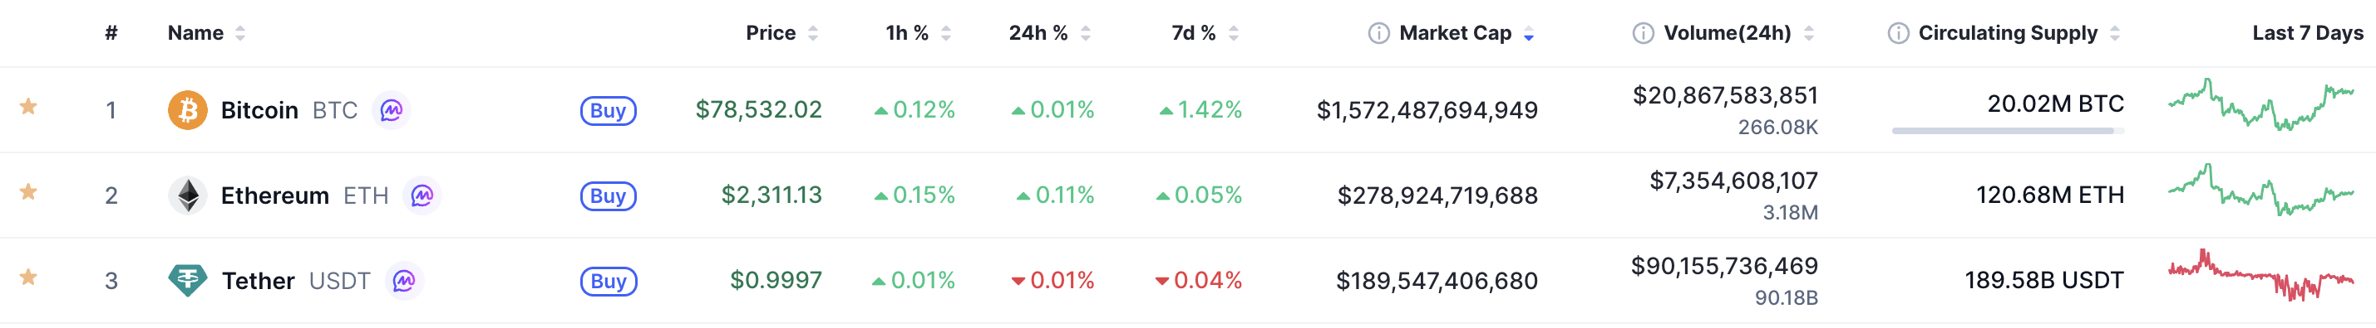
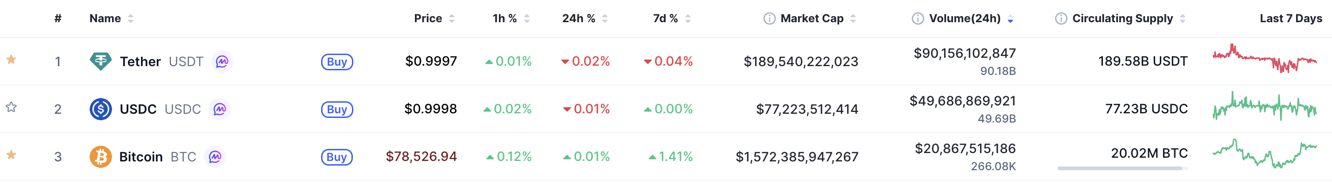
Tether: a private company, a global currency
Tether in numbers
Tether is the most capitalized stablecoin in the world: ~$189.5bn in circulation as of May 2026.
Tether also ranks first by 24-hour trading volume, at ~$90bn.
Source: https://coinmarketcap.com/
International Financial Law | Regulatory issues regarding stablecoins
Anna Durante

Slide 13


Tether Foundation
Understanding the backing
Corporate structure: initially incorporated as a BVI company; subsequently, redomiciled to El Salvador.
CEO: Paolo Ardoino, an Italian computer scientist who became the leading executive figure behind Tether’s global expansion after serving as CTO of Bitfinex.
Stated purpose: long-term financial inclusion → YouTube video: Tether Wallet | The People’s Wallet.
Source: https://tether.io/
International Financial Law | Regulatory issues regarding stablecoins
Anna Durante

Slide 14
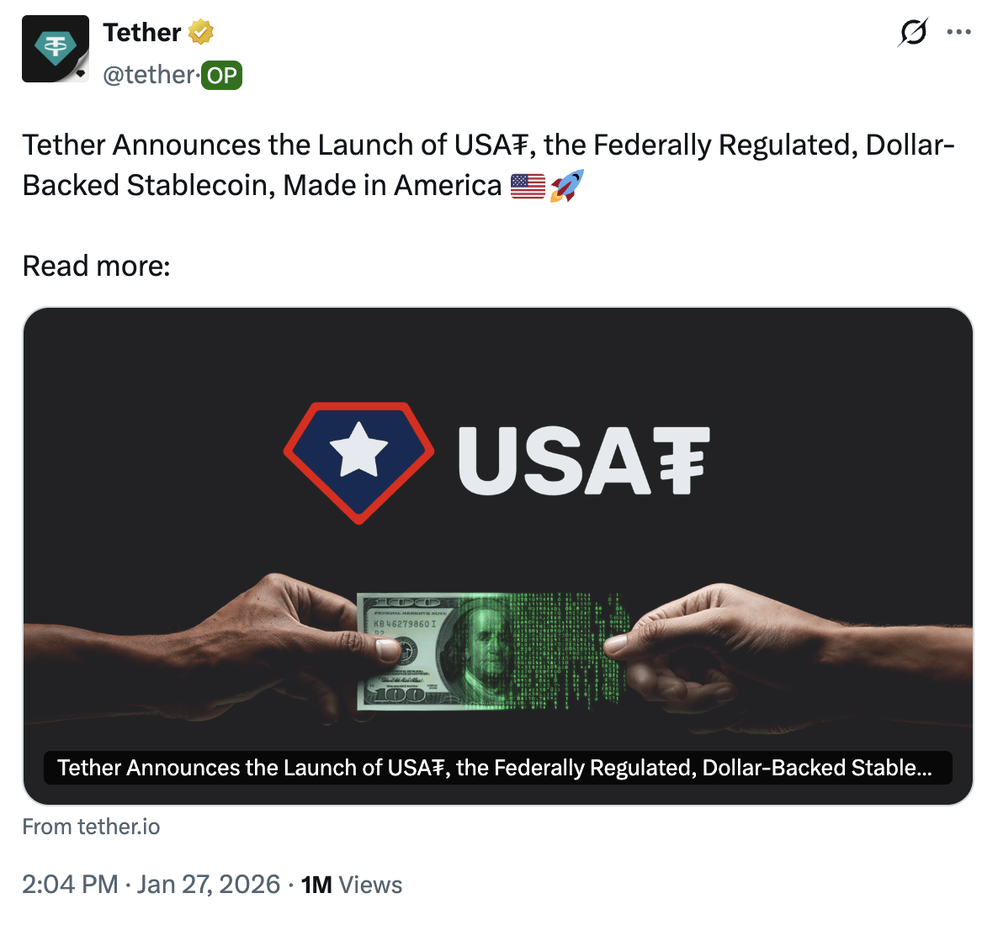

USAT: Tether's onshore twin
A political choice?
USA₮ is the first federally regulated, dollar-backed stablecoin.
Developed specifically to operate within the United States’ federal stablecoin framework: the GENIUS Act.
Issuer: Anchorage Digital Bank, N.A., a federally chartered institution and the first crypto-native entity approved as a national bank by the OCC
If the purpose is financial inclusion, why targeting the US market with USAT rather than the EU market, and deciding to be excluded by that market in the EU?
Source: https://usat.io/
International Financial Law | Regulatory issues regarding stablecoins
Anna Durante

Slide 15
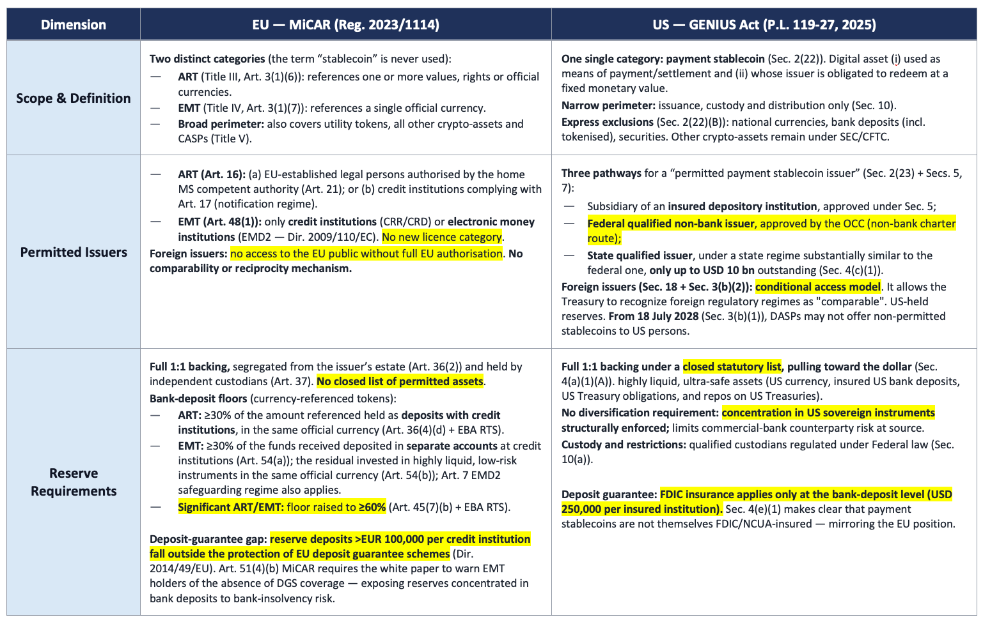
MiCAR vs GENIUS Act
Note: ART: Asset-Referenced Token; CASP: Crypto-Asset Service Provider; CRD: Capital Requirements Directive (Directive 2013/36/EU); CRR: Capital Requirements Regulation (Regulation (EU) No 575/2013); DASP: Digital Asset Service Provider; DGS: Deposit Guarantee Scheme (Directive 2014/49/EU); EBA: European Banking Authority; EMD2: Second Electronic Money Directive (Directive 2009/110/EC); EMT: E-Money Token; EU: European Union; FDIC: Federal Deposit Insurance Corporation; GENIUS Act: Guiding and Establishing National Innovation for U.S. Stablecoins Act (Public Law 119-27, 2025); MiCAR: Markets in Crypto-Assets Regulation (Regulation (EU) 2023/1114); MS: Member State; NCUA: National Credit Union Administration; OCC: Office of the Comptroller of the Currency; RTS: Regulatory Technical Standards; SEC/CFTC: Securities and Exchange Commission / Commodity Futures Trading Commission; US: United States.
International Financial Law | Regulatory issues regarding stablecoins
Anna Durante

Slide 16
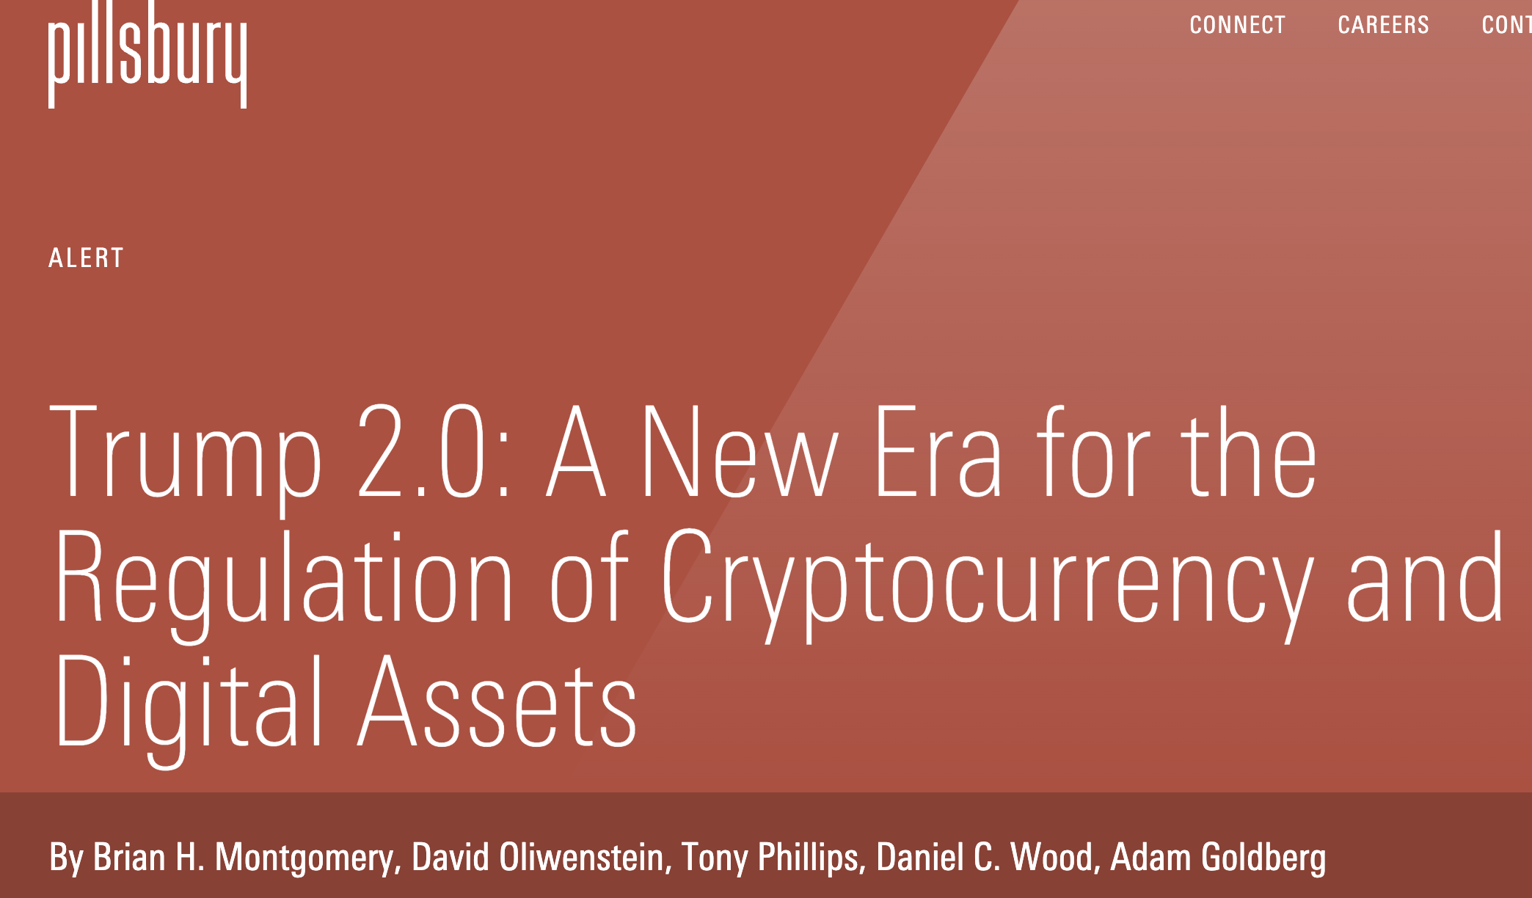
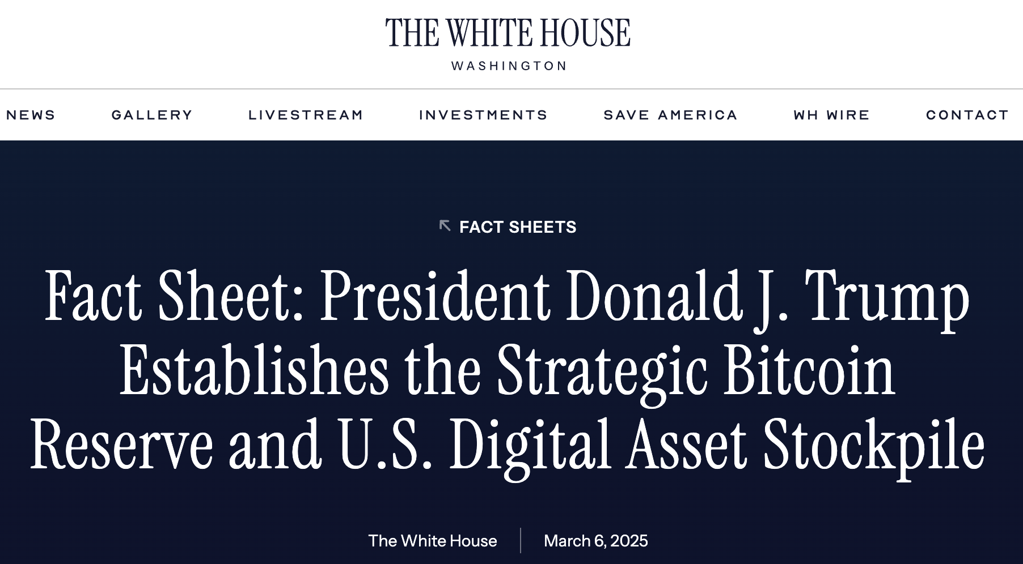

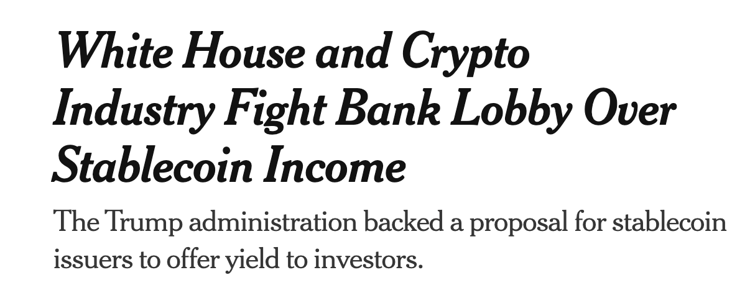
The political dimension (1/4)
A pro-crypto stance: how the US engages with the industry
International Financial Law | Regulatory issues regarding stablecoins
Anna Durante

Slide 17
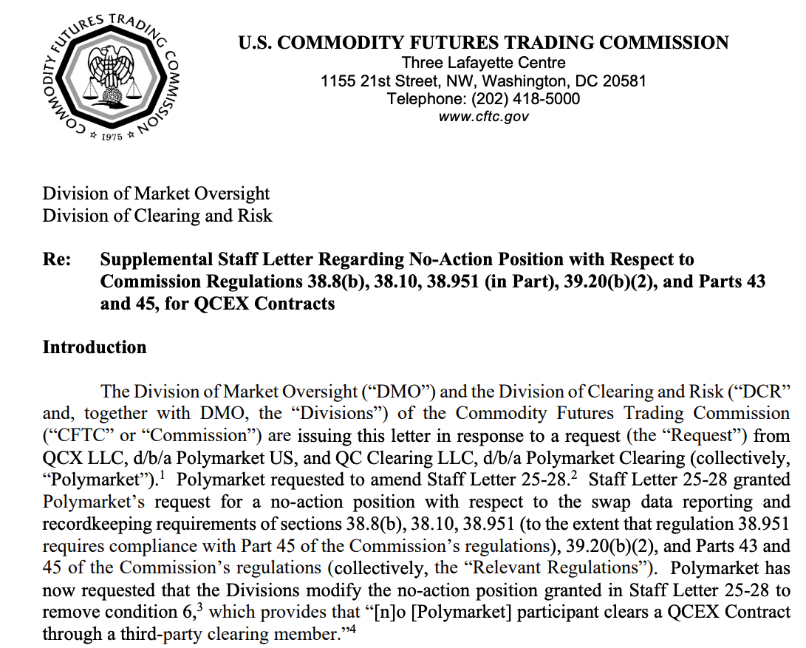

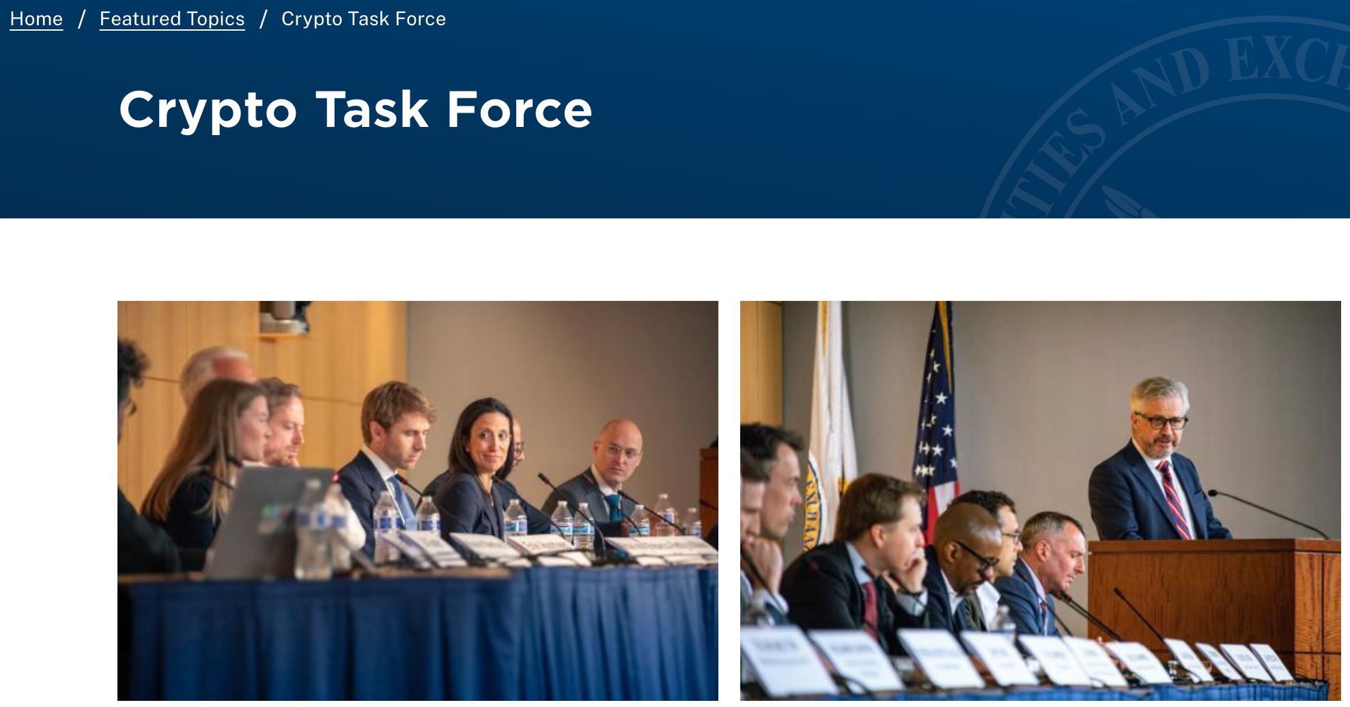

The political dimension (2/4)
A pro-crypto stance: how the US engages with the industry
The creation of a Crypto Task Force.
Open dialogue between US authorities and market players through tools such as no-action letters and requests for comment.
International Financial Law | Regulatory issues regarding stablecoins
Anna Durante

Slide 18
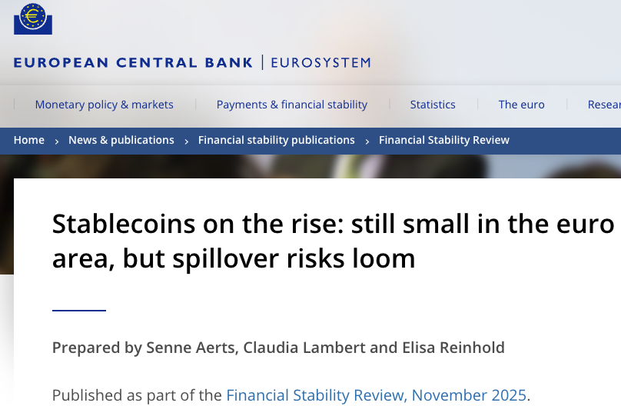
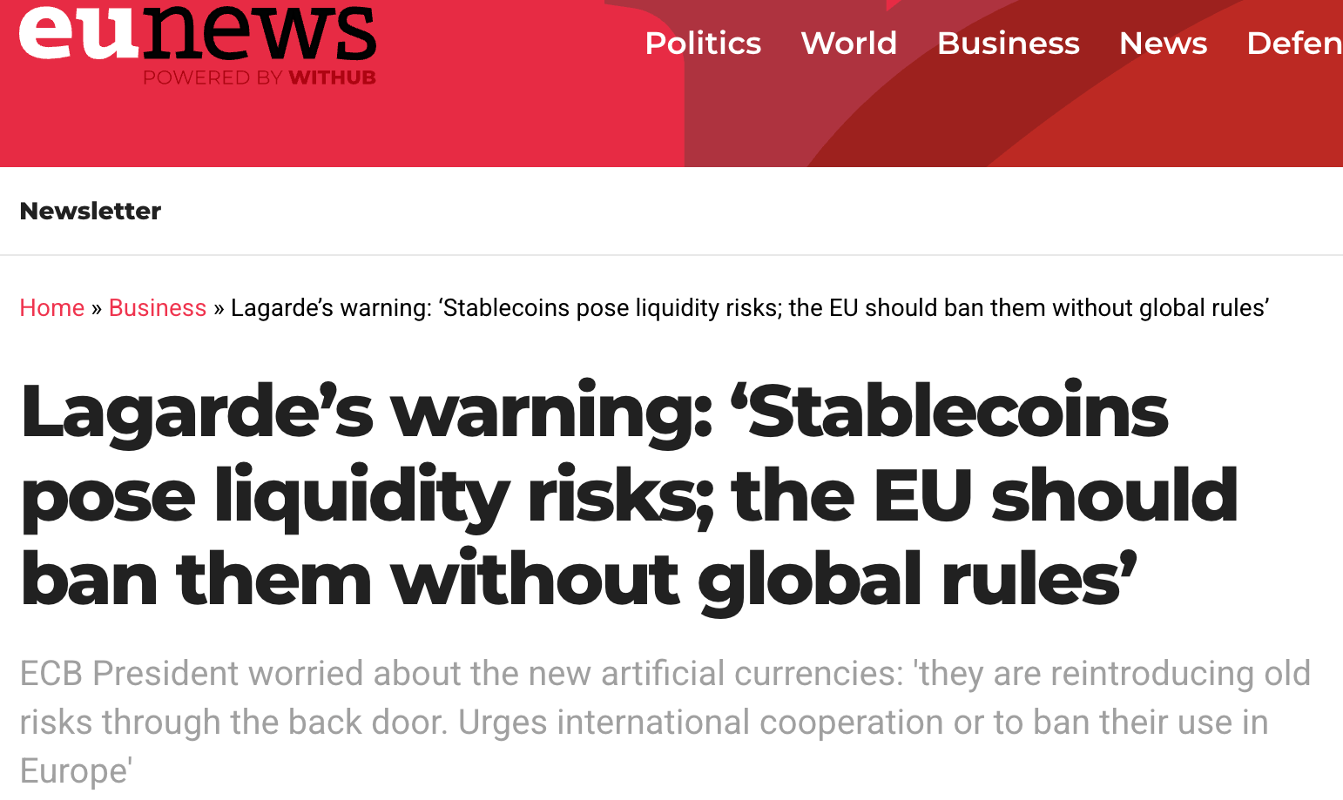
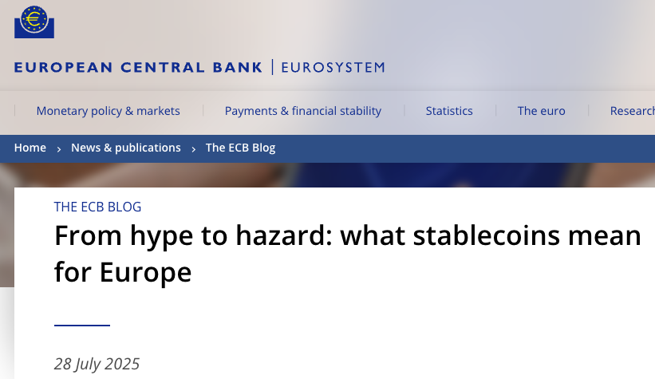
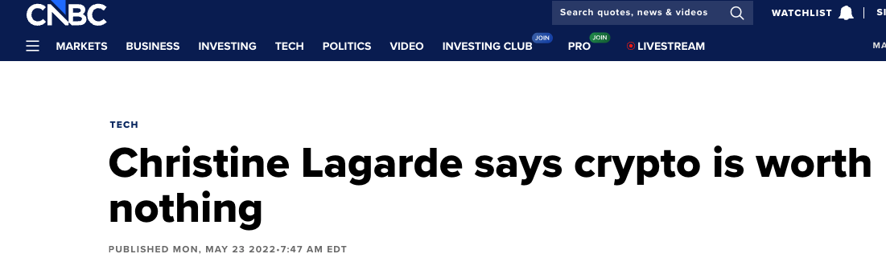
The political dimension (3/4)
A defensive Europe
ECB President Christine Lagarde openly dismisses crypto assets.
EU supervisors repeatedly warn retail investors against crypto exposure, framing stablecoins as a systemic threat.
International Financial Law | Regulatory issues regarding stablecoins
Anna Durante

Slide 19
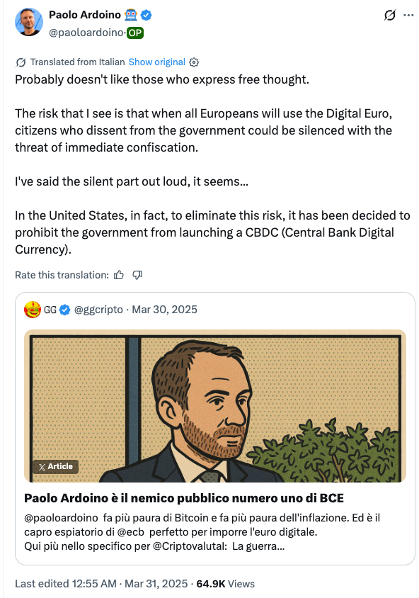

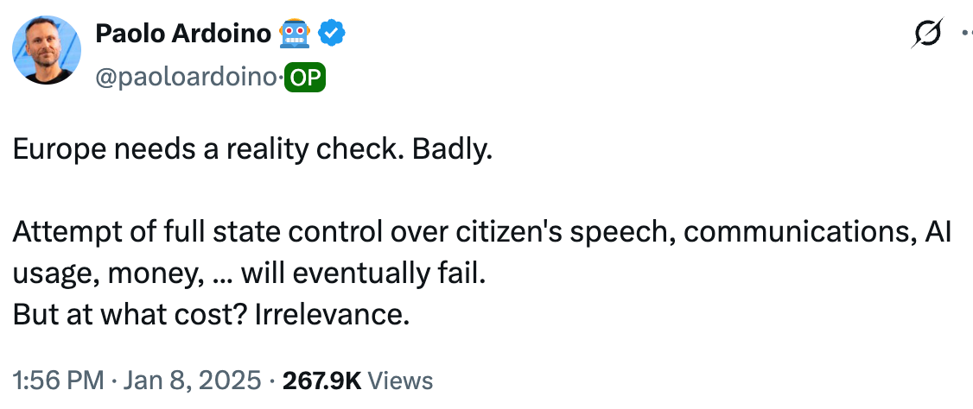
The political dimension (4/4)
A defensive Europe
The tense relationship between the EU and Tether's CEO, Paolo Ardoino.
International Financial Law | Regulatory issues regarding stablecoins
Anna Durante

Slide 20
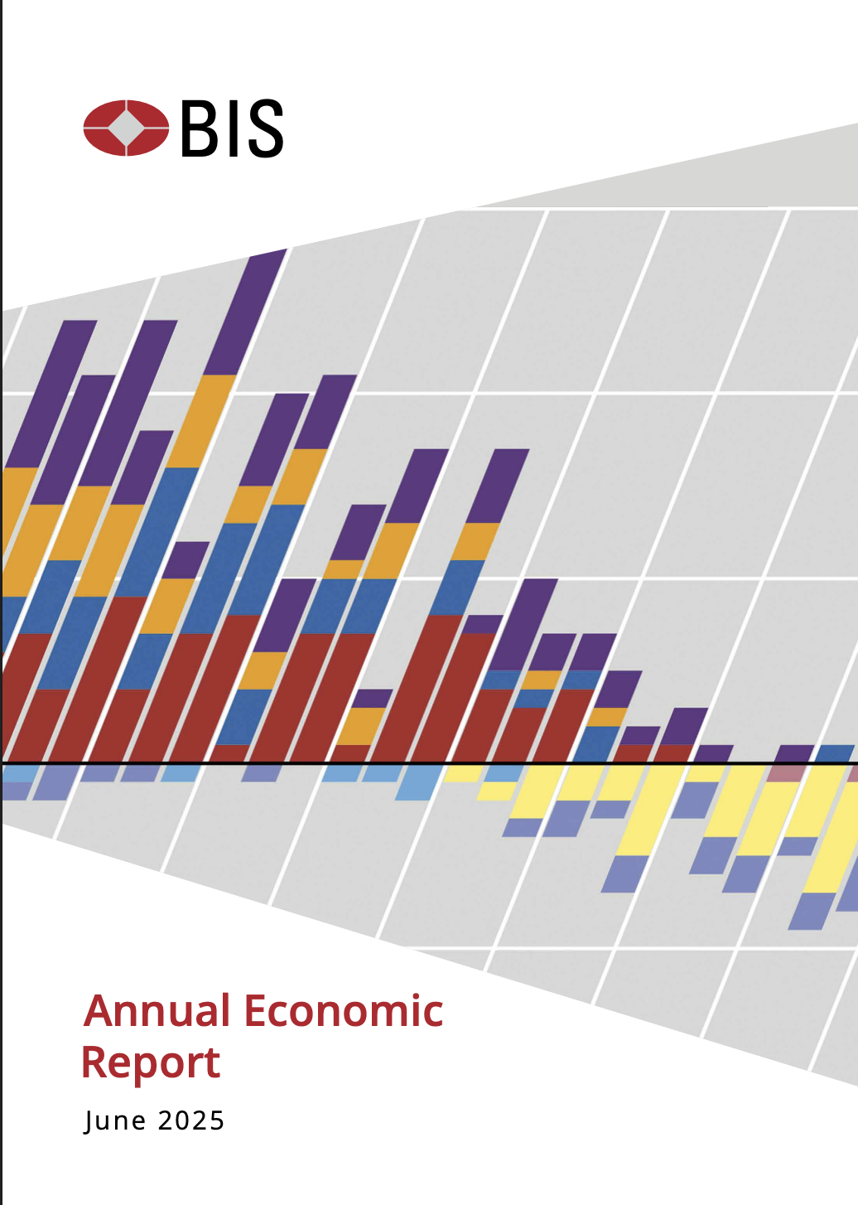
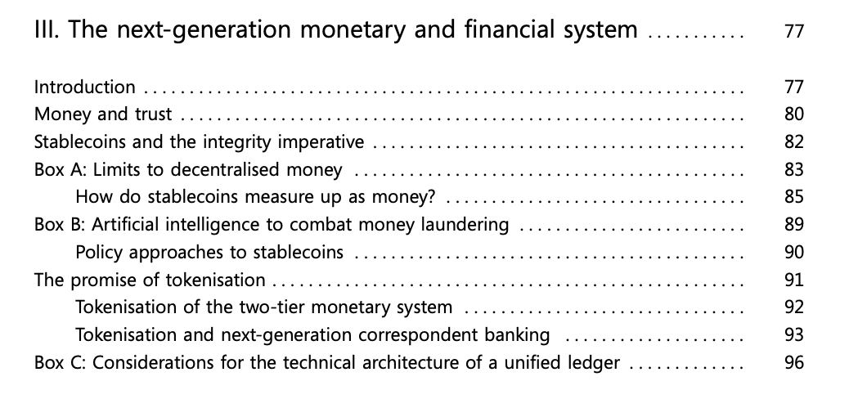
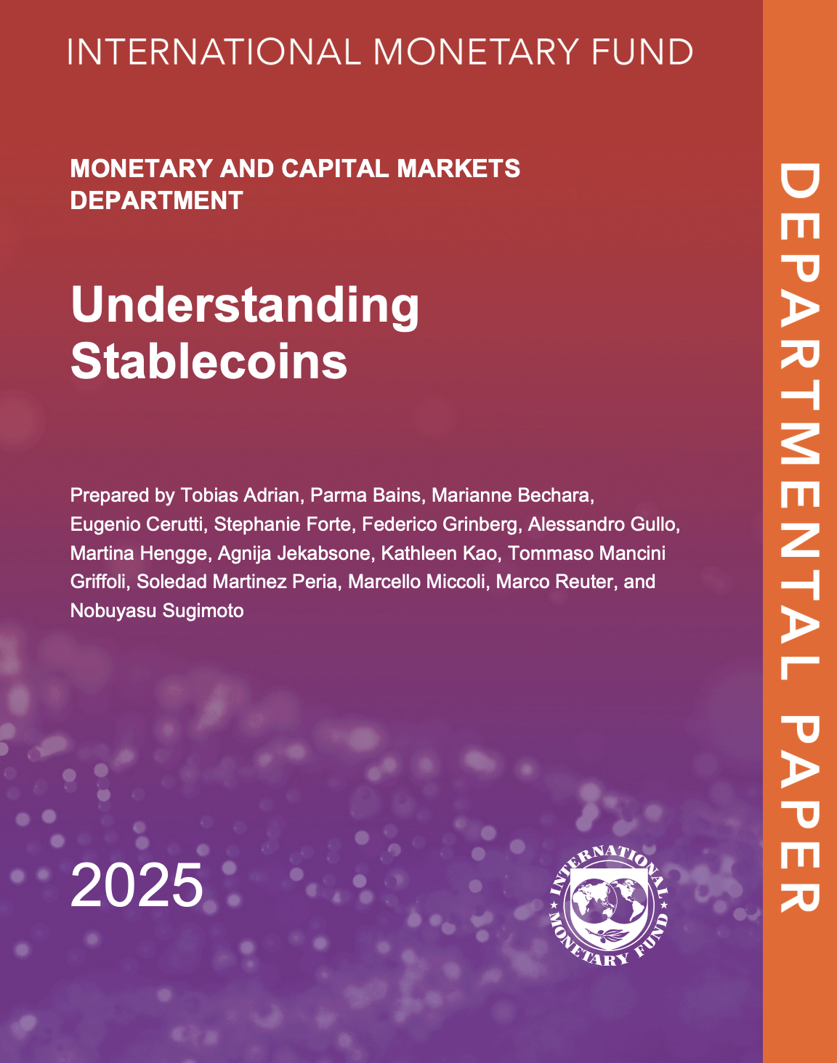
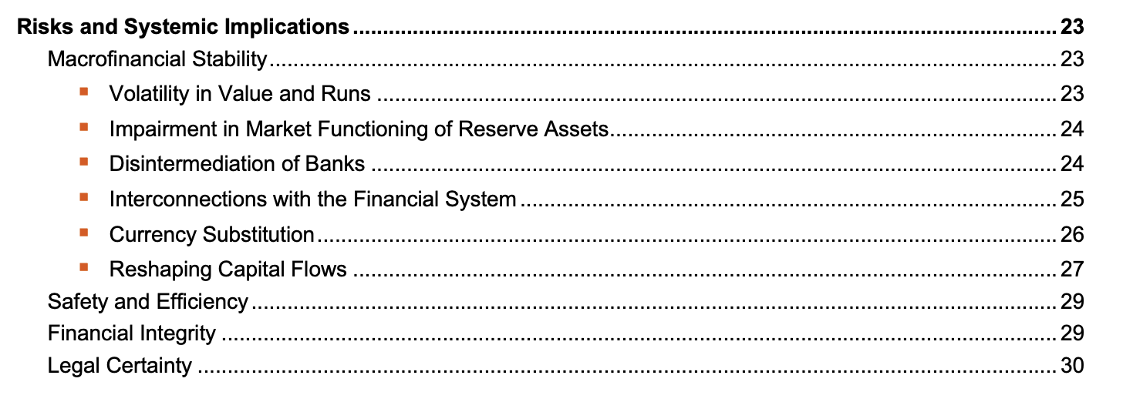

BIS Annual Economic Report 2025, Chapter III
Conclusion
The political choice: regulatory differences exist, but they alone do not explain Tether's move. The focus is on the EU's defensive and paternalistic posture vs the US's open dialogue with the industry.
A silent collaboration: by accommodating Tether under the GENIUS Act, the US has found a private vehicle to export the dollar, globally, into the developing markets Tether has targeted since 2014.
The EU's missed opportunity: by pushing Tether out, Europe gave up the chance to export the euro and is now passively watching what the BIS calls stealth dollarisation.
International Monetary Fund, Departmental Paper
International Financial Law | Regulatory issues regarding stablecoins
Anna Durante

Slide 21
The evolution and
effectiveness of
IMF conditionality
International Financial Law
Jakub Walczak
legal mechanism
economic tool
political bargain
01

Slide 22
1. What is IMF conditionality?
IMF money is paid in tranches. The next tranche depends on whether the state keeps policy promises.
Financing
Policy program
Reviews & disbursements
02

Slide 23
2. Evolution: from stabilization to tailored reform
The Fund learned from crises: debt crises, Asia 1997, Greece 2010, Covid and Ukraine.
1944-70s
1997-98
2009
Focus on exchange stability and short-term balance of payments support
Korea/Indonesia: financial-sector and corporate-governance reforms
Less use of hard structural performance criteria; more benchmarks and reviews
1980s
2002
2024-26
Latin American debt crisis: fiscal cuts, privatization, trade liberalization
Rules push ‘ownership’, ‘parsimony’ and country-specific design
More attention to social spending, governance, climate and fragile states
03

Slide 24
3. How conditionality works in practice
The tools are practical: some conditions unlock the program, others monitor it.
Prior actions
Example: pass an emergency budget or remove an exchange-rate restriction first
Quantitative performance criteria
Example: deficit ceiling, reserve floor, debt limit, no central bank financing
Indicative targets
Example: social-spending floor or tax-collection target used for monitoring
Structural benchmarks
Example: strengthen bank supervision, anti-corruption bodies, public procurement
04

Slide 25
4. Effectiveness: what should we measure?
A program can succeed on stabilization and still fail politically or socially.
1
2
3
Stabilization
Credibility
Development
Korea 1997
Argentina 2018
Greece 2010
05

Slide 26
Conclusion: make conditionality disciplined
Three tests for judging an IMF condition
1
2
3
Macro-critical
Country-owned
Socially legitimate
07

Slide 27
Sources used
IMF, IMF Conditionality Factsheet; Guidelines on Conditionality, 2002.
IMF, Korea Stand-By Arrangement summary, 1997.
IMF, Greece Stand-By Arrangement and Ex Post Evaluation, 2010/2013.
IMF, Argentina SBA reviews, 2018.
IMF, Ukraine Extended Fund Facility materials, 2023 onward.
IEO, Structural Conditionality in IMF-Supported Programs, 2008.
ECB Occasional Paper 235, Conditionality and design of IMF-supported programmes, 2019.
James, Harold, From Grandmotherliness to Governance: The Evolution of IMF Conditionality, Finance & Development, International Monetary Fund, 1998.
08

Slide 28
Thank you!
08

Slide 29


International Financial Law
ha
Elise David
21st May 2026
CLIMATE FINANCE RISK AND BANKING REGULATION

Slide 30
WHY CLIMATE RISK IS ALSO A BANKING ISSUE
Nature and Communities
Floods, fire, biodiversity loss, ecosystem damage
Economy
Supply chains, property values, agriculture
Financial System
Bank losses, collateral risk, repricing of assets
→ Lending choices help shape which activities grow
Notes:
picture: https://ixelles.ecolo.be/z-archives/elections-2018/0-liste-2018-portaits/39-olivier-de-schutter/
accessed 28.02.2025
definition: O. De Schutter, ‘The Green Rush: The Global Race for Farmland and the Rights of Land Users’ (2011)
52(2) Harvard International Law Journal, pp. 504–59, at 504

Slide 31
THREE WAYS CLIMATE RISK REACHES BANKS
Physical Risk
Direct damage: floods, storms, droughts, wildfires
e.g: flood-prone property loses value as a collateral
Transition Risk
Policy, technology and market shift to a low -carbon economy
e.g.: fossil fuel firms suddenly losing value
Legal Risk
Lawsuits, fiduciary duties, greenwashing
e.g. misleading sustainability claims damage trust
Notes:
picture: https://ixelles.ecolo.be/z-archives/elections-2018/0-liste-2018-portaits/39-olivier-de-schutter/
accessed 28.02.2025
definition: O. De Schutter, ‘The Green Rush: The Global Race for Farmland and the Rights of Land Users’ (2011)
52(2) Harvard International Law Journal, pp. 504–59, at 504

Slide 32


HOW BANKS CAN RESPOND
Pillar 1: Minimum capital
  Should climate-vulnerable exposures require more capital?
Pillar 2: Supervisory review
  ICAAP, stress test and forward-looking scenario
Pillar 3: Market discipline
  Standardised disclosures to investors and supervisors
Environmental/ social risk, especially agriculture and deforestation
Green Credit Guidelines encourage sustainability lending
Notes:
picture: https://ixelles.ecolo.be/z-archives/elections-2018/0-liste-2018-portaits/39-olivier-de-schutter/
accessed 28.02.2025
definition: O. De Schutter, ‘The Green Rush: The Global Race for Farmland and the Rights of Land Users’ (2011)
52(2) Harvard International Law Journal, pp. 504–59, at 504

Slide 33
TAKEAWAYS
Too little regulation
Climate risks build up unnoticed
→ Asset values can fall suddenly
→ Financial stability is weakened
Too much regulation
Lending may be restricted
→ Rules may become symbolic
→ Risk assessement becomes distorted
BALANCE
Notes:
picture: https://ixelles.ecolo.be/z-archives/elections-2018/0-liste-2018-portaits/39-olivier-de-schutter/
accessed 28.02.2025
definition: O. De Schutter, ‘The Green Rush: The Global Race for Farmland and the Rights of Land Users’ (2011)
52(2) Harvard International Law Journal, pp. 504–59, at 504

Slide 34
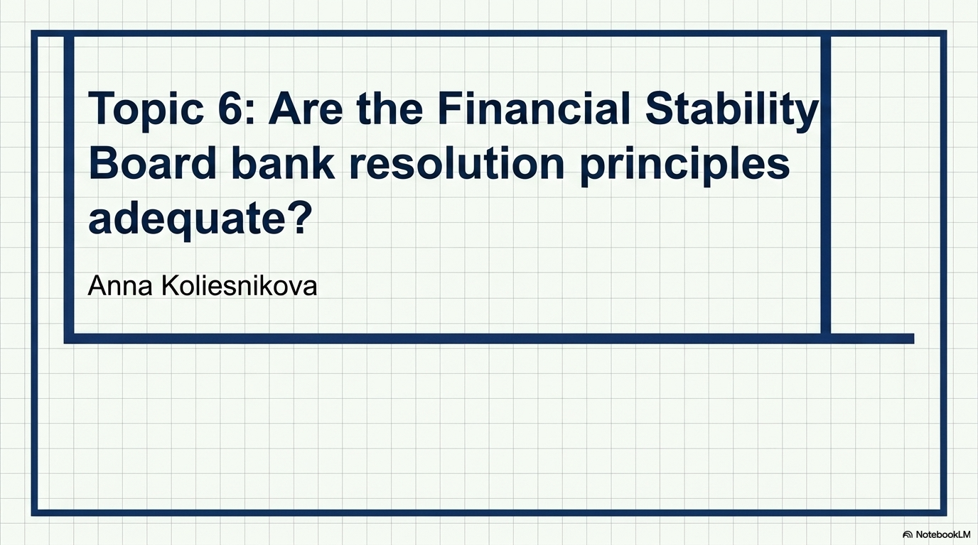

Slide 35
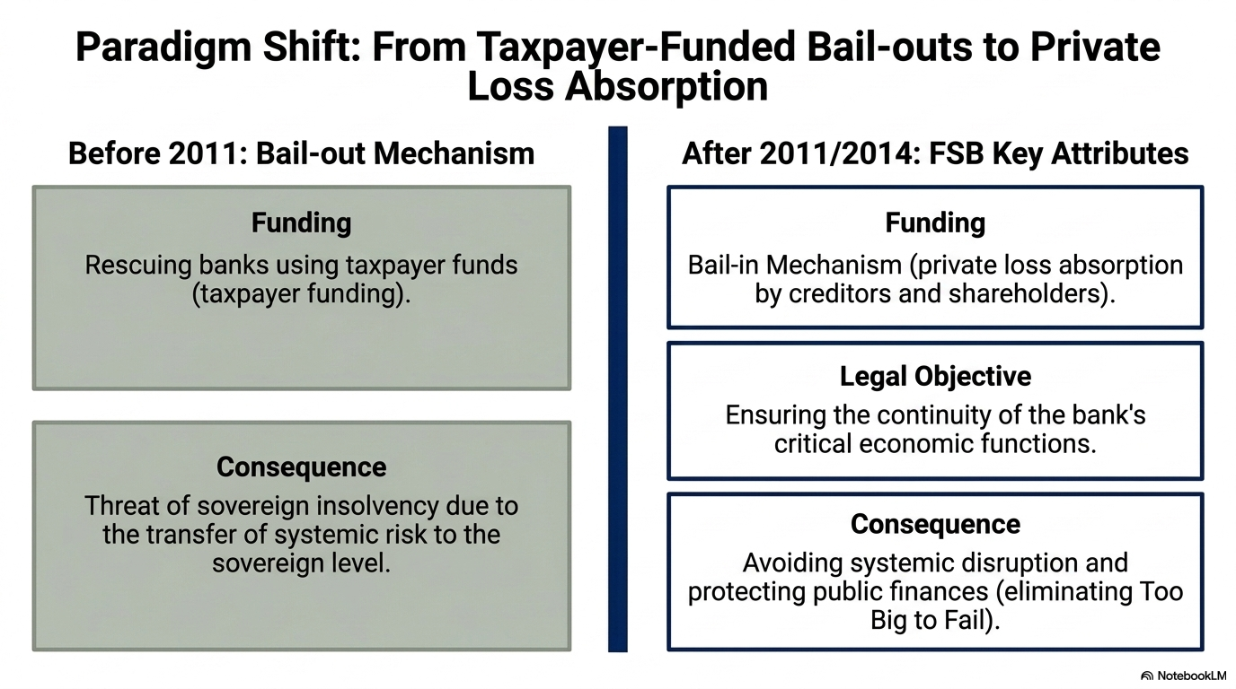

Slide 36
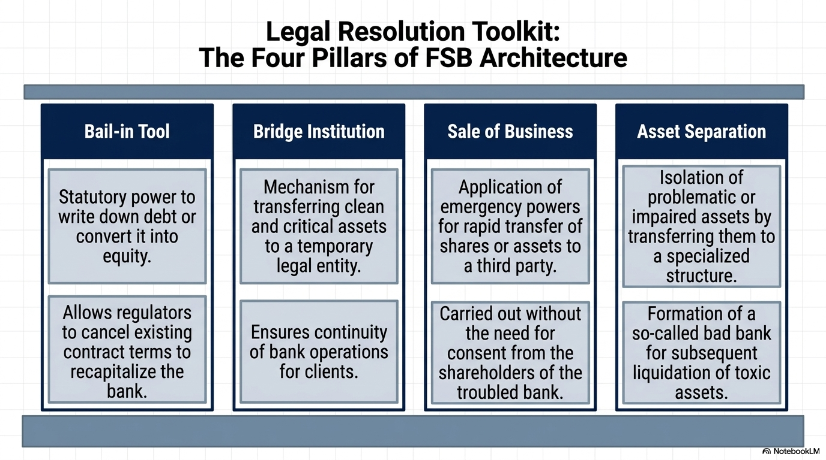

Slide 37
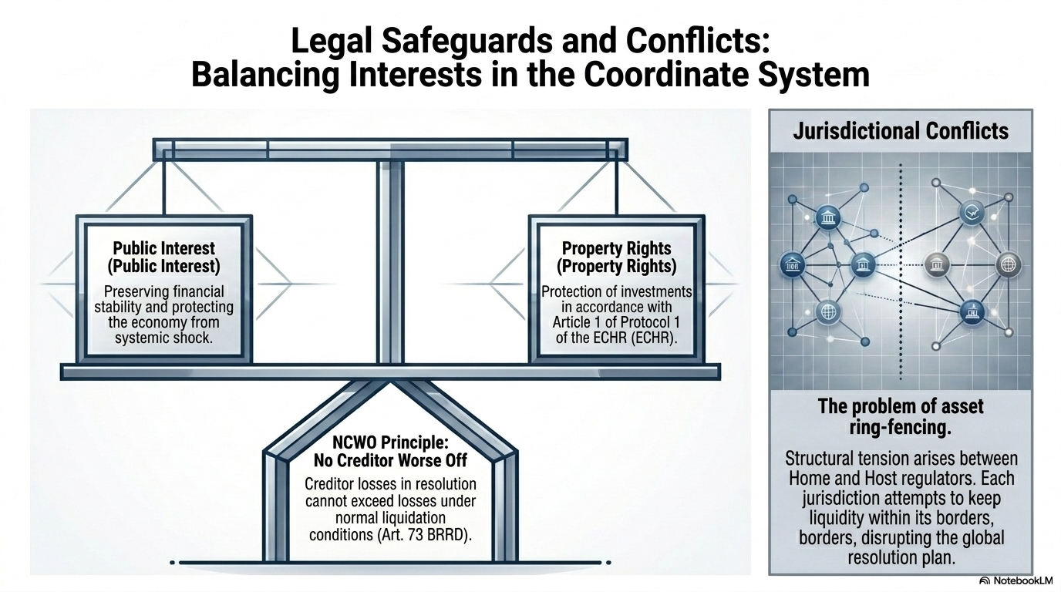

Slide 38
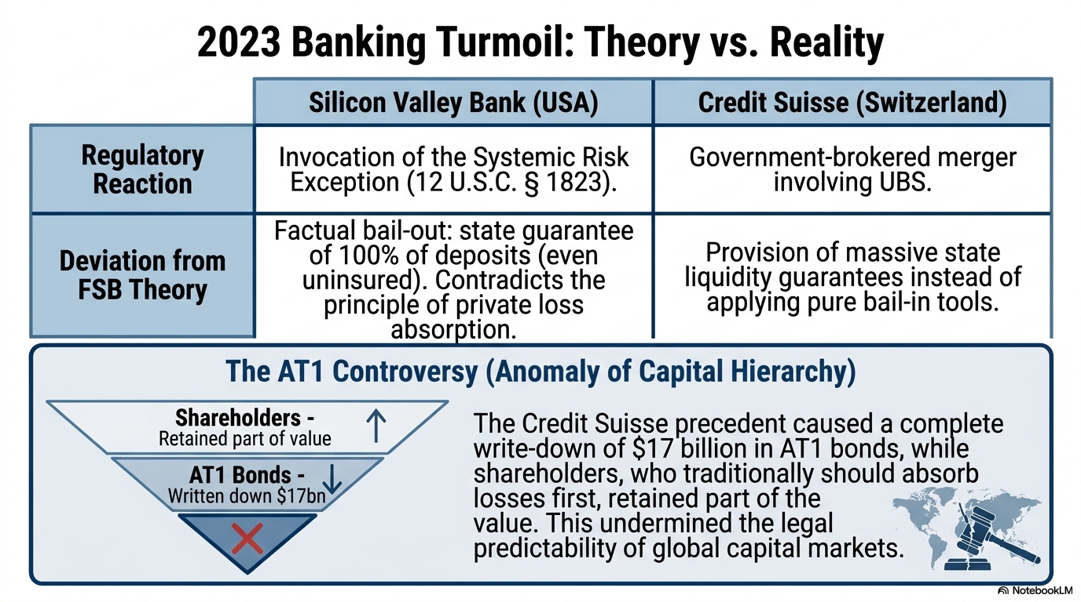

Slide 39
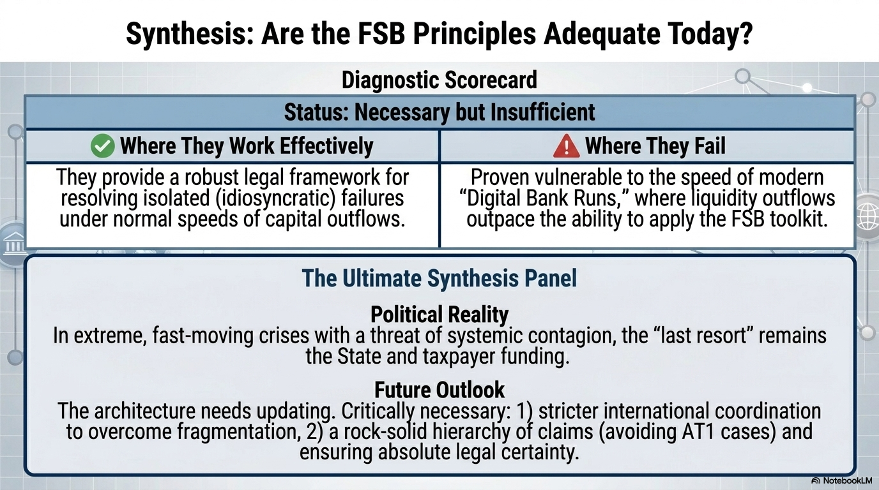

Slide 40


Capital requirements and risks in insurance companies and banks
Fabio Häderli

Slide 41
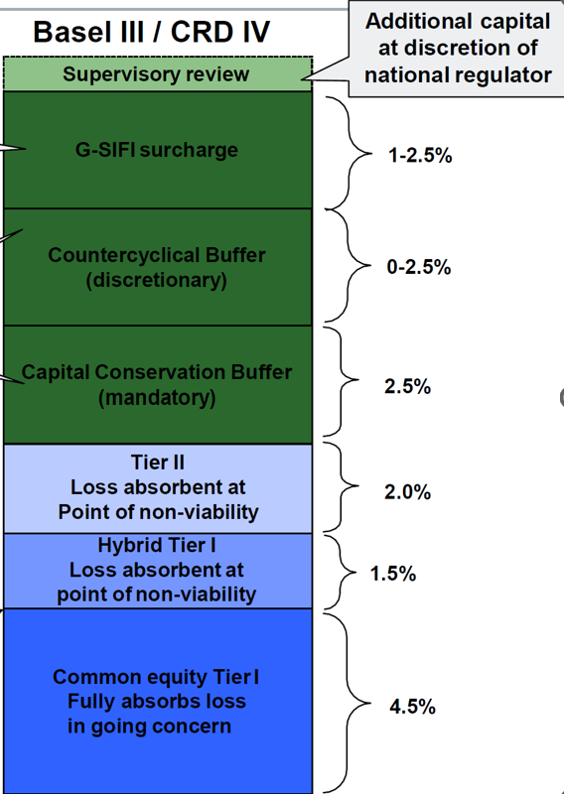
Capital requirements: Banks
Basel III:
Capital requirements as percentage of RWA
  10.5-13% minimum, 11.5-15.5% for SIFIs
Leverage ratio: ≥ 3%, ≥ 6% for SIBs

Slide 42
Capital requirements: Insurances
Insurance Capital Standard (ICS) / Solvency II:
99.5% Value at Risk (VaR) over 1 year
  = hold enough capital to survive a 1-in-200 years loss
Solvency Capital Requirement (SCR) is 100% of VaR
  Insurances typically hold well above 100%

Slide 43
Liquidity requirements?
Banks:
Liquidity Coverage Ratio (LCR) >100%
Net Stable Funding Ratio (NSFR) >100% over 1 year
Insurances:
None
  Long-term liabilities

Slide 44
Risks
Solvency
Market risk from investments
Banks | Insurances
Risk of bank run Customers withdraw funds due to loss of confidence in bank | Risk of overwhelming amount of claims

Slide 45
Main takeaways
Both banks and insurances have certain capital requirements, but different calculation methods
Both are exposed to solvency and market risks
Banks mainly affected by loss of confidence
Insurances more at risk of claims
  esp. Catastrophes (but: instruments such as CAT bonds used)

Slide 46
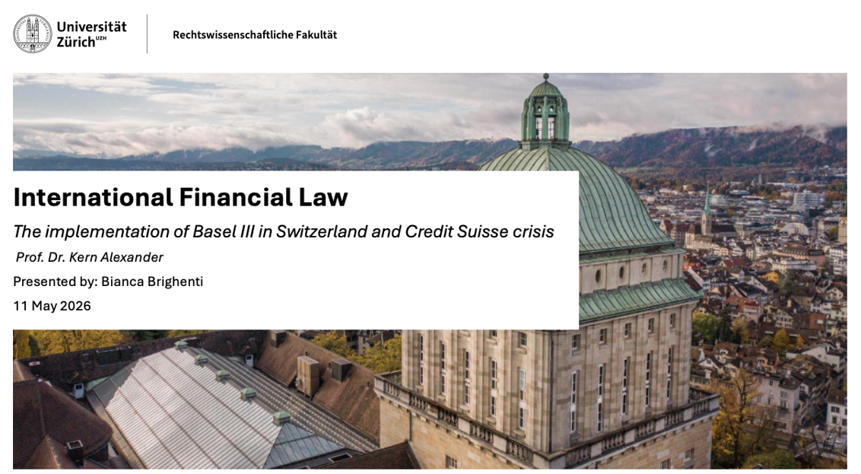

Slide 47
The Central Question
How does a Basel III-compliant bank fail within 72 hours?
Capital Ratios Met
Disclosures Filed
Still Collapsed
CET1 above minimums
Pillar 3 published
Forced UBS merger @ CHF 3bn
✓
✓
✗

Slide 48
Basel III: The Framework
Soft law with hard consequences: three interlocking pillars
Pillar I
Pillar II
Pillar III
Minimum Capital
Supervisory Review
Market Discipline
CET1 ≥ 4.5%
Total Capital ≥ 8%
Leverage Ratio
LCR & NSFR (liquidity)
Internal risk governance
Supervisory assessment
Pillar 2 add-ons
Stress testing
Public disclosure
Risk transparency
Market pricing
Investor oversight

Slide 49
Credit Suisse: A Slow-Motion Collapse
2021 – 2023 timeline of governance failures
Archegos & Greensill
Espionage Scandal
SNB Backstop
UBS Merger
$5.5bn loss
Risk control failure
Mgmt turnover
Client outflows accelerate
CHF 50bn liquidity
Markets unnerved
Forced deal @ CHF 3bn
Far below book value
2021
2022
Jan
2023
Mar
2023
CHF 50bn
72 hrs
CHF 3bn
Emergency liquidity (SNB)
From backstop to collapse
vs ~CHF 7bn book value

Slide 50
Where Basel III Met Its Limits
Pillar
Requirement
CS Position
Gap
Pillar I — Capital
CET1 ≥ 4.5%; Conservation Buffer +2.5%
Ratios technically met
Buffers eroded by years of operating losses
Pillar I — Liquidity
LCR: 30-day stress survival
NSFR: stable long-term funding
LCR reported compliant
Large institutional deposits — flighty, near-instant withdrawal
Pillar II — Governance
Supervisors must act on culture & risk failures
Scandals visible for years
Pillar 2 tools not deployed with force or speed
Pillar III — Disclosure
Market must be able to price risk
Disclosures published
By the time markets priced it in, the bank run had begun

Slide 51
Swiss Federal Council
Reform Package 2025
Four Conclusions
Capital ratios measure resilience, not confidence, and it is confidence that keeps a bank alive.
Capital Uplift
01
UBS foreign subsidiaries: CET1 backing raised from 60% → 100%
+$24bn estimated capital requirement
Liquidity crises move far faster than regulatory intervention can respond.
02
Senior Managers Regime
Named executive accountability
Bonus clawback powers
Individual legal responsibility
Governance is not a soft afterthought, serial failures destroyed market trust that no buffer could restore.
03
Timeline
Too-big-to-fail remains unsolved. Government intervention persists, therefore moral hazard persists.
04
Implementation expected 2028
Legislative process ongoing

Slide 53
Elena Pugliese
Are IOSCO Standards
Effective in Regulating
Capital Markets?
An Analysis of IOSCO Principles implementation by global jurisdictions and effect on capital markets
International Financial Law, University of Zürich - 2026

Slide 54
01 | Introduction: What is IOSCO and Why Does it Matter?
WHAT IS IOSCO?
THE 3 CORE OBJECTIVES
Global standard-setting body for securities regulation
Founded in 1983, succeeding the Inter-American Association of Securities Commission
It counts 241 members, including regulatory authorities from more than 130 jurisdictions and covering 95% of global financial markets
Key Members Include:
SEC (USA)
FCA (United Kingdom)
CONSOB (Italy)
FINMA (Switzerland)
SEBI (India)
CVM (Brazil)
01
Investor Protection
Ensure investors have accurate, timely information and are shielded from fraud, manipulation, and insider trading.
02
Fair and Transparent Markets
Guarantee prices reflect all available information and all participants compete on equal terms.
03
Reduce Systemic Risk
Prevent localized failures from spreading into full-scale financial crises across the global system.

Slide 55
02 | The 38 Standards: Structure and Content
Organized across 10 key areas covering every dimension of securities market oversight:
Area | Focus
Regulator | Independence, accountability, adequate resources and powers
Self-Regulation | Role of exchanges and industry bodies in supervision
Enforcement | Powers to investigate, sanction and deter violations
International Cooperation | Information sharing between national regulators
Issuers | Disclosure obligations, financial transparency, governance
Auditors & Rating Agencies | Standards for third-party oversight providers
Fund Managers | Requirements for asset managers and collective investments
Market Intermediaries | Capital, conduct and risk standards for brokers/dealers
Secondary Markets | Rules for exchanges, trading platforms, market surveillance
Clearing & Settlement | Post-trade infrastructure and CCP risk management
The 38 principles are soft law, best practices expected to be adopted into national legislation, not legally binding international obligations.

Slide 56
03 | Strengths and Limitations
STRENGTHS
LIMITATIONS
Common language
Soft law
Created a shared regulatory language across 130+ jurisdictions worldwide
Compliance is voluntary, no sanctions for non-adoption
Cross-border cooperation
Uneven implementation
Significantly improved joint enforcement via the MMOU and EMMoU
Developed vs. emerging markets face a major compliance gap
Post-2008 reforms
2008 financial crisis
Guided new rules on hedge funds, OTC derivatives & rating agencies
Structured products & shadow banking exposed critical gaps
FSAP accountability
Slow peer reviews
IMF/World Bank assessments create public pressure to reform
Infrequent, politically sensitive, countries rarely face consequences
Market development
Regulatory arbitrage
Higher compliance correlates with deeper, more liquid capital markets
Firms shift operations to jurisdictions with weaker enforcement

Slide 57
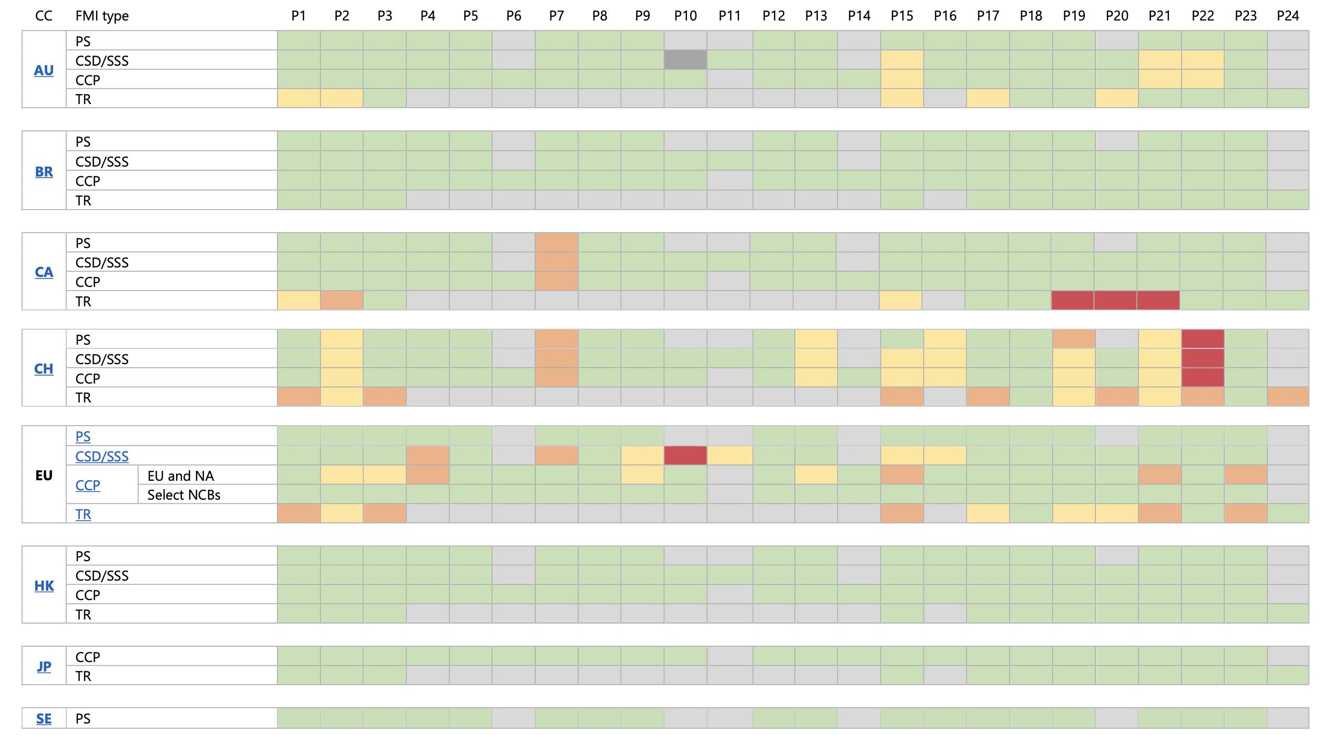
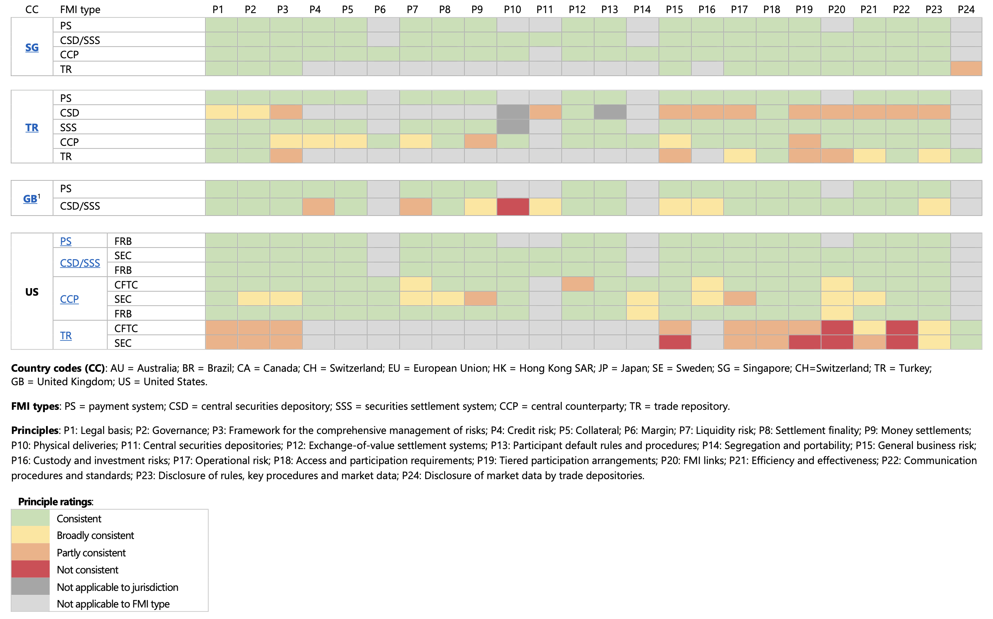
04 |Summary table of CPMI-IOSCO Level 2 assessment principle ratings by jurisdiction and FMI type (1)

Slide 58
05 |Summary table of CPMI-IOSCO Level 2 assessment principle ratings by jurisdiction and FMI type (2)

Slide 59
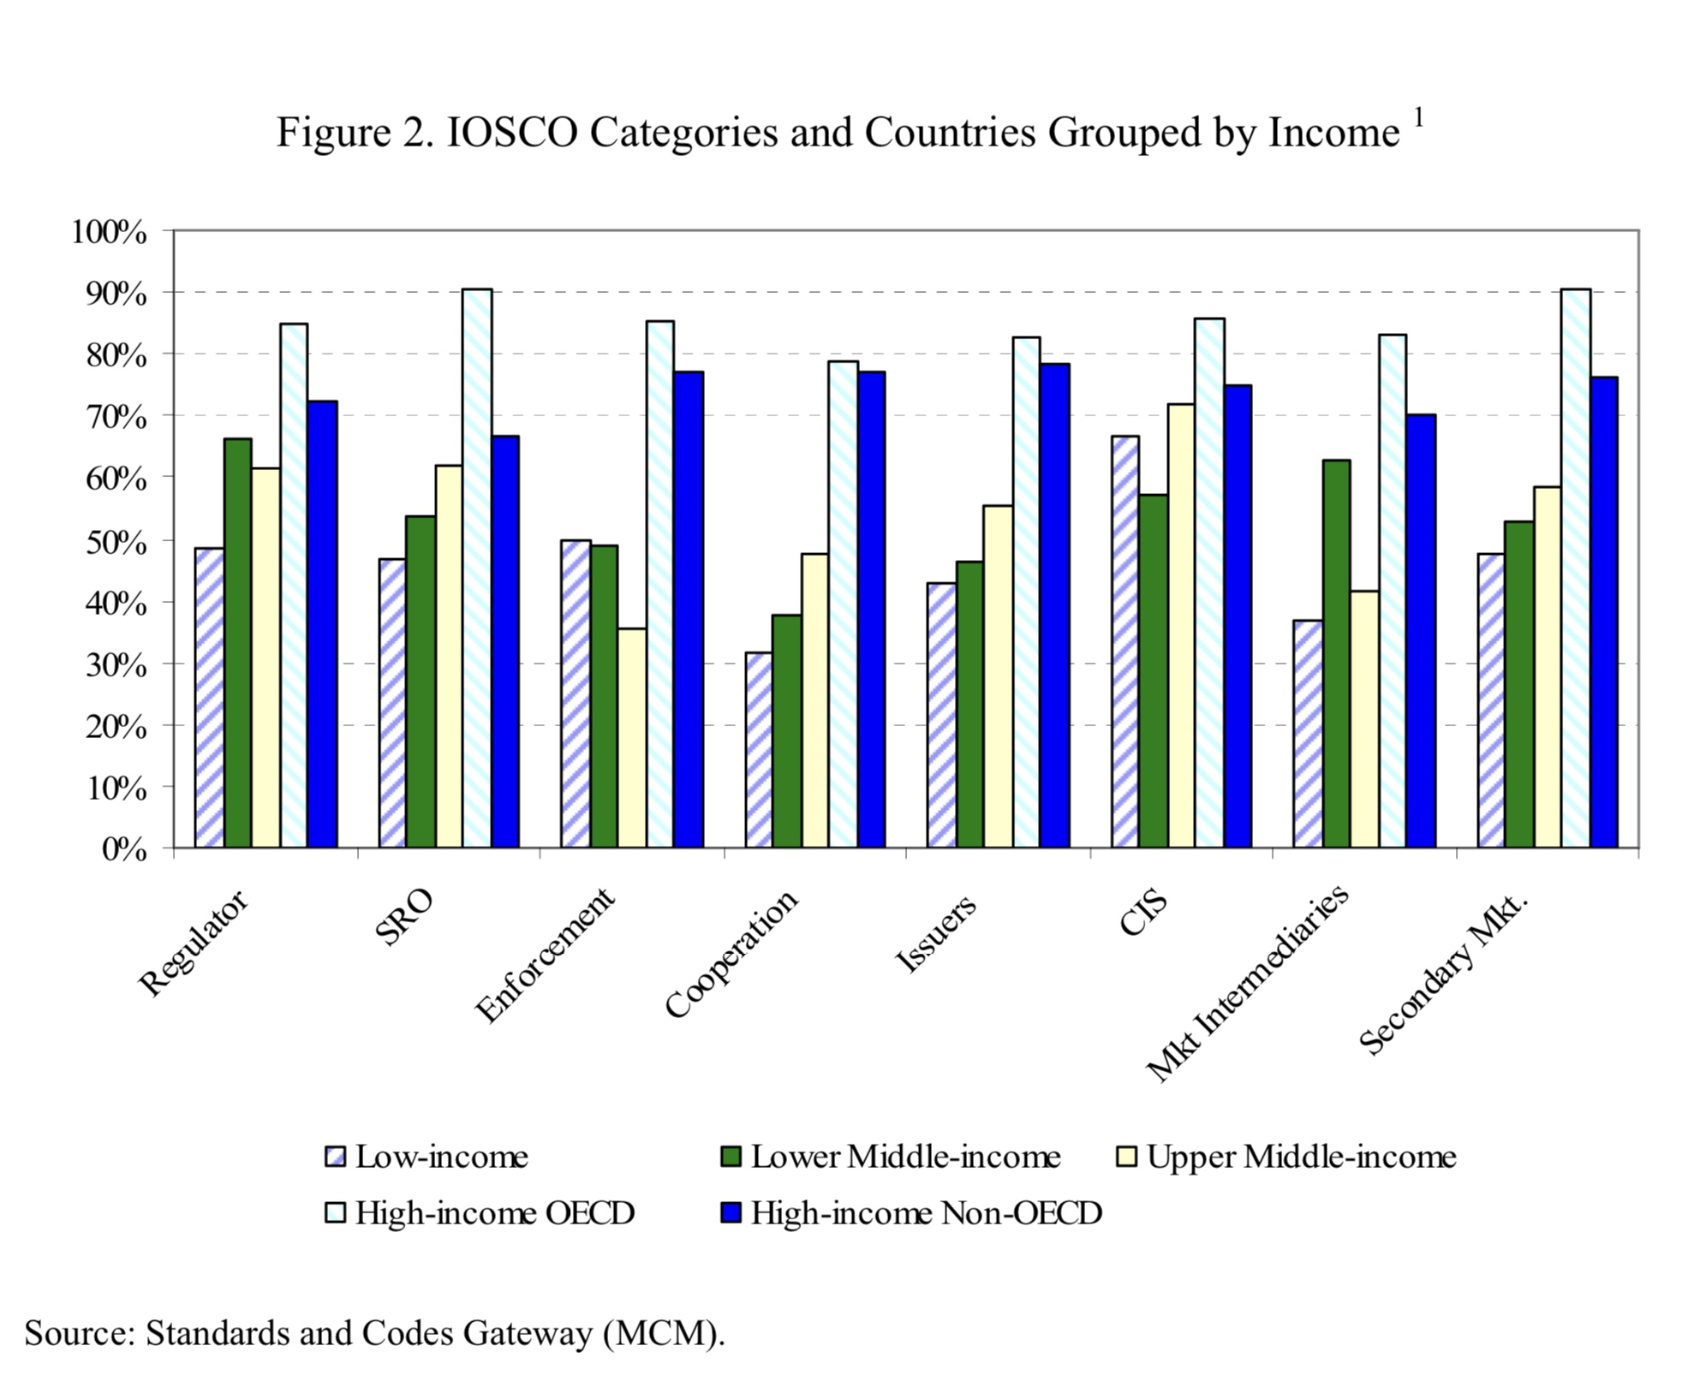
06 |Are IOSCO Standards effective?
Strong income-implementation link: high-income countries (especially OECD) show consistently higher adoption of IOSCO principles.
Correlation, not necessarily causation: the chart does not establish whether implementation causes more developed capital market, or is a result of it.
IOSCO’s Assessment Committee monitors implementation of its principles, but does not publish studies measuring their actual impact on market stability or effectiveness. Its own Impact Assessment guidelines acknowledge the difficulty of establishing such causal links.

Slide 60
07 | Sources
IOSCO (2010), Objectives and principles of securities regulation. International Organization of Securities Commissions. https://www.iosco.org/library/pubdocs/pdf/IOSCOPD323.pdf
Committee on Payments and Market Infrastructures & International Organization of Securities Commissions (2026, April). Summary table of CPMI-IOSCO Level 2 assessment principle ratings by jurisdiction and FMI type. Bank for International Settlements. https://www.bis.org
International Monetary Fund (2023). Financial sector assessment program. IMF https://www.imf.org/en/About/Factsheets/Sheets/2016/08/01/16/14/Financial-Sector-Assessment-Program
Financial Stability Board (2023). FSB work programme for 2023. FSB. https://www.fsb.org/2023/02/fsb-work-programme-for-2023/
IOSCO (2023). Policy recommendations for crypto and digital asset markets. International Organization of Securities Commissions. https://www.iosco.org/library/pubdocs/pdf/IOSCOPD734.pdf
La Porta, R., Lopez-de-Silanes, F., & Shleifer, A. (2006). What works in securities laws? The Journal of Finance, 61(1), 1-32. https://doi.org/10.1111/j.1540-6261.2006.00828.x
Jackson, H. E., & Roe, M. J. (2009). Public and private enforcement of securities laws: Resource-based evidence. Journal of Financial Economics, 93(2), 207-238. https://doi.org/10.1016/j.jfineco.2008.08.006
Coffee, J. C. (2007). Law and the market: The impact of enforcement. University of Pennsylvania Law Review, 156(2), 229-311.
Carvajal, A., Elliot, J. (2007), Strengths and Weaknesses in Securities Market Regulation: A Global Analysis. https://www.imf.org/en/publications/wp/issues/2016/12/31/strengths-and-weaknesses-in-securities-market-regulation-a-global-analysis-21428

Slide 61
IS DEPOSIT
INSURANCE
ADEQUATE TODAY?
The SVB Collapse · US · EU · UK · Switzerland
by Aidana Duisen

Slide 62
BACKGROUND
What is deposit insurance?
ORIGIN
PROMISE
LIMITS
Born from the
Great Depression
A guarantee
against panic
How much
is covered?
4,000 US banks failed 1929-33 when ordinary savers lost everything.
The FDIC was created in 1933 to restore public trust in the banking system.
If you know your money is safe, you won't rush to the branch.
Deposit insurance is fundamentally about psychology (breaking the panic spiral before it starts).
USA: $250,000 per depositor (FDIC)
EU: €100,000 (DGSD)
UK: £85,000 (FSCS)
Switzerland: CHF 100,000 (esisuisse)
2 / 11

Slide 63
CASE STUDY
SVB: from boom to bailout in 48 hours
2020 – 21
SVB doubles in size on the tech startup boom. Deposits surge from $60B to $190B.
$212B
total assets
2022
The Fed hikes rates aggressively. SVB's long-duration bond portfolio silently loses billions in market value.
94%
Mar 8, 2023
SVB announces a $1.8B bond loss and a $2.25B emergency capital raise. The announcement triggers panic.
deposits uninsured
$42B
Mar 9
Peter Thiel's Founders Fund advises portfolio companies to withdraw.
$42 billion leaves via smartphone apps within one day.
withdrawn in 1 day
48h
Mar 10
FDIC takes over. 16th largest US bank collapses. $175B in deposits at risk.
48 hours from announcement to failure.
announcement → failure
3 / 11

Slide 64
Why the $250K limit wasn't built for SVB
$4.2M
SVB's average deposit size which is 17 times the FDIC limit
THE DIGITAL
BANK RUN
1930s: queues took days to form
2023: apps drained $42B in hours
No circuit-breakers exist for digital withdrawals
Social media amplified fear faster than any regulator could respond
The rulebook was written for a pre-smartphone world
94%
of SVB deposits sat above the $250K threshold
2008
last time the US limit was raised which is why inflation has eroded its real value since
4 / 11

Slide 65

GLOBAL COMPARISON
US · EU · UK · Switzerland: same goal, different stories
🇺🇸 United States
🇪🇺 European Union
FDIC · $250,000
DGSD · €100,000
The gold standard where in 90 years no insured depositor has lost their money. But SVB showed 94% of deposits sat above the limit. The government guaranteed everything anyway, making the $250K figure look like a fiction.
Cyprus 2013: uninsured depositors were subjected to a bail-in losing a chunk of their savings to recapitalise banks. This became a legal template. The EU limit covers retail savers but leaves business deposits exposed.
🇬🇧 United Kingdom
🇨🇭 Switzerland
FSCS · £85,000
esisuisse · CHF 100,000
Northern Rock 2007: the first UK bank run in 150 years, with queues around the block.
Forced an increase from £35K to £85K. The FSCS pays out quickly, but the limit remains low for businesses banking large sums.
Credit Suisse 2023: not a depositor insurance failure, but a forced merger with UBS orchestrated over a weekend. AT1 bondholders were wiped out, a controversial call that shocked global markets and tested confidence in Swiss guarantees.
5 / 11

Slide 66
CLOSER TO HOME
Bank Astana, Kazakhstan - 2018
I am from Kazakhstan. This is not an abstract case study - it is what banking failure looks like from the inside.
Context
Bank Astana was a small lender, one of three banks to lose their licences that year (alongside Qazaq Banki and Eximbank). Kazakhstan had spent ~$14B bailing out problem bank assets since 2017 (equal to 9% of GDP). The government was willing to rescue well-connected banks but let others fail.
Apr 19, 2018
President Nazarbayev publicly criticises Bank Astana
Apr 22
Bank imposes first restrictions: transfers capped at 200,000 tenge (~$600) and weekly withdrawals limited to 1 million tenge (~$3,000). Panic begins quietly.
What it revealed about deposit insurance
Kazakhstan's deposit guarantee (KZT 10M ~$22K) covered retail savers — but business deposits above the limit were at risk
Weeks of frozen withdrawals before revocation: depositors knew something was wrong but had no exit
Political signal (Nazarbayev's criticism) preceded collapse by 5 months — opacity over transparency
Selective bailouts: state-connected banks rescued, smaller ones liquidated — unequal treatment erodes trust
May 2
Bank Astana halts all deposit withdrawals, loans, international transfers and currency exchange. Effectively frozen. Depositors have no access to their money.
Sep 18–19
National Bank of Kazakhstan revokes the licence.
6 / 12

Slide 67
WHAT HAPPENED NEXT
The government guaranteed everything
WHAT THE FED DID
THE CONTRADICTION
Treasury + Fed + FDIC issued a joint guarantee on 12 March
All deposits covered far beyond the $250K limit
Bank Term Funding Program (BTFP) extended emergency loans
Contagion to Signature Bank (also failed) was contained
No direct taxpayer funds (financed via bank industry levies)
Official limit = $250K. Actual outcome: everyone covered.
If the guarantee is always implicit, why does the limit exist?
VCs who panicked first were rewarded. Prudent depositors bailed out anyway.
Small banks penalised vs. 'too big to fail' perception
The BTFP was improvised in 72 hours
"No depositor who had money at these institutions has lost a dime." President Biden, 13 Mar 2023
6 / 11

Slide 68
Cover everything → banks gamble more.
Cover nothing → panic kills solvent banks.
The fundamental problem
Solutions
Unlimited deposit insurance solves panic but creates moral hazard. If depositors know everything is guaranteed, they have no incentive to choose well-managed banks over reckless ones.
Banks, knowing deposits won't flee, are free to take on excessive risk. The guarantee that prevents one crisis plants the seeds of the next.
Risk-Weighted Premiums
Banks pay FDIC premiums proportional to their risk profile (leverage, duration mismatch, deposit concentration). SVB would have paid far more.
Depositor Coinsurance
Above a threshold (e.g. €250K), depositors bear a small loss share approx. 5-10%. Preserves incentive to pick good banks, without triggering a full wipeout.
Mandatory Disclosure
Large depositors above the limit must receive quarterly bank health summaries. Creates market discipline where informed depositors monitor risk without needing government to do it.
The goal is not to eliminate risk but to ensure the people taking risks bear them.
7 / 11

Slide 69
Is deposit insurance adequate today?
YES
NO
No insured depositor has ever lost money in FDIC's 90-year history
Emergency interventions (SVB) proved the implicit backstop is real
Blanket unlimited cover would worsen moral hazard which leads banks to gamble
$250K covers 99%+ of individual personal accounts (FDIC data)
Post-SVB stress testing now includes deposit concentration risk
Limit hasn't kept pace with inflation
Digital bank runs move faster than any regulatory response
SVB: 94% of deposits above limit: the rule was the exception
Gap between $250K limit and implicit guarantee creates dangerous ambiguity
Systemic tools (BTFP) were improvised in 72 hours — not pre-designed
8 / 11

Slide 70
Five reforms that could work
01
Raise limits for business payroll accounts
04
Depositor coinsurance above the threshold
Target protection where jobs are at stake. A higher limit (e.g. $10M) specifically for payroll accounts protects workers without blanket moral hazard.
Large depositors bear a modest loss share (5-10%) above the limit. Preserves market discipline without triggering catastrophic runs.
02
Risk-weighted insurance premiums
05
Formalise the implicit guarantee transparently
Banks with concentrated uninsured deposits pay more for coverage.
Any ambiguity shall be avoided. The standards and regulations shall apply to all the banks equally.
03
Digital liquidity buffers
Require banks to hold liquid reserves calibrated to their digital withdrawal velocity to be up-to-date with the smartphone age.
9 / 11

Slide 71
Three questions worth arguing about
Should business and personal accounts be treated the same?
A retiree with $250K in savings and a startup with $5M in payroll have very different risk profiles. Should the same limit apply to both?
Is market discipline a myth when 'too big to fail' always wins?
If regulators always step in to prevent contagion, depositors will never truly discipline banks. Does the implicit guarantee already exist and should we just admit it?
Who pays when the system fails and is that fair?
SVB's rescue was funded by bank industry levies. But those levies are ultimately passed on to customers. Is the cost allocated fairly between risk-takers and the public?
10 / 11

Slide 72
CONCLUSION
Deposit insurance was not designed for a $212B bank where 94% of deposits sit above the limit.
The SVB rescue proved governments will always guarantee more than the rulebook says creating dangerous ambiguity.
Digital speed has outpaced every regulatory tool built for a branch-banking world.
The answer is not unlimited cover — it is smarter pricing, market discipline, and honest transparency about the backstop.
11 / 11

Slide 73
The Rationale for
Bank Capital Regulation and Basel III
KOSARACHI CHARITY EMENIKE
21 May 2026

Slide 74



Why are Bank’s subject to Capital Regulation?
Bank’s Are
Uniquely Fragile
Moral Hazard
Negative Externalities
Banks lie at the heart of the economy. They are highly leveraged, the maturity of its instruments are mismatched, and they are deeply interconnected to other Banks. Consequently, Bank failures have high societal costs.
When the government insures bank deposits, depositors abandon their role of monitoring bank activities. This erodes market discipline and the banks rely on the states ability to absorb losses in taking excessive risks which eventually lead to market failure.
The society and not the Bank’s shareholders bear the social cost of bank failure. Implicit state guarantees mean banks underweight the social cost of risk. Capital regulation corrects this distortion.

Slide 75
Reasons Basel II Failed
Basel II Failed majorly due to structural flaws which were exposed by the 2008 Financial Crisis. The crisis revealed that the banks were severely undercapitalised
Pro-Cyclicality
01
Basel II risk models used recent data which made assets look safe in safe periods and dangerous in crisis. Bank capital requirements sporadically tightened exactly when banks needed room to absorb losses.
Bank Manipulation of Risk-Weight Assessments
02
The System allowed banks to use their internal models to assess the required capital for their risk weighted assets. This created opportunities for the Banks to manipulate the system by artificially lowering their risk weights to reduce their capital requirements and as such there was insufficient capital to serve as a buffer against losses.
03
Hidden Risks
The Bank’s held enormous financial risks in off balance sheet vehicles which were not covered by the scope of Basel II capital requirements. However when these vehicles collapsed during the 2008 financial crisis, these losses fell back to the balance sheet.

Slide 76
Basel III: Major Responses
Basel III introduced major pillars which addressed the 2008 Financial Crisis
CET1 CAPITAL
BUFFERS
Better Quality Capital
Capital Buffers
Common Equity Tier 1 was raised to 4.5% of RWA. This equity capital was determined as sufficient to genuinely absorb the bank’s losses in time of crisis.
Capital Conservation buffer (2.5%) + Countercyclical Capital buffer (0–2.5%) were introduced to address the pro-cyclicality problem.
G-SIB SURCHARGE
Leverage Ratio
Too-Big-To-Fail Levy
Non-Risk Based Backstop
G-SIB’s were charged an additional levy of 1–3.5% CET1 depending on their importance score. This forces them to internalise the social cost of their failure.
This addressed the problem of manipulation of the risk weighted capital requirement system. Banks were required to hold Tier 1 capital of ≥ 3% of total unweighted exposures.

Slide 77
Basel III: Major Responses (contd.)
LIQUIDITY REQUIREMENTS
Liquidity Coverage Ratio (LCR)
Required banks to hold sufficient high-quality liquid assets such as government bonds. The assets should be sufficient to cover total net cash flows over a 30-day stress period. The LCR must exceed 100%.
Net Stable Funding Ratio(NSFR)
Required banks to fund their long term assets with long term stable lending sources rather than short term overnight borrowing which is insufficient in times of crisis.

Slide 78
The Regulatory Bargain
CONCLUSION
Basel III forced Banks to internalise the social cost of their failure
Bank’s are important institutions of the state and their activities have enormous social impacts.
Bank Capital Regulation reflects a fundamental regulatory bargain as banks are major state beneficiaries and consequently, they are bound to comply with corresponding obligations.
Basel III reflects a comprehensive approach to develop an international framework that addresses the failures exposed by the 2008 crisis. The pillars developed under this framework addressed issues which arose in the crisis.

Slide 79
Topic 2: Regulatory Issues
Regarding Stablecoins
Elena Fernandez Mas
International Financial Law

Slide 80
PART I
What Are Stablecoins?

Slide 81
Definition & Key Characteristics
Stablecoins are privately issued digital crypto tokens designed to maintain a stable value relative to a reference asset
They hold a peg through backing mechanisms: fiat-backed, crypto-backed, or commodity-backed
Market capitalisation exceeded $300 billion in 2026
Operate on public permissionless blockchains (e.g. Ethereum, Tron): 24/7 availability, pseudonymous transfers, programmable via smart contracts
Key players: Tether (USDT), USD Coin (USDC), PayPal USD (PYUSD)
Source: BIS Papers No 170 (Aldasoro, Frost & Ito, May 2026)

Slide 82
PART II
Current Regulatory
Regimes

Slide 83
United Kingdom — FSMA
Scope: Sterling-denominated systemic stablecoins recognised as such by HM Treasury; dual-regulated by the BoE (prudential) and the FCA (conduct)
Reserve requirements: 40% held as deposits at the BoE + up to 60% in short-term UK government debt; issuers must hold backing assets in the same currency as the coin
Capital: greater of 6 months' operating expenses or cost of recovering from the largest plausible loss event; must include CET1-equivalent instruments held in the UK
Non-sterling or non-UK issuers: BoE may defer to home authority if outcomes are broadly equivalent and cooperation arrangements are in place
Source: BoE Consultation Paper — Proposed Regulatory Regime for Sterling-Denominated Systemic Stablecoins (10 Nov 2025)

Slide 84
United States — The GENIUS Act
Definition: 'payment stablecoin' = digital asset issued for payment/settlement, redeemable at a fixed amount; explicitly NOT a security or commodity
Reserve requirement: 1:1 backing in high-quality liquid assets
Permitted issuers: (i) subsidiaries of insured depository institutions, (ii) federally licensed nonbanks (OCC-supervised), (iii) state-qualified issuers with <$10 bn outstanding
Disclosure obligations
Foreign issuers: Treasury may establish 'reciprocal arrangements' with comparable jurisdictions; non-compliant foreign stablecoins restricted from US markets
Source: CRS In Focus IN12553 — Stablecoin Legislation: An Overview of S. 1582, GENIUS Act of 2025 (updated 18 July 2025)

Slide 85
European Union — MiCA Regulation
Two categories:
  Asset-Referenced Tokens (ARTs): pegged to baskets of assets
  E-Money Tokens (EMTs): pegged 1:1 to a single fiat currency
ART issuers must be established in the EU and obtain authorisation from their home-state competent authority (Article 16 MiCA)
Reserve requirements: full liquid-asset backing, regular reserve transparency reports, mandatory audits; EMT issuers must be authorised credit or e-money institutions
Significant tokens: EBA designation triggers enhanced prudential requirements and direct EBA oversight
Transaction caps for non-EU currency stablecoins: max 1 million transactions/day or €200 million in payment value
  Aimed at protecting euro monetary sovereignty
Source: MiCA Regulation (EU) 2023/1114; ESMA & EBA technical standards

Slide 86
PART III
Regulatory Issues

Slide 87
1
Cross-Border Nature & Jurisdictional Shopping
Stablecoins operate on public permissionless blockchains that are borderless by design: a token minted in one jurisdiction circulates globally without passing through any regulated intermediary
Issuers can strategically incorporate in jurisdictions with lighter-touch regimes while their tokens remain fully accessible to users around the world
  EU’s concerns with multi-issuer schemes
Jurisdictional shopping distorts holder rights
Fragmentation in oversight: no single regulator has full visibility over a globally circulating stablecoin
FSB High-Level Recommendations on Global Stablecoin Arrangements (2023) call for cross-border cooperation, but remain non-binding
Sources: BIS Papers No 170 (2026); FSB High-Level Recommendations on GSC Arrangements (2023); MiCA Regulation (EU) 2023/1114

Slide 88
2
Anonymity: AML & Counter-Terrorist Financing Challenges
Stablecoins circulate on public blockchains under pseudonyms: wallet addresses are visible on-chain but are not tied to legal identities unless the holder uses a regulated on/off ramp
Traditional AML supervision relies on banks and financial intermediaries filing suspicious activity reports but peer-to-peer stablecoin transfers can bypass these intermediaries entirely, leaving no institution obligated to report
Large-scale illicit flows: pseudonymous cross-border transfers make stablecoins an attractive vehicle for sanctions circumvention, tax evasion, and terrorist financing
Unhosted wallets (wallets controlled directly by users without a custodian) allow transfers with no KYC whatsoever
  MiCA and GENIUS attempt to address this but only reach regulated CASPs, not peer-to-peer flows
Enforcement gap: regulators cannot easily monitor on-chain transfers between unhosted wallets; algorithmic compliance tools (blockchain analytics) are probabilistic, not conclusive
Sources: FATF Updated Guidance for Virtual Assets (2021, rev. 2023); MiCA / TFR (EU) 2023/1113; GENIUS Act §4 (BSA obligations)

Slide 89
3
Instability: Run Risk, De-Pegging & Systemic Contagion
Structural fragility: stablecoin peg stability depends on reserve quality, transparency, and the ability of arbitrageurs to act
De-pegging events: USDC and Silicon Valley Bank
Algorithmic failures: TerraUSD
Systemic contagion risk: a large-scale run would force rapid asset sales into the same markets that central banks use for monetary policy transmission, potentially distorting yields and amplifying stress across the broader financial system
Interconnection with DeFi: stablecoins serve as collateral in decentralised lending protocols; a de-pegging event can trigger cascading liquidations across DeFi
Sources: BIS Papers No 170 (2026); Ahmed et al. (2025); Aldasoro et al. (2023b); FSB Assessment of Global Stablecoin Risks (2023)

Slide 90
4
Monetary Implications
Digital dollarisation: ~98% of stablecoins are dollar-denominated; widespread adoption in emerging markets enables residents to shift savings into dollar claims without a foreign-currency bank account, eroding the domestic currency's role as a store of value
Monetary policy transmission: when residents can seamlessly convert domestic currency into dollar stablecoins at the first sign of stress, central banks lose traction as interest rate policy becomes less effective if a large share of savings is held offshore in digital form
Capital control circumvention: pseudonymous on-chain transfers allow residents to move funds across borders outside formal banking channels
Threat to monetary sovereignty: digital dollarisation risks de facto currency substitution that is harder to reverse than its traditional form
Sources: BIS Papers No 170 (2026); ECB Occasional Paper on Stablecoins and Monetary Policy (2022); FSB High-Level Recommendations (2023)

Slide 91
Topic No. 3 (“The Basel III reforms on liquidity risks”)
Martin Svetoslavov Dimov

Slide 92
What?
Basel III Pillar 1: Two new standards for funding liquidity: LCR and NSFR
Intended to promote financial stability

Slide 93
Why?
«The Achilles heel of banks» (Alexander, 2019, p. 109)
Maturity transformation
The 2007 financial crisis

Slide 94
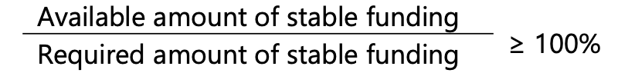
How? – NSFR
Goal: Maintain stable long-term funding structure
Promotes stable liabilities: avoiding "borrowing short»
More long-term funding is better – less risk of solvency shocks
“A sustainable funding structure is intended to reduce the likelihood that disruptions to a bank’s regular sources of funding will erode its liquidity position in a way that would increase the risk of its failure and potentially lead to broader systemic stress” (BIS (2014) para. 1)
Figure 1: The NSFR formula (BIS (2014) para. 9)

Slide 95
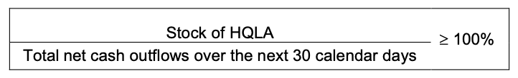
How? – LCR
Goal: Survive a 30-day stress scenario
Focuses on stable assets: supporting "loaning long”
The bank has to have the potential to cover the net outflows with its HQLA (the "liquidity cushion").
Numerator: The HQLA: assets that can immediately be converted to cash without loss
  Four criteria: (i) inherently low-risk, ii) certain valuation, (iii) low correlation with other assets, (iv) Listed on developed and recognised exchanges (BIS (2013) para. 23).
  "Quality”: Level 1, Level 2a, Level 2b
Denominator: The net outflows during 30-day period.
  "30 days”: Time for bank and regulators to react
Figure 2: The LCR formula (BIS (2013) para. 22)

Slide 96
Counterarguments?
Accepting NSFR means accepting costs and risk of shadow banking
Holding too much HQLA is inefficient and promotes tighter relationships between governments and banks
LCR and NSFR reduce maturity transformation – the constituent of banking business

Slide 97
The evolution and effectiveness of IMF conditionality
The ineffectiveness of structural adjustment programs
Victor Allcock

Slide 98
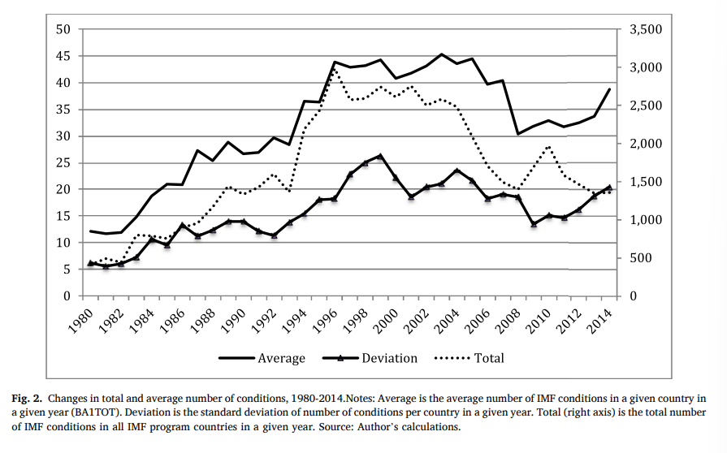
Evolution of IMF conditionality
Bretton Woods (1944)
Since 1980:
  More complex
  Wider in scope
    Social policy, labour market, gender equality, public enterprises…
  Longer duration

Slide 99
Research question
Does IMF conditionality actually help countries achieve structural transformation, especially through more sophisticated exports and greater economic complexity.
  More advanced and higher-value goods
  Diversity and knowledge intensity of and economy’s productive structure
Simple terms:
  IMF-Conditionality → more advanced forms of production and trade
Why important?
  Short term → reduction inflation etc
  X Long term

Slide 100
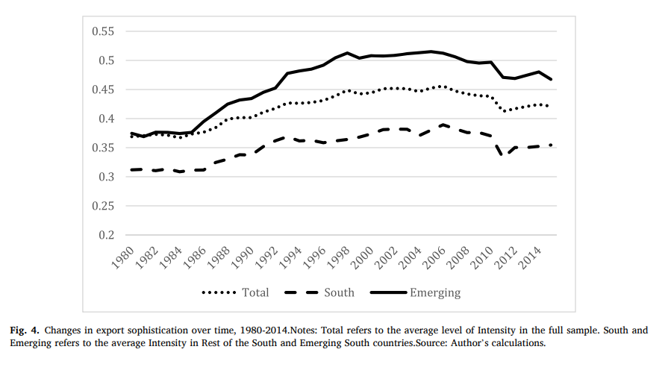
Findings
1) No effect on export sophistication
2) No effect on economic complexity
3) No effect on export diversification

Slide 101
What does this mean?
No robust impact on long term structural parameters
Solution:
  Taken account of them when imposing conditionality
  Pilot project with sophisticated exports and economic complexity conditionality

Slide 102
Questions?

Slide 103

Are the Financial Stability Board bank resolution principles adequate?
Yiorgos Lemos and Georgia Hill

Slide 104
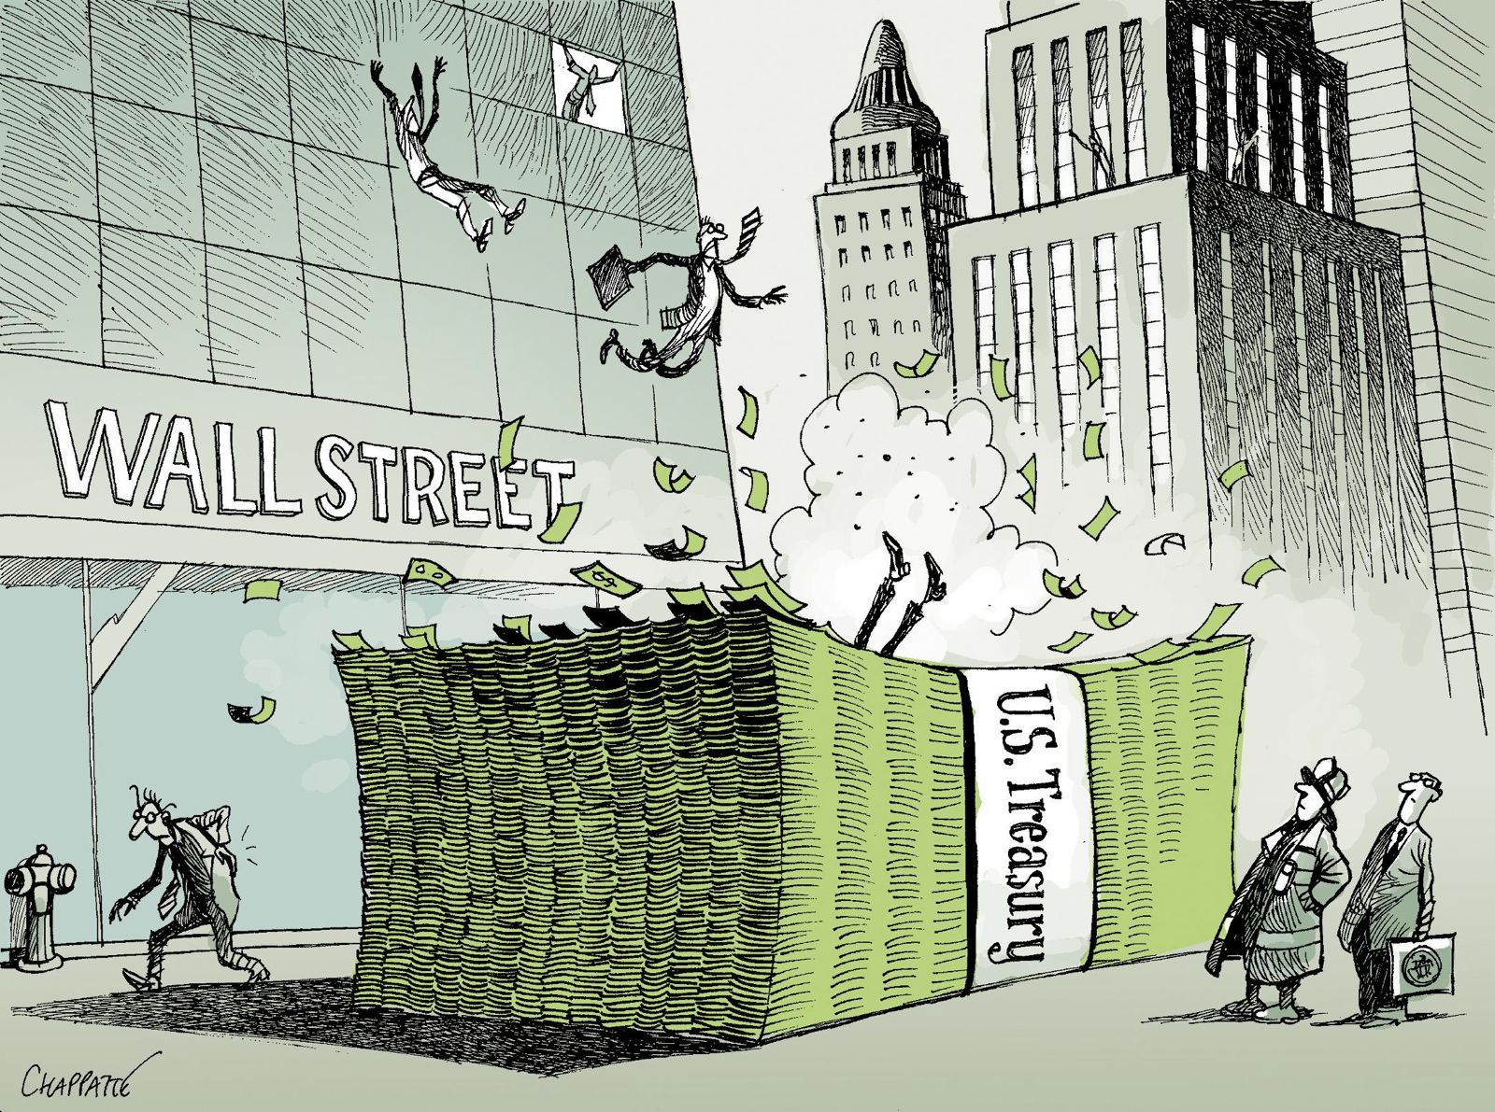
The Post-2008 Paradigm Shift
Regulatory scars left by the 2008 financial crisis
‘Too big to fail’
Disorderly insolvency (Lehman) or taxpayer bailout
Key question: Are these FSB principles actually adequate?
Plan:
  Presentation of toolkit
  Strangths
  Adequacy gap

Slide 105
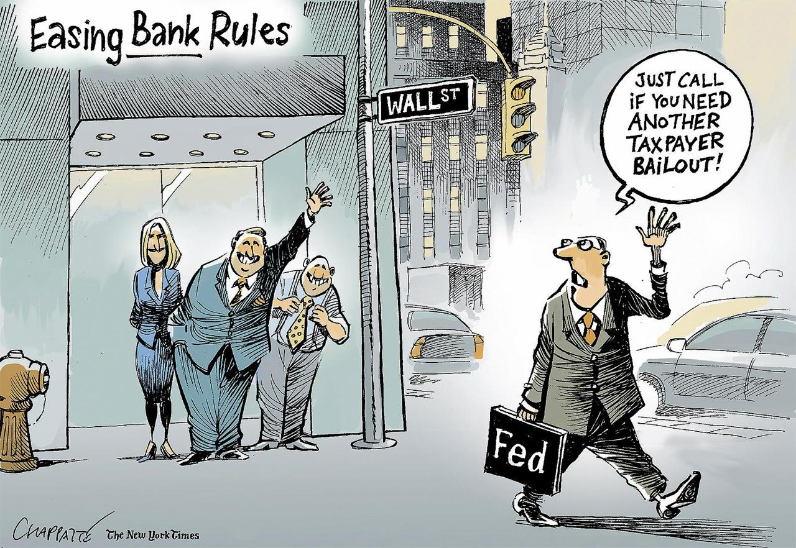
The Core Toolkit
Bail-in Powers
Total loss-absorbing capacity (TLAC)
Resolution Planning
Institutional Mandates

Slide 106


Where the principles succeed
Innovation in cross-border bank failure
Global legal harmonization
‘No Creditor Worse Off’ (NCWO) principle
Stronger market discipline
Shift from taxpayer-funded bailouts
Successful cases:
  SVB UK
  Banco Popular Español

Slide 107
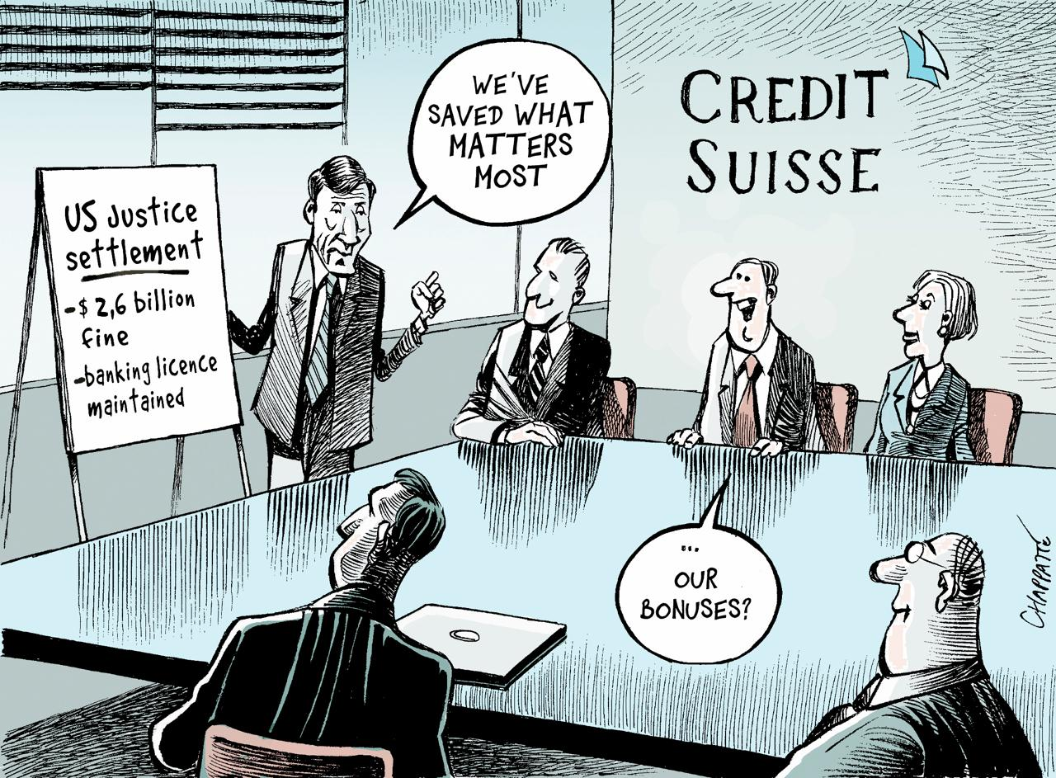
Where the principles fall short
The Liquidity Problem
TLAC Gap
The ’Soft Law’ Trap
Political Reality
A Twitter speed panic:
  Credit Suisse
  SVB Bank

Slide 108
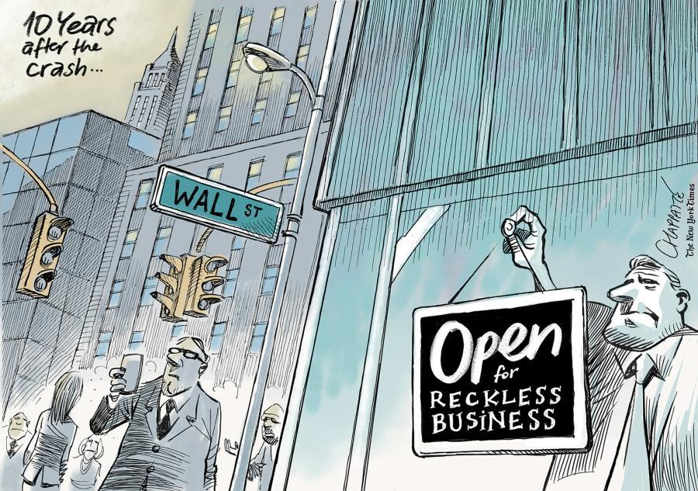
Conclusion
Strong legal foundation post-2008
Reduced taxpayer exposure
Weak under extreme, fast crises
Political reality limits bail-in use
Adequate in theory, incomplete in practice

Slide 109
INTERNATIONAL FINANCIAL LAW
Capital Requirements
BANKS
vs.
Banks vs. Insurance Companies
INSURERS
Regulatory Frameworks, Global Standards & Key Differences
Jack Brennan

Slide 110
WHY CAPITAL REQUIREMENTS MATTER
Capital Requirements
Absorb
Losses
Protect
Policyholders & Depositors
Systemic
Stability
Buffer against unexpected shocks and financial stress
Ensure claims and withdrawals can be met
Prevent contagion and broader financial crises
Capital = financial cushion that protects stakeholders when things go wrong

Slide 111
BANKS: THE BASEL FRAMEWORK
Three Pillars of Basel III
Key Capital Ratios (Basel III)
1
Minimum Capital
Risk-weighted assets; CET1 ≥ 4.5%; Tier 1 ≥ 6%; Total ≥ 8%
2
Supervisory Review
Internal capital assessments (ICAAP); stress tests; supervisory oversight
3
Market Discipline
Disclosure requirements; transparency on risk exposures and capital adequacy

Slide 112
INSURANCE: THE SOLVENCY II FRAMEWORK
Two Capital Requirements
Solvency II — Three Pillars
SCR — Solvency Capital Requirement
1
Quantitative Requirements
• Value-at-Risk at 99.5% confidence over 1 year
• Covers: underwriting, market, credit, operational risk
• Breach triggers supervisory intervention
SCR, MCR, technical provisions, own funds
2
Governance & ORSA
Own Risk and Solvency Assessment; system of governance
MCR — Minimum Capital Requirement
• Hard floor: 25–45% of SCR
• Breach = withdrawal of licence possible
• Absolute minimum floors by licence type
3
Reporting & Disclosure
SFCR (public) and RSR (supervisory) reports

Slide 113
HEAD-TO-HEAD: KEY DIFFERENCES
BANKS (Basel III)
INSURERS (Solvency II)
Risk Focus
Credit & liquidity risk
(run on deposits)
Underwriting & longevity risk
(long-tail liabilities)
Capital Metric
Risk-Weighted Assets (RWA)
& Leverage Ratio
Solvency Capital Requirement
(SCR) via VaR 99.5%
Time Horizon
Shorter-term stress testing
(e.g. 1-year horizon)
Long-term liability matching
(decades for life insurers)
Hard Floor
CET1 ≥ 4.5% of RWA
MCR = 25–45% of SCR
Regulator (EU)
ECB / National Competent
Authority + EBA
National supervisor
+ EIOPA
Global Standard
BCBS (Basel Committee)
IAIS (Insurance Capital
Standard — ICS 2.0)

Slide 114
GLOBAL PICTURE & KEY TAKEAWAYS
Global Dimension
Key Takeaways
BCBS
Both sectors use a 3-pillar model, but risk profiles drive different capital metrics
Sets Basel standards; 45+ member jurisdictions
Banks face liquidity & credit risk; insurers face long-term liability & actuarial risk
IAIS / ICS 2.0
Emerging global standard for insurers; addresses cross-border G-SIIs
Basel III is globally harmonized; insurance regulation is more fragmented (no single global standard yet)
FSB
Coordinates systemic risk; designates G-SIBs & G-SIIs
Regulatory convergence is underway — especially post-2008 and post-COVID stress tests
Convergence Trend
Both sectors moving toward risk-sensitivity & stress testing
Key tension: risk-sensitivity vs. simplicity — more complex models can game the system

Slide 115
The Implementation of Basel III
in Switzerland and the Credit Suisse Crisis
Compliant on paper, fragile in practice.
Francesco Longobardi

Slide 116
PART 1 · CONTEXT
Basel III: the legal backbone
CAPITAL STACK (RWA-based)
THE THREE PILLARS
I
Minimum capital requirements
TLAC
Quantitative rules: CET1, AT1, T2, leverage, LCR/NSFR. Risk-Weighted Assets via Standardised or Internal Models.
T2
AT1 (CoCo)
II
Supervisory review (SREP)
Capital Conservation Buffer — 2.5% always CET1
FINMA's discretion to impose additional requirements based on governance, risk management, business model.
CET1 — 4.5% common shares + retained earnings
III
Market discipline
+ Leverage Ratio (3% Tier 1 / total exposure, risk-insensitive backstop)
+ LCR ≥ 100% (30-day stress) and NSFR ≥ 100% (1 year)
Mandatory disclosure to investors and creditors. Enables external monitoring of the bank's risk profile.
Basel IV (2017, in force CH 1 Jan 2025): output floor 72.5% to limit internal-model RWA reductions.
2 / 7

Slide 117
PART 2 · SWISS IMPLEMENTATION
The Swiss "Finish": stricter than Basel (with caveats)
FROM UBS 2008 TO FINAL BASEL III
2008
2012
2013
2015
2017
2023
2025
UBS bailout
BankG amendment
in force
CAO revised
(Basel III)
Going-concern
LR raised to 5%
FINMA grants
regulatory filter to CS
CS collapse,
UBS merger
Final Basel III
in force
STRICTER THAN BASEL
BUT — RELIEFS UNDER PILLAR 2
TLAC 27.6% RWA (UBS, from 2030) vs DB 24.2% · MS 21.5%
Leverage Ratio 9.6% LR (UBS) vs DB 7% · MS 9.5%
CoCo trigger 7% CET1 (Art. 27 OFR) vs EU 5.125%
Going-concern requirement for G-SIBs: 14.3% RWA + 5% LR
2017 regulatory filter: FINMA allowed CS to value foreign participations as a portfolio, with 10-year phase-in
Parent bank capital: only ~60% backing of foreign subsidiaries' carrying value
Low RWA densities: UBS 22%, CS 25% (Q4 2015) vs international median 35%
3 / 7

Slide 118
PART 3 · THE CRISIS
Credit Suisse: solvent on paper, fragile in reality
STRUCTURAL DECLINE — 2015 to March 2023
THE PARADOX
2017
FINMA grants regulatory filter
Portfolio valuation + 10-year phase-in
Capital ratios always above the regulatory minimum.
2021
Greensill + Archegos losses
USD 15+ bn combined; FINMA enforcement
“Even during the months when it was experiencing its greatest difficulties, Credit Suisse Group's capital ratios were always above the regulatory requirements.”
2022
Deposit run begins
CHF 84 bn net outflow in one quarter
— FDF, Too-big-to-fail factsheet, 2024
2023 (Mar 15)
Saudi NB "absolutely not"
PUK Report, December 2024:
Share price −24%; BNS opens CHF 50 bn line
2023 (Mar 19)
Emergency takeover by UBS
“Without the regulatory filter granted by FINMA in 2017, Credit Suisse would have failed capital adequacy requirements — marginally in 2021, significantly thereafter.”
Art. 5a Notverordnung; AT1 wiped out
Filter judged “inappropriate though legally sound.”
Solvent under Basel III but illiquid, mistrusted, and structurally unable to restructure.
4 / 7

Slide 119
PART 4 · MARCH 2023 WEEKEND
The resolution that wasn't
WHAT THE TBTF FRAMEWORK PRESCRIBED
WHAT ACTUALLY HAPPENED
BankG art. 25–37 + OFR-FINMA
Orderly resolution by FINMA as resolution authority
Single Point of Entry bail-in
Conversion of gone-concern instruments into equity, recapitalisation without taxpayer funds
Predictable creditor hierarchy
Shareholders absorb first; AT1 next; T2 next; senior debt last
Continuity of systemic functions
Without taxpayer bailout, in line with FSB Key Attributes
Notverordnung of 16 March 2023
Federal Council emergency ordinance under Cost. art. 184(3), 185(3)
Art. 5a inserted on 19 March, 8 pm
Empowers FINMA to order write-down of AT1; bypasses shareholder vote (Art. 10a)
State support package
CHF 100 bn SNB liquidity line + CHF 9 bn federal loss guarantee to UBS
Resolution framework not used
Engineered private merger preferred over statutory bail-in (FSB 2023 lessons)
The 2012 resolution framework was bypassed by emergency ordinance — the very ad-hoc state intervention TBTF was designed to prevent.
5 / 7

Slide 120
PART 5 · LOSS ALLOCATION
AT1 bonds: who really pays?
AT1 BONDHOLDERS
CS SHAREHOLDERS
CHF 16 bn
CHF 3 bn
written down to ZERO
in UBS shares (diluted, not wiped out)
Largest single AT1 loss in history (19 March 2023)
Inverted absolute priority rule
FEDERAL ADMINISTRATIVE COURT, 1 OCTOBER 2025 · Case B-2334/2023
FINMA's decree annulled. Art. 5a Notverordnung declared unconstitutional.
Cost. arts. 184(3), 185(3): TBTF framework already governs this area; no genuine emergency gap.
Cost. art. 178(3): Delegation of expropriation requires a formal statute, not an ordinance.
Cost. art. 26 (property guarantee): AT1 are protected property rights; expropriation must be proportional and lawful.
FINMA appealed to the Federal Supreme Court · ~360 cases pending · Five BIT/ICSID arbitrations against Switzerland
Loss allocation decided by emergency decree, and 30 months later, declared unlawful.
6 / 7

Slide 121
CONCLUSIONS
Three lessons and one open question
1
Capital ratios are lagging indicators in confidence-driven runs.
Basel's risk models “failed to take account of systemic risks.” In a digital deposit run, regulatory metrics measure yesterday's solvency, not tomorrow's liquidity.
2
The Swiss Finish was severe in form, undermined by discretion.
Reliefs, granted to CS in 2017, neutralised the severity of Pillar 1. The PUK called the filter “inappropriate though legally sound.” Formal compliance is not substantive resilience.
3
Bank regulation increasingly arbitrates who pays, not whether losses occur.
AT1 holders bore CHF 16.5 bn; shareholders kept CHF 3 bn; the State extended CHF 109 bn in liquidity and guarantees. The absolute priority rule was inverted; the resolution framework was bypassed.
OPEN QUESTION
If solvency is what regulators measure, but confidence is what the market enforces, can Basel III ever be enough?

Slide 122
Are IOSCO Standards Effective in Regulating Capital Markets?
Presenter: Lapo Linossi

Slide 123
International Organization of Securities Commissions (IOSCO)
Protecting investors
Ensuring markets are fair, efficient, and transparent
Reducing systemic risk

Slide 124



The effectiveness of IOSCO:
FSAP Grade, external pressure & compliance
The IMF and World Bank grade national markets using IOSCO principles. A poor grade triggers:
Financial Impact
Expertise Gap
Reputational Pressure

Slide 125

The effectiveness of IOSCO:
MMoU, the engine of enforcement
The 2002 Multilateral Memorandum of Understanding (MMoU) enables cross-border investigative assistance
Operationalizes Cooperation
The Enhanced MMoU (2017)
Global Reach

Slide 126

Framework deficiencies and challenges
Despite its strengths, IOSCO faces significant structural hurdles:
Soft Law Nature
Sovereignty Constraints
Regulatory Arbitrage
Implementation Gap
This Photo by Unknown Author is licensed under CC BY-SA

Slide 127
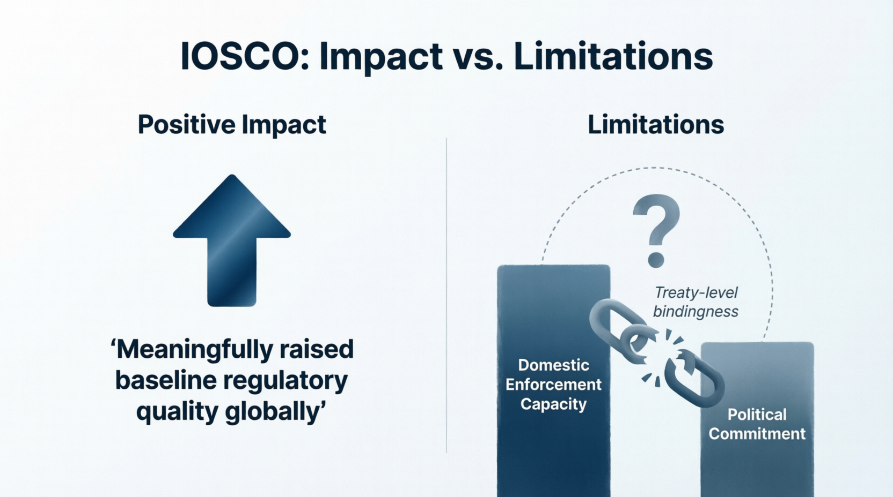
Conclusion: Stability or Veneer?

Slide 128


Is deposit insurance adequate today to address banking risk problems? Discuss SVB case
Presented by : Valeria Marinova UZH
LLM Queen Mary University of London

Slide 129
THE THIRD-LARGEST BANK FAILURE IN THE USA
COLLAPSE : SWIFT & DRAMATIC
STATE AUTHORITIES AND THE FEDERAL DEPOSIT INSURANCE CORPORATION ( FDIC ) PLACED THE BANK INTO RECEIVERSHIP
FDIC TRANSFERRED BANK'S ASSETS TO A BRIDGE BANK
US GOVT ANNOUNCED A BAILOUT GUARANTEEING ALL DEPOSITS
THE BARR REPORT FOLLOWED ASSESSING THE CAUSES OF THE FAILURE AND THE GOVT RESPONSE
BANK CONSIDERED NOT SYSTEMICALLY IMPORTANT , NOT POSING A SYSTEMIC THREAT
A YEAR PRIOR THE COLLAPSE VC FELL SHARPLY DUE TO BROADER PULL BACK IN TECH INVESTMENT DRIVEN BY LOWER INVESTOR RISK APPETITE AS INTEREST RATES ROSE AND FUNDING FOR VENTURE CAPITAL CLIENTS DECREASED , CONCERNS REGARDING ECONOMY SUBSEQUENTLY INCREASED .
HOW DID SVB FINANCIAL GROUP ( THE ACTUAL OWNER OF THE BANK ) INVEST THE DEPOSIT FUNDS ?
THE INVESTMENT WAS IN LONG-TERM UNINSURED SECURITIES . AS INTEREST RATES ROSE AND BOND PRICES FELL ,
SVBFG'S INVESTMENT PORTFOLIO STARTED LOSING VALUE .
SVB CLIENTS OPERATED IN LOW-INTEREST-RATE , HIGH-LIQUIDITY ENVIRONMENT, HENCE THEIR ABILITY TO BORROW DECREASED -OUTFLOW OF DEPOSITS FROM THE BANK , LIQUIDITY CRUNCH OCCURRED .

Slide 130

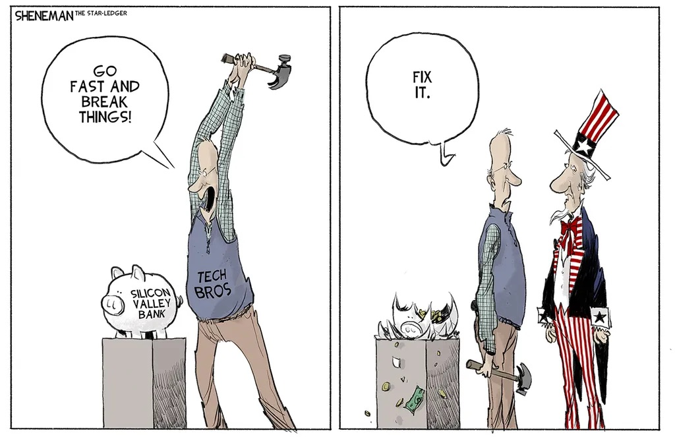
THE PLAN
PLAN WAS TO SELL A BUNDLE OF SECURITIES AT A LOSS OF $ 1.8 B AND OFFER NEW EQUITY OF $ 2.25 B ;
INVESTORS & DEPOSITORS CONSIDERED THIS A SIGN OF FINANCIAL DISTRESS , THE RESULT ? WITHDRAWALS OF $ 40 B ON 9.03.23 PURSUANT TO BARR'S REPORT , WITHDRAWAL OF DEPOSITS HAPPENED IN A COORDINATED MANNER AND UNPRECEDENTED SPEED ;
SOCIAL MEDIA BLAMED FOR THE DIGITAL BANK RUN DISTINGUISHING IT FROM THE 2008 LEHMAN BROTHERS COLLAPSE ;
THE REGULATORY RESPONSE :
AS THE SVBFG'S STOCK PRICE FELL SHARPLY AND THE WITHDRAWAL REQUESTS REACHED $100 B PER DAY , CALIFORNIA DEPARTMENT OF FINANCIAL PROTECTION AND INNOVATION ( THE STATE'S BANK AUTHORITY ) STEPPED IN TO CLOSE THE BANK AND APPOINTED FDIC AS RECEIVER , THE FEDERAL GOVT. ANNOUNCED A RESCUE PLAN TO PROTECT ALL DEPOSITORS ( $ 100 B IN UNINSURED DEPOSITS ) ;
DECISION MADE BETWEEN PRESIDENT BIDEN , THE DEPARTMENT OF THE TREASURY , FEDERAL RESERVE & FDIC ;

Slide 131
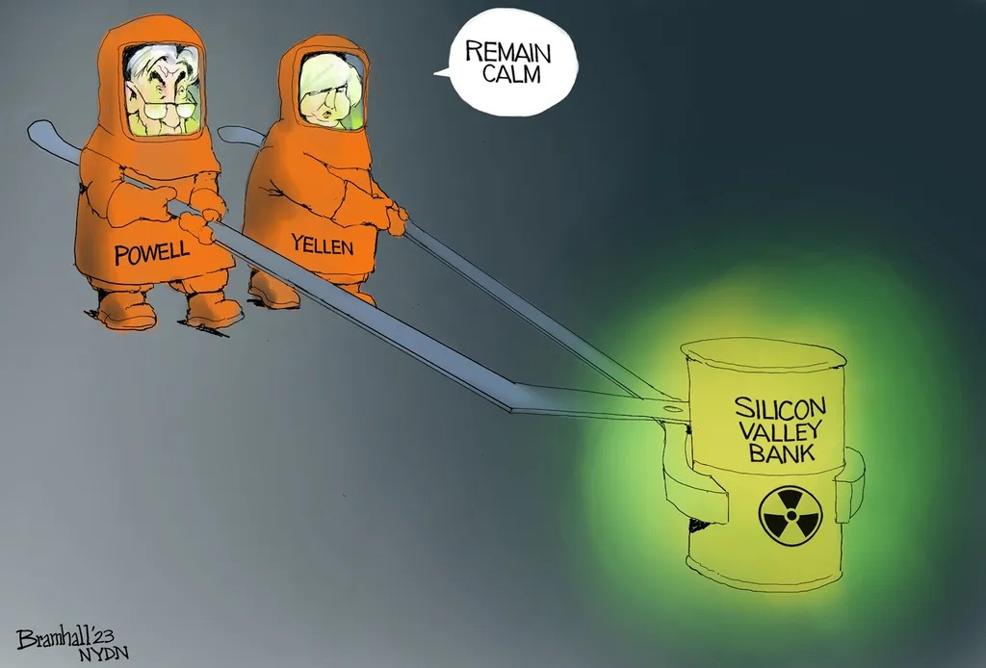
THE LEGAL AUTHORITY
WHAT LEGAL AUTHORITY DID THE GOVT. USE TO IMPLEMENT THE RESCUE PLAN ?
12 US CODE 1823 C – THE DEFAULT RULE IS THAT FDIC CAN ONLY PROVIDE FUNDING , NECESSARY TO MEET THE OBLIGATIONS FOR INSURED DEPOSITORS .
FDIC AUTHORITY TO BE EXERCISED THE LEAST COSTLY WAY . THE STATUTE ADDS THAT FDIC CANNOT TAKE ACTIONS 'PROTECTING DEPOSITORS FOR MORE THAN THE INSURED PORTIONS OF THE DEPOSITS ' .
THE SYSTEMIC RISK EXCEPTION THAT ACTUALLY SWALLOWS THE RULE ?
SECTION 1823 ( C ) ( 4 ) ( G ) ASSISTANCE BEYOND THE INSURANCE LIMITATIONS , IF ASSISTANCE WITHIN THE LIMITATIONS COULD POTENTIALLY CAUSE SERIOUS ADVERSE EFFECTS ON ECONOMIC AND FINANCIAL STABILITY , THE ALTERNATIVE ASSISTANCE DEEMED PREFERABLE
Type to enter a caption.

Slide 132

CRITICISM
FLOODGATES , GOVERNMENT – SPONSORED FULL DEPOSITORS RESCUE PLANS FOR LARGE BANKS ;
THE EXPECTATION TO RECEIVE THE SAME PROTECTION IN THE FUTURE AS ALREADY SET PRECEDENT
BANKS HAVE NO INCENTIVE TO COMPETE OVER STABILITY ;
DEPOSITORS HAVE NO INCENTIVE TO MONITOR THEIR BANK'S RISK PROFILE AND LIQUIDITY ;
FULL PROTECTION BY THE GOVERNMENT MEANS NO DISCIPLINE ON THE BANKS ;
THE MORAL HAZARD – THE BANK BAILOUTS ;
BANKS OPERATING OUTSIDE THE RULES OF THE MARKET ECONOMY
MY TAKE : HIGH CAP ON UNINSURED DEPOSITORS TO PREVENT BANK RUNS OTHERWISE THEY ARE AT MERCY OF THE GOVERNMENT OR BECOME UNSECURED CREDITORS
MACRO-ECONOMIC CONSIDERATIONS WHEN REGULATORS DECIDE WHETHER IT IS REALLY URGENT TO INVOKE THE SRE
Type to enter a caption.

