Slide 1



The rationale for bank capital regulation and Basel III
International Financial Law | Extra credit presentation
Lina De Crop
Topic No. 1
Prof. Dr. iur. Kern Alexander

Slide 2


Why do we regulate banks? (The rationale)
1. Asymmetric information: Banks know much more about their investments than the people who give them money (depositors/investors).
•
If a bank takes huge risks, we often don't realize it until it's too late.
•
Regulation forces banks to be transparent and maintain a "safety net."
2. Negative externalities & systemic risk: Unlike a normal business, if a big bank fails, it doesn't just hurt its owners/shareholders.
•
It causes Contagion: A defaulting bank fails to repay loans to other banks (domino effect), depositors lose their confidence in healthy banks leading to bank runs, and the whole economy can crash.
•
The "social cost" of a bank failure is much higher than the "private cost."

Slide 3


What is “bank capital” exactly?
Think of capital as a Cushion. It is the money provided by the bank's owners (equity), not borrowed money (debt).
The basic equation:
Capital
If a bank makes a loss on a loan, that loss is deducted from capital first.
Assets: Loans given out
Liabilities: Customer deposits / Debt
Capital: Owners' equity
As long as the bank has capital, it can stay open even if some loans go bad.
If capital runs out, the bank is insolvent and must close.

Slide 4


The Basel III “Rulebook”
Basel III was created after the 2008 Financial Crisis because banks didn't have enough high-quality capital to survive the shock.
Main goals:
Why international?
•
Improve the Quality of capital (more common stock, less complex debt).
To ensure a Level Playing Field. If one country has weak rules, its banks might take more risks to get higher profits, which endangers everyone else.
•
Increase the Quantity of capital (higher ratios).
•
Introduce Liquidity rules (ensuring banks have cash ready for a crisis).

Slide 5
How is the Capital Ratio calculated?
We don't just look at total assets. We look at Risk-Weighted Assets (RWA). Not all assets are equally dangerous.
Asset Type | Risk Weight | Reasoning
Cash / Government bonds | 0% | Basically zero risk of not being paid back.
Residential mortgages | 35% - 75% | Lower risk because there is a house as collateral.
Corporate loans | 100% | Standard risk for lending to companies.

Slide 6




Basel’s Three Pillar Approach
Pillar 1
Pillar 2
Pillar 3
Minimum Capital
Supervisory Review
Market Discipline
The math: How much capital MUST you hold for credit, market, and operational risks?
Regulators check the bank's internal models and can tell them: "Your math is wrong, hold more!"
Banks must publish their risks so that investors and the public can judge them.

Slide 7



New Tools in Basel III
Capital is not enough. You can have capital but still run out of Cash. Basel III added:
1. Liquidity Coverage Ratio (LCR): Banks must hold enough "High-Quality Liquid Assets" (cash/bonds) to survive a 30-day bank run.
2. Leverage Ratio: A simple "backstop." It ignores the RWA math and says: your total debt can't be more than 33x your capital (Minimum 3% Tier 1 Capital).
3. Capital Buffers: In good times, banks must save extra capital so they can use it during bad times (Capital Conservation Buffer).

Slide 8

Summary: Why this matters for us
•
Banks are naturally fragile because they borrow short and lend long.
Secretary General of the Basel Committee on Banking Supervision :
“Global financial stability is a public good: the full benefits of Basel III can only be locked in if all members implement these reforms.”
•
Regulation is not meant to stop all failures, but to ensure the financial system stays alive.
•
Basel III is the global standard, making banks more resilient than in 2008.
Thank you!
Prof. Dr. iur. Kern Alexander

Slide 9
Topic No. 1
The rationale for bank capital regulation and Basel III
Natalia Hane

Slide 10
Outline
Introduction
Bank capital definition
Rationale development
Basel III
Conclusion

Slide 11
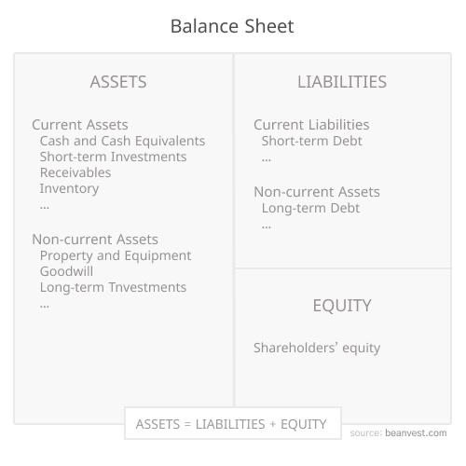
Bank capital
- is a bank’s own loss-absorbing funds (equity, retained earnings and capital reserves)
The conventional role of capital is to ensure the survival of business enterprises when they
encounter unexpected losses.
Source: https://beanvest.com/definition/balance-sheet?utm_source=chatgpt.com

Slide 12
The Rationale for Bank Capital Regulation
To ensure a loss-absorption buffer
To protect depositors and creditors
To reduce moral hazard
After 2008: macroprudential control of systemic risk

Slide 13
Basel III as a regulatory response
Stronger capital
Leverage ratio
Capital conservation and countercyclical buffers
Extra capital for systemically important banks
Liquidity resilience: LCR and NSFR

Slide 14
Conclusion
“Basel III expands the role for regulatory capital to be concerned not only with micro-prudential balance sheet risks of individual banks but also with the risks posed by banks to the broader financial system”.
— Kern Alexander, Principles of Banking Regulation, p. 118

Slide 15
Thank you
Natalia Hane
International and Comparative Law
natalia.hane@uzh.ch

Slide 16

INTERNATIONAL FINANCIAL LAW
Regulatory Issues
Regarding Stablecoins
The international regulatory response to private digital money
Sultan Dukaev | University of Zurich | 2026
Notes:
Good morning. The topic of today's presentation is the regulation of stablecoins under international financial law. My core thesis is that stablecoins are a stress test for the international regulatory architecture: a borderless private payment instrument that can only be governed through coordinated standards from the FSB, the Basel Committee and IOSCO, implemented through divergent domestic regimes — primarily MiCA, the GENIUS Act, and the Swiss DLT Act. I will move through the legal taxonomy, the four core regulatory issues, the EU-US divergence, the international response, the Swiss approach, and a brief conclusion.
— BACKGROUND —
Market context for Q&A: stablecoin sector is ~$280B market cap, 99% USD-pegged, $390B payment volume in 2025. Tether (USDT) and Circle (USDC) dominate. The biggest issuers now hold more US Treasuries than several G20 countries — a fact you can deploy if a question goes to systemic significance.
Why this is an IFL question and not a crypto question: stablecoins are functionally money, used cross-border, regulated by no single jurisdiction. That triggers the classic IFL coordination problem the FSB was designed to address.
If you have to cut for time: drop the structural preview ("I will move through…"). Just announce the thesis and start.

Slide 17


What is a stablecoin?
Working definition and the MiCA legal taxonomy
Definition. A crypto-asset that aims to maintain a stable value by reference to one or several official currencies, commodities, or other crypto-assets that are typically backed by reserves held by the issuer.
E-Money Tokens
Asset-Referenced Tokens
MiCA Title IV · Art. 48 et seq.
MiCA Title III · Art. 16 et seq.
Pegged to a single official currency (e.g. USDC, EURC). Legally treated as electronic money under EMD2. Holders have an unconditional right of redemption at par, in fiat.
Pegged to a basket of currencies, commodities, or crypto-assets (e.g. PAX Gold). Heavier prudential regime, including own-funds and reserve composition requirements.
Algorithmic stablecoins (e.g. former TerraUSD) fall outside both categories and are effectively prohibited under MiCA.
Notes:
The legal foundation is MiCA — Regulation 2023/1114. The word “stablecoin” itself does not appear in the operative provisions; MiCA splits these instruments into two categories. E-Money Tokens, governed by Title IV from Article 48, are pegged to a single official currency. USDC and EURC are the typical examples; the holder has an unconditional right to redeem at par in fiat. Asset-Referenced Tokens, governed by Title III from Article 16, are pegged to a basket — currencies, commodities, or crypto-assets. PAX Gold is the textbook example. Algorithmic stablecoins like the collapsed TerraUSD fall outside both categories and are effectively prohibited in the EU.
— BACKGROUND —
EMTs are legally electronic money under EMD2 (Directive 2009/110/EC). Issuers must already be a credit institution or an EMI — not a new licence category. The redemption-at-par right is the central consumer protection.
ARTs have a heavier prudential regime: own-funds requirement (greater of €350,000, 2% of average reserve assets, or quarter of fixed overheads), governance requirements, and detailed reserve-composition rules.
TerraUSD collapsed May 2022, $40B+ wiped out in days — this is the named cautionary tale every examiner expects you to know. The peg was maintained algorithmically against LUNA rather than by reserves; when the death spiral started, there was nothing to redeem against.
If asked why MiCA splits the categories: different risk profiles. EMTs are essentially digital fiat, so the existing e-money framework can be adapted. ARTs are closer to investment products and need bespoke prudential rules.

Slide 18




Four core regulatory issues
The cross-border challenges that drive the international regulatory response
01
Financial stability
02
Regulatory perimeter
A run on a systemically important issuer could trigger fire-sales of its US Treasury reserves, transmitting stress into sovereign bond and bank funding markets — a textbook FSB systemic-risk concern.
Stablecoins do not map cleanly onto existing categories — money, e-money, security, or commodity. The result is jurisdiction shopping and an uneven international playing field that the FSB's October 2020 high-level recommendations were designed to correct.
03
Consumer protection
04
AML / CFT and sanctions
Reserve composition, redemption rights, custody segregation and disclosure obligations engage the IOSCO investor-protection objectives that have driven securities regulation since the 1980s.
Borderless transferability puts the FATF Travel Rule, KYC standards and sanctions enforcement under pressure — with non-EU issuers operating outside any single jurisdiction's reach.
Notes:
The four issues on this slide are the substantive drivers of the international response. First, financial stability — a run on a major issuer would force fire-sales of its US Treasury reserves, transmitting stress into sovereign bond markets. This is a textbook FSB systemic-risk concern. Second, regulatory perimeter — stablecoins do not map cleanly onto money, e-money, security, or commodity, which produces jurisdiction shopping. Third, consumer and investor protection — reserve composition, redemption rights, and disclosure are core IOSCO concerns. Fourth, AML, CFT and sanctions — borderless transferability puts the FATF Travel Rule under pressure. Each of these issues, on its own, justifies coordinated regulatory intervention.
— BACKGROUND —
The fifth issue (held in reserve): monetary sovereignty / dollarisation. If USD-pegged stablecoins are used as a unit of account inside the euro area, the ECB progressively loses control over monetary conditions. The ECB has explicitly warned of this in recent Financial Stability Reviews. Don't volunteer this — it's central-banking territory and not the IFL frame — but if a question goes there, you have it.
On financial stability — the precise scenario is: confidence event → mass redemption requests → issuer must liquidate billions in T-bills in days → fire-sale dynamics propagate into sovereign bond markets and bank funding costs. This is exactly the scenario the BCBS Group 1b classification and FSB recommendations are designed to address.
On consumer protection — MiCA's specific tools are the white paper requirement, segregation of reserves from issuer assets, custody rules for the reserve, and the unconditional redemption right. These map directly onto the IOSCO Objectives and Principles of Securities Regulation.
On AML/CFT — the FATF Travel Rule (Recommendation 16) requires originator and beneficiary information to travel with transfers above $1,000. Pseudonymous on-chain transfers and self-custody wallets make this structurally hard to enforce.
If running short: drop the AML/CFT line and just say "and AML, sanctions, and Travel Rule concerns round out the set." That saves ~10 seconds.

Slide 19
A divergence of philosophies
MiCA (EU) vs. the GENIUS Act (US, July 2025)
Issue | European Union (MiCA) | United States (GENIUS Act)
Logic | Defensive — close the regulatory perimeter | Offensive — entrench the dollar globally
Issuer status | Credit institution or EMI required | Bank or licensed non-bank payment issuer
Reserves | 1:1 in liquid assets; bank deposits component | 1:1 in cash, T-bills, repos, Fed credits
Interest to holders | Prohibited | Prohibited
Redemption | At par, unconditional | At par; monthly attested
Foreign issuers | Authorisation required to access EU market | Equivalence/reciprocity regime
Both frameworks converge on reserves and redemption — they diverge sharply on whether stablecoins should expand or be contained.
Notes:
To understand what is distinctive about MiCA, it helps to compare it to the American approach. In July 2025, the United States enacted the GENIUS Act — the first federal stablecoin law. The two frameworks share a technical core, one-for-one reserves, redemption at par, and a prohibition on paying interest, but rest on opposite policy logics. MiCA is defensive: it closes the regulatory perimeter against foreign private money in the euro area. The GENIUS Act is offensive: the official US position is that a regulated dollar-stablecoin market entrenches the global role of the dollar by creating new demand for Treasuries. The takeaway is the IFL pattern this captures: convergence on technical mechanics, divergence on policy.
— BACKGROUND —
GENIUS Act = Guiding and Establishing National Innovation for U.S. Stablecoins Act. Signed July 2025. First federal stablecoin law; before it, US regulation was a patchwork of state money-transmitter regimes (notably New York's BitLicense for issuers like Paxos).
Issuer status: MiCA requires credit institution or EMI authorisation. GENIUS Act allows a federally-chartered bank or a licensed non-bank payment stablecoin issuer (a new category, supervised by the OCC).
Reserves: MiCA requires liquid low-risk assets including a meaningful share in bank deposits. GENIUS allows cash, T-bills (≤93 days), repos collateralised by Treasuries, and Federal Reserve credit balances. Federal Reserve credit balance access is the geopolitically loaded element — it ties the dollar stablecoin to the Fed's balance sheet.
Foreign issuers: this is the divergence with the most IFL bite. MiCA requires authorisation for any issuer offering tokens in the EU — extraterritorial. GENIUS operates an equivalence/reciprocity regime, more permissive. This asymmetry is exactly what's been driving Tether's exit from the EU market.
Strongest single fact for Q&A: Tether (USDT) refused MiCA authorisation and was delisted from major EU exchanges in 2025. Circle (USDC + EURC) became the first global issuer to be MiCA-compliant. By early 2026, ~14 issuers authorised across 7 Member States.

Slide 20
THE INTERNATIONAL REGULATORY RESPONSE
Three pillars of the global standard-setting response
How the FSB, BCBS and IOSCO have built a coordinated regulatory framework
01
02
03
FSB recommendations
BCBS prudential treatment
IOSCO recommendations
The FSB's High-Level Recommendations on Global Stablecoin Arrangements (October 2020, revised July 2023) operationalise the “same activity, same risk, same regulation” principle — the cornerstone of cross-border consistency.
The BCBS Standard on the Prudential Treatment of Cryptoasset Exposures (December 2022, in force January 2025) classifies stablecoins as Group 1b and imposes a capital add-on, plus a 1% exposure limit relative to Tier 1 capital.
IOSCO's November 2023 Policy Recommendations for Crypto and Digital Asset Markets address conflicts of interest, market manipulation and custody — bringing stablecoins under the discipline of international securities regulation.
FSB High-Level Recommendations (revised July 2023) · BCBS SCO60 (December 2022) · IOSCO Policy Recommendations (November 2023)
Notes:
This is the heart of the IFL story: the international regulatory response, built on three pillars. First, the FSB's High-Level Recommendations on Global Stablecoin Arrangements (October 2020, revised July 2023) operationalise the “same activity, same risk, same regulation” principle — the cornerstone of cross-border consistency. Second, the Basel Committee's Standard on the Prudential Treatment of Cryptoasset Exposures (December 2022, in force January 2025) classifies compliant stablecoins as Group 1b at standard risk weights, while non-compliant cryptoassets fall into Group 2 with a punitive 1250 percent risk weight and a one percent Tier 1 exposure cap. Third, IOSCO's November 2023 Policy Recommendations bring stablecoins under the discipline of international securities regulation — addressing market manipulation, conflicts of interest, and custody.
— BACKGROUND —
FSB recommendations are soft law — non-binding, but operate through peer review and FSB membership pressure. The October 2020 version was triggered by Facebook's Libra/Diem proposal. The July 2023 revision tightened the redemption-at-par and reserve-segregation expectations. The FSB's October 2025 peer review found significant implementation gaps.
BCBS Standard SCO60. Two-group taxonomy. Group 1: tokenised traditional assets and stablecoins meeting the redemption test → existing Basel risk weights (Group 1a tokenised, Group 1b stablecoin). Group 2: everything else (most cryptoassets, including those failing the redemption test) → punitive 1250% risk weight. The 1% Tier 1 exposure limit applies to Group 2 — that's the figure to know precisely.
IOSCO recommendations cover: (1) conflicts of interest from vertically integrated activities; (2) market manipulation, insider dealing, and fraud; (3) cross-border risks and regulatory cooperation; (4) custody and client asset protection; (5) operational and technological risk; (6) retail access and disclosure. Companion DeFi recommendations published December 2023.
The "same activity, same risk, same regulation" principle is the FSB's organising frame — it answers the categorisation question by saying the legal label doesn't matter, the economic function does. This is the principle that justifies treating EMTs as e-money, ARTs as quasi-investment products, and DeFi protocols as the activities they actually perform.
If a question asks "is FSB law?": no, it's soft law / standards. But via the G20 endorsement chain and FSB peer review, it becomes effectively binding on members. This is the standard IFL story — Basel I-IV is the most famous example.

Slide 21

The Swiss approach
A third comparator alongside MiCA and the GENIUS Act — and a window into Switzerland's third-country position
The DLT Act (2021)
Third-country position
Activity-based regulation.
Switzerland amended ten federal acts (FinSA, FinIA, FMIA, BankA, AMLA et al.) to cover DLT-based assets and create the new DLT trading venue licence — without dedicated stablecoin legislation.
FINMA stablecoin guidance.
FINMA's Guidance 06/2024 treats stablecoin issuance as a deposit-taking activity requiring either a banking or fintech licence — a fundamentally activity-based response, in contrast to MiCA's instrument-based regime.
No equivalence regime.
Switzerland is treated as a third country under MiCA. Swiss issuers must obtain authorisation in a Member State to access the EU market — there is currently no equivalence finding for the Swiss regime.
Why it matters.
The activity-based Swiss model and the instrument-based EU model coexist without mutual recognition — a microcosm of the broader IFL coordination problem the FSB is trying to bridge.
Notes:
Switzerland gives us a third comparator and shows the home-host coordination problem in concrete form. Switzerland has not adopted dedicated stablecoin legislation. The DLT Act of 2021 amended ten federal statutes — including FinSA, FinIA, FMIA, the Banking Act and AMLA — to bring DLT-based assets within existing law, and created a new DLT trading venue licence. FINMA's Guidance 06/2024 then treated stablecoin issuance as deposit-taking, requiring a banking or fintech licence. The contrast with MiCA is fundamental: Switzerland regulates the activity, the EU regulates the instrument. With no equivalence finding, Swiss issuers must obtain authorisation in a Member State to access the EU market.
— BACKGROUND —
The DLT Act's full name: Federal Act on the Adaptation of Federal Law to Developments in Distributed Ledger Technology, in force since 1 August 2021. The drafting choice was deliberate: rather than create a "crypto code," Switzerland chose to retrofit existing financial law. This is the Swiss IFL signature — incremental, technology-neutral, activity-based.
Key DLT Act changes: (1) new register-uncertificated security in the Code of Obligations (Art. 973d et seq.) — gives tokenised assets civil-law recognition; (2) DLT trading facility licence in FMIA (Art. 73a-f) — a new venue category alongside exchanges, MTFs and OTFs; (3) segregation of crypto-assets in Banking Act insolvency provisions; (4) AMLA expanded to cover DLT-based payment tokens.
FINMA Guidance 06/2024: stablecoin issuance is functionally deposit-taking under Art. 1 BankA, so the issuer needs a banking licence — or, if turnover stays below thresholds, the lighter fintech licence (Art. 1b BankA, max CHF 100m public deposits, no interest paid). This activity-based reasoning is the most striking IFL contrast: where MiCA invented new instrument categories (EMT/ART), FINMA simply applied existing deposit-taking rules.
Equivalence: MiCA Art. 17(1) requires non-EU issuers to obtain authorisation in a Member State. There is no Swiss equivalence finding. So a Swiss-licensed stablecoin issuer cannot rely on FINMA authorisation to access the EU — it must license separately under MiCA. This is the cross-border friction point.
If asked "why didn't Switzerland adopt MiCA-style legislation?": Swiss financial regulation has long been activity-based and technology-neutral, the DLT Act represents the application of that philosophy. Also, Switzerland's regulatory tradition rewards principles-based supervision over rule-based prescription.
If running short on this slide: drop the FinSA/FinIA/FMIA/BankA/AMLA list and just say "ten federal statutes including the Banking Act."

Slide 22
CONCLUSION
Stablecoins are a stress test for
international financial law.
A borderless private payment instrument can only be regulated through coordinated international standards — the FSB recommendations, BCBS prudential treatment and IOSCO investor-protection rules — implemented through divergent domestic regimes (MiCA, the GENIUS Act, the Swiss DLT Act). The result is a familiar IFL pattern: convergence on principles, divergence on instruments, and persistent gaps in cross-border enforcement.
Thank you · Questions welcome
Notes:
To close. Stablecoins are a stress test for international financial law. A borderless private payment instrument can only be regulated through coordinated international standards — the FSB recommendations, the BCBS prudential treatment, and IOSCO's investor-protection rules — implemented through divergent domestic regimes: MiCA, the GENIUS Act, the Swiss DLT Act. The result is a familiar IFL pattern: convergence on principles, divergence on instruments, persistent gaps in cross-border enforcement. Thank you for your attention. I am happy to take questions.
— BACKGROUND —
Likely Q&A topics and your fallback answers:
(1) Decentralised stablecoins (DAI, etc.). MiCA's category-based architecture presupposes an identifiable issuer. DAI sits uneasily in this framework. The current EU position is that the practical controllers of the protocol — the foundation, the governance token holders — may be treated as the issuer. This is unsettled and one of the most interesting open questions.
(2) Extraterritoriality and Tether. MiCA binds issuers offering tokens in the EU, but USDT continues to circulate via non-EU exchanges and self-custody wallets. Enforcement is structurally porous. This is the strongest single example of the cross-border problem.
(3) Cross-border resolution. The FSB Key Attributes were designed for banks. Whether they can be adapted to a failing global stablecoin issuer — and how home and host authorities would coordinate — is untested. Connect to Lecture 4-5 on bank resolution.
(4) Lender of last resort. Should the ECB or any central bank stand behind a private stablecoin issuer in distress? Current doctrine says no. But a systemic euro-denominated stablecoin would test that position. Same logic as the historical SIFI/G-SIB debate.
(5) Digital euro. If asked about CBDCs: the EU's response has two tracks — defensive (MiCA constrains private stablecoins) and offensive (the digital euro provides a public alternative). Project Appia (March 2026) extends this to wholesale by tokenising central-bank money for settlement of tokenised assets.
(6) "Same activity, same risk, same regulation." If asked to defend or critique the principle: defence — it answers the categorisation question by looking at function, not legal label. Critique — the principle is hard to apply to genuinely novel structures (decentralised protocols, tokenised reserves) where no existing activity-template fits cleanly.
(7) FATF Travel Rule. Recommendation 16: originator and beneficiary information must travel with virtual asset transfers above $1,000 / €1,000. Implementation uneven across jurisdictions; non-custodial wallets remain the structural blind spot.
If you finish under time: don't pad. Just stop. Examiners reward concision. The closing line is your strongest framing — let it land.

Slide 23

Faculty of Law
Basel III reforms on liquidity risks
  International financial law
  Youssra Fnighri
  22nd May 2026

Slide 24
Over​view
Meaning of Basel III
2. Types of liquidity risks
3. Liquidity standards
4. Regulatory Framework
Conclusion

Slide 25
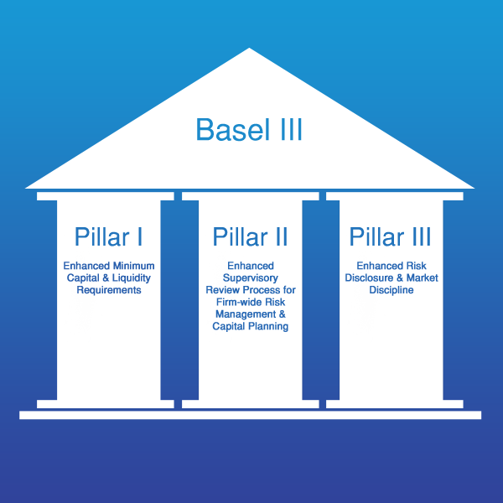
What is Basel III
Adopted after the 2008 Global Financial Crisis
Global regulatory standard on
Shift from solvency-only → liquidity + solvency
Why Liquidity regulation?
Pre-crisis focus: capital adequacy (Basel II)
Crisis revealed: liquidity failures of solvent banks
Bank runs and funding freezes
Need for short-term survival + long-term stability

Slide 26
Types of Liquidity risk
Funding liquidity risk
Market liquidity risk
Inability to meet obligations when due
Difficulty selling assets quickly

Slide 27
Liquidity Standards
Liquidity Coverage Ratio (LCR)
The LCR is a response from Basel committee to the recent financial crisis. The LCR proposal requires banks to hold high quality liquid asset in order to survive in emergent stress scenario.
" If a crisis hits tomorrow and money starts flowing out, can the bank survive for at least one month without collapsing"
LCR is the answer to this question
LCR = Liquid Assets / Net Cash Outflows ≥ 100%
HQLA
Net Stable Funding Ratio (NSFR)
NSFR ensures that a bank doesn’t rely on unstable or short-term funding to finance long term or illiquid assets.
"Is the bank funded in a sustainable way over time ?"
Stable funding ≥ Required funding (over 1 year)
Situation before 2008 ?
NFSR
Available Stable Funding
Easily convertible into cash
Reliable in stress market
Required Stable Funding
Level 1
Level 2

Slide 28

Regulatory Framework
How is liquidity risk embedded into a complete regulatory and supervisory system ?
Basel III Governance responsibility
Banks must define liquidity risk appetite
Monitor cash inflows and outflows
Diversify funding resources
Banks are required to anticipate crisis
How ?
Stress Testing + Contingency funding Plans (CFPs)
However,
Basel III is not a binding law = International Standard
In EU, it becomes legally enforceable through,
Capital Requirement Regulation (CRR)
Capital requirement directive (CRD)

Slide 29
Conclusion
Basel III : LCR + NSFR
Quantitative ratios + Qualitative Supervision
Bank resilience and systemic stability
EU Enforcement via CRR and CDR
Limits ?

Slide 30
The
Taxonomy
Trap
GREEN
Sustainable Finance & International Regulation
?
International Financial Law · University of Zurich · 2026 – Jade Bourdon

Slide 31
$5T+
Everything depends
on the definition.
green investment needed / year
IEA, 2023
40+
competing green taxonomy frameworks
Who decides what
counts as 'green'?
IPSF, 2024
0
fully interoperable global standards
as of 2026
The taxonomy IS the regulation.
01

Slide 32
Same asset. Four verdicts.
Natural gas power plant — how each major framework classifies it:
EU
CN
US
INT
EU Taxonomy
China Green Bond Catalogue
US SEC Climate Rules
IPSF Common Ground
TRANSITIONAL
GREEN
NO TAXONOMY
~80% OVERLAP
Gas included until 2030
Gas classified as green
No asset classification
EU–China comparison exercise
Below 270g CO₂/kWh threshold
Clean coal was green until 2021
Disclosure-only approach
20% gap = gas, nuclear, agriculture
Added after intense lobbying
Growth objectives dominate
Rules challenged in courts
Most contested assets excluded
02

Slide 33
Fragmentation has consequences.
01 Greenwashing
02 Regulatory Arbitrage
Issuers choose the most permissive framework
Banks exploit gaps between frameworks
A green label ≠ a green asset
'Transitional' in EU = 'green' elsewhere
ESMA (2023): 40% of ESG funds mislabelled
Same dynamic as pre-2008 structured finance
03

Slide 34
Why can't they agree?
Taxonomy decisions are industrial policy dressed as technical standards.
The nuclear fault line
The gas fault line
The agriculture fault line
France insisted → included
Eastern EU pushed for inclusion
Brazil & Indonesia refused limits
Germany refused → compromise
Gas = coal exit ramp for Poland
Development vs. conservation clash
Result: credibility damaged
EU taxonomy undermined at launch
Green protectionism by another name
04

Slide 35
Three institutional proposals
Three international institutions have each proposed a distinct path forward.
Interoperability over harmonisation
I
IPSF, 2021
Map frameworks against each other
IPSF Common Ground Taxonomy → expand EU–China to G20
No forced single standard
Transition plans over static labels
II
ISSB / IFRS S2, 2023
Require credible decarbonisation roadmaps
Trajectories, not today's snapshot
36+ jurisdictions adopting IFRS S2
Basel Pillar 2 as the anchor
III
NGFS, 2020
Embed climate risk via supervisory review
Capital surcharges — no Pillar 1 rewrite
Common NGFS scenarios across jurisdictions
05

Slide 36
Not a technical problem.
A political one.
Fragmented definitions → greenwashing + arbitrage
Three institutions already point the way: IPSF · ISSB · NGFS
Political compromise is the only real fix
Thank you · International Financial Law · University of Zurich · 2026

Slide 37

Law Faculty
The implementation of Basel III in
Switzerland and Credit Suisse crisis
Gulnara Aleeva, Topic No. 8

Slide 38
Law Faculty
Crisis 2008 and its consequences
Crisis of 2008
Basel III set of measures
Implementation of measures in Switzerland
Basel III Final implementation
Credit Suisse crisis
Too-big-to-fail approach
Higher CET1 capital requirements
Capital conservation buffers
Leverage ratio requirements
Liquidity standards: LCR and NSFR
Risk diversification
Supervisory stress testing and recovery planning
Stricter Swiss implementation for systemic banks
Capital Adequacy Ordinance (CAO) and FINMA ordinances
Operational risk approach was replaced with the Standardized Measurement Approach (SMA)
Revised risk-weighted asset (RWA) calculations
Output floor (72.5%)
New regulatory reporting and disclosure standards
  Gulnara Aleeva / International Financial Law, 2026
4
2

Slide 39
Law Faculty
Why Basel III Was Not Enough?
  Gulnara Aleeva / International Financial Law, 2026
3

Slide 40


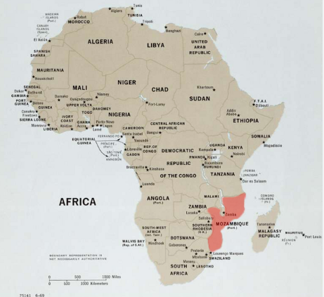
Law Faculty
Credit Suisse Before the Crisis
Major scandals and failures
Archegos Capital collapse (2021) - USD 5.5 billion loss
Greensill Capital scandal (2021)
-Frozen investment funds
-Client losses
Mozambique “tuna bond” scandal
- Corruption and hidden debt
Surveillance scandal (2019)
- Illegal spying on former executives
  Gulnara Aleeva / International Financial Law, 2026
4

Slide 41
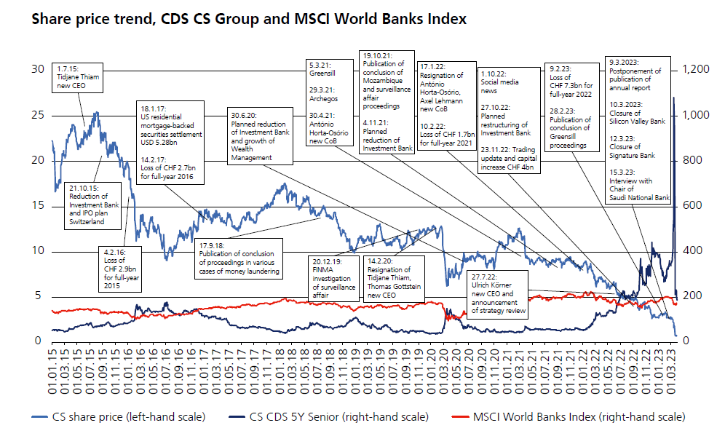
Law Faculty
Credit Suisse formally met:
But the bank still faced:
Capital requirements
Liquidity requirements
BUT
Credit Suisse still faced:
Loss of market confidence
Massive deposit withdrawals
Digital bank run
Falling share price
Liquidity crisis
  Gulnara Aleeva / International Financial Law, 2026
5

Slide 42
Law Faculty
Swiss Government and FINMA Response
What happened?
March 2023 emergency intervention: FINMA, Swiss Government intervened, UBS acquired Credit Suisse, AT1 bonds written down
Goal
stabilize markets
avoid global contagion
protect financial stability
Alternatives considered
restructuring, nationalization, bankruptcy
  Gulnara Aleeva / International Financial Law, 2026
6

Slide 43
Law Faculty
Why Basel III Failed to Save Credit Suisse?
  Gulnara Aleeva / International Financial Law, 2026
7

Slide 44

Law Faculty
Capital proved to be an insufficient safeguard. Although Credit Suisse complied with regulatory requirements, the market lost confidence in the bank, liquidity disappeared too quickly
Basel III did not adequately account for a “digital bank run”. Liquidity outflows occurred instantaneously, globally and through digital channels. Existing liquidity assumptions turned out to be overly optimistic.
Governance risk became critically important. The main problem was not capital itself, but rather:
risk culture
incentive structures
governance failures
The resolution framework had never been tested in practice. A global bail-in of a G-SIB had never previously been implemented. There was substantial uncertainty surrounding such a process. The authorities therefore preferred a merger with UBS as a more predictable solution.
The cumulative effect of scandals eroded the bank’s credibility, destroyed investor confidence, made stable funding impossible, accelerated client outflows. Ultimately, it was the crisis of confidence — rather than a lack of capital — that became the immediate cause of the collapse of Credit Suisse in March 2023.
  Gulnara Aleeva / International Financial Law, 2026
8

Slide 45
Law Faculty
Lessons of the Crisis
Switzerland implemented very strict standards, but stronger regulation alone is not sufficient. Governance and trust remain essential.
Effective supervision
Risk culture
Internal controls
Governance
Capital requirements
Financial stability
  Gulnara Aleeva / International Financial Law, 2026
9

Slide 46
Is Deposit Insurance Adequate Today to Address Banking Risks Problems – SVB Case
Yu Wang
22 May 2026
Erstellt durch Vorlagenbauer.ch
University of Zurich

Slide 47
Content
  Deposit Insurance: Concept & Purpose
  SVB Case: What Happened
  Key Debate: Moral Hazard vs Financial Stability
  Personal Position
  Conclusion
University of Zurich
1

Slide 48
Deposit Insurance: Concept & Purpose
  Concept:
    Protects depositors if a bank fails
    Funded by banks (risk-based premiums)
    Coverage is limited per depositor → e.g. US $250k / EU €100k / UK £85k
    Part of the financial safety net
  Purpose:
    Depositor protection
    Financial stability
University of Zurich
2

Slide 49

SVB Case
  Silicon Valley Bank failed in March 2023
  Most deposits (around 94%) exceeded the insured limit
  Large losses from long-term bonds after rate hikes
  Rapid withdrawals triggered a bank run
  FDIC intervened and protected all deposits
https://www.computerbild.de/artikel/cb-Tipps-Finanzen-Silicon-Valley-Bank-35354333.html
University of Zurich
3

Slide 50
Key Debate
Moral Hazard
Loss of Market Discipline
Shadow Banking
Insufficient Coverage
Financial Stability
Depositer Protection
University of Zurich
4

Slide 51
Personal Position -
Broader Deposit Insurance with Strong Regulation
  Broader Deposit Insurance
    Better Financial Stability
    Fairer Competition Between Banks
    Smaller Shadow Banking Sector
  Strong Regulation
    Risk-based insurance premiums
    Strong supervision
    Capital & liquidity requirements
    Limits on excessive risk-taking
University of Zurich
5

Slide 52
Conclusion
Is Deposit Insurance Adequate Today to Address Banking Risks Problems ?
-No, Broader deposit insurance with stronger regulation is needed.
University of Zurich
6

Slide 53
Thank you!
Yu Wang
22 May 2026
Erstellt durch Vorlagenbauer.ch
University of Zurich

