Slide 1
Introduction to Swiss Law
Swiss Constitutional Law
(incl. Bilateral Relations CH-EU)
Prof. Dr. Matthias Oesch

Slide 2
Table of Contents
  Short History
  The Swiss Constitution
  Federal Authorities
  Swiss Federalism
  Fundamental Rights
  Political Rights
  Judicial System
  Bilateral Relations CH-EU
  Case Study: Expulsion Initiative (“Ausschaffungsinitiative”)

Slide 3
1848 first Constitution, the foundation for Switzerland to become a federal state
1874 first complete revision of the Constitution; right of referendum for statutes
1891 right of initiative for partial revisions of the Constitution
1918 proportional election for the members of the National Council
1921 right of referendum for international treaties
1947 more powers for the Federation in the field of economic law
1971 women’s right to vote
1978 creation of the Canton of Jura
1999 second complete revision of the Constitution
Notes:
1947: i.e. a shift in the economic system towards more governmental regulation.

Slide 4
Table of Contents
  Short History
  The Swiss Constitution
  Federal Authorities
  Swiss Federalism
  Fundamental Rights
  Political Rights
  Judicial System
  Bilateral Relations CH-EU
  Case Study: Expulsion Initiative (“Ausschaffungsinitiative”)

Slide 5
Preamble
Part I: General Provisions
Art. 1-6
Part II: Fundamental Rights and Liberties, Citizenship and Social Goals
Art. 7-41
Part III: Federation, Cantons and Communes
Chapter I: Relation between the Federation and the Cantons
Art. 42-53
Chapter II: Competencies
Art. 54-125
Chapter III: Financial Regime
Art. 126-135
Part IV: People and Cantons
Art. 136-142
Part V: Federal Authorities
Art. 143-191c
Part VI: Revision of the Constitution and Transitional Provisions
Art. 192-197

Slide 6
Table of Contents
  Short History
  The Swiss Constitution
  Federal Authorities
  Swiss Federalism
  Fundamental Rights
  Political Rights
  Judicial System
  Bilateral Relations CH-EU
  Case Study: Expulsion Initiative (“Ausschaffungsinitiative”)

Slide 7
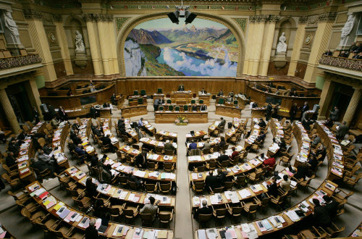
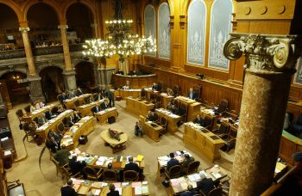
Federal Assembly (Legislature)
National Council (Art. 149 Cst.)
200 Members
Popular election for four years
Council of States (Art. 150 Cst.)
46 Members
2 delegates per Canton (in 6 half-Cantons 1 delegate), elected by the Cantons for four years

Slide 8

Political Parties

Slide 9
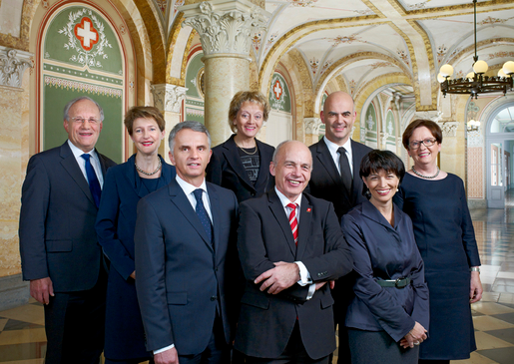
Federal Council (Executive; Art. 175 Cst.)
7 Members
(+ 1 Federal Chancellor)
Election by the Federal Assembly for four years
President of the Federal Council is elected for one year only (primus inter pares)

Slide 10








Current Composition of the Federal Council (2011-2015)
Didier Burkhalter
Federal Department of Foreign Affairs
Eveline Widmer-Schlumpf
Federal Department of Finance
Alain Berset
Federal Department of Home Affairs
Ueli Maurer
Federal Department of Defence, Civil Protection and Sport
Simonetta Sommaruga
President 2015
Federal Department of Justice and Police
Corina Casanova
Federal Chancellor
Doris Leuthard
Federal Department of Transport, Communication and Energy
Johann N. Schneider-Ammann
Federal Department of Economic Affairs, Education and Research

Slide 11
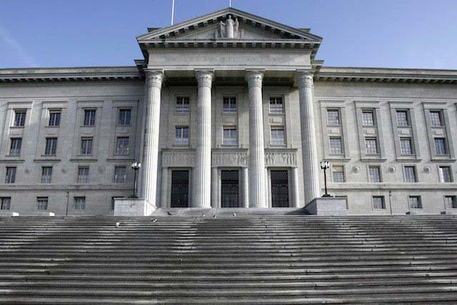
Federal Supreme Court (Judiciary; Art. 188 Cst.)
Highest Federal Judicial Authority in Switzerland
39 Members
Election by the Federal Assembly for six years
Located in Lausanne

Slide 12
Table of Contents
  Short History
  The Swiss Constitution
  Federal Authorities
  Swiss Federalism
  Fundamental Rights
  Political Rights
  Judicial System
  Bilateral Relations CH-EU
  Case Study: Expulsion Initiative (“Ausschaffungsinitiative”)

Slide 13
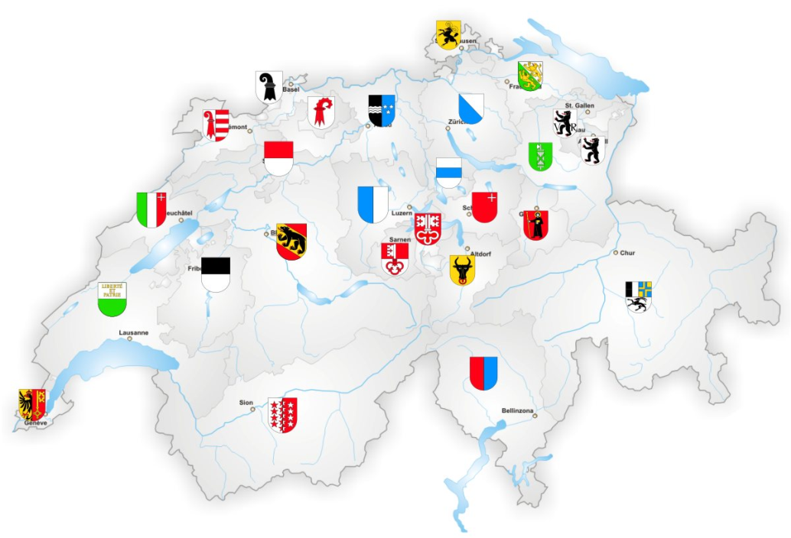
Art. 1 Cst. The Swiss Confederation
The People and the Cantons of Zurich, Bern, Lucerne, Uri, Schwyz, Obwalden and Nidwalden, Glarus, Zug, Fribourg, Solothurn, Basel Stadt and Basel Landschaft, Schaffhausen, Appenzell Ausserrhoden and Appenzell Innerrhoden, St. Gallen, Graubünden, Aargau, Thurgau, Ticino, Vaud, Valais, Neuchâtel, Geneva, and Jura form the Swiss Confederation.

Slide 14

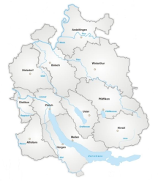
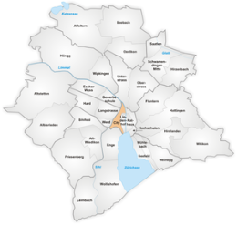
Competencies
Federation
All competencies enumerated in the Constitution (Art. 42, 54-125 Cst.)
Cantons
All competencies not conferred to the Federation (Art. 3, 46 Cst.)
Implementation of federal law (Art. 46 Cst.)
Communes
Competencies are determined by cantonal law (Art. 50 Cst.)

Slide 15
Principles
Subsidiarity
(Art. 43a Cst.)
Cooperation
(Art. 44 Cst.)
Cantonal Autonomy
(Art. 47 Cst.)
Supremacy of Federal Law
(Art. 46 Cst.)

Slide 16
Table of Contents
  Short History
  The Swiss Constitution
  Federal Authorities
  Swiss Federalism
  Fundamental Rights
  Political Rights
  Judicial System
  Bilateral Relations CH-EU
  Case Study: Expulsion Initiative (“Ausschaffungsinitiative”)

Slide 17
Human Dignity (Art. 7 Cst.)
Protection against Discrimination and Arbitrariness
Equality before the Law (Art. 8 sect. 1 Cst.)
Non Discrimination (Art. 8 sect. 2 Cst.)
Equality of men and women (Art. 8 sect. 3 Cst.)
Protection against Arbitrariness (Art. 9 Cst.)
Protection of Good Faith (Art. 9 Cst.)
Social Rights
Right to Assistance when in need (Art. 12 Cst.)
Right to Basic Education (Art. 19 Cst.)
Right to Legal Assistance (Art. 29 sect. 3 Cst.)
Procedural due Process
General Procedural Guarantees (Art. 29 Cst.)
Access to the Courts (Art. 29a Cst.)
Guarantees in Judicial Proceedings (Art. 30 Cst.)
Habeas Corpus (Art. 31 Cst.)
Criminal Proceedings (Art. 32 Cst.)

Slide 18
Civil liberties and freedoms (Art. 10-36 Cst.)
Right to Life and Personal Freedom (Art. 10 Cst.)
Right to Privacy (Art. 13 Cst.)
Right to Marry and to Have a Family (Art. 14 Cst.)
Freedom of Religion and Conscience (Art. 15 Cst.)
Freedom of Expression and of Information (Art. 16 Cst.)
Freedom of the Media (Art. 17 Cst.)
Freedom to use any language (Art. 18 Cst.)
Academic Freedom (Art. 20 Cst.)
Freedom of Artistic Expression (Art. 21 Cst.)
Freedom of Assembly (Art. 22 Cst.)
Freedom of Association (Art. 23 Cst.)
Protection against expulsion, extradition and deportation (Art. 25 Cst.)
Guarantee of Ownership (Art. 26 Cst.)
Economic Freedom (Art. 27 Cst.)

Slide 19
Art. 36 Cst. Restrictions on Fundamental Rights
¹ Restrictions on fundamental rights must have a legal basis. Significant restrictions must have their basis in a federal act. The foregoing does not apply in cases of serious and immediate danger where no other course of action is possible.
² Restrictions on fundamental rights must be justified in the public interest or for the protection of the fundamental rights of others.
³ Any restrictions on fundamental rights must be proportionate.
⁴ The essence of fundamental rights is sacrosanct.

Slide 20
Table of Contents
  Short History
  The Swiss Constitution
  Federal Authorities
  Swiss Federalism
  Fundamental Rights
  Political Rights
  Judicial System
  Bilateral Relations CH-EU
  Case Study: Expulsion Initiative (“Ausschaffungsinitiative”)

Slide 21
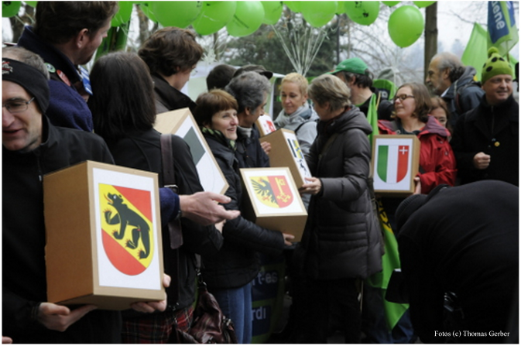
Initiative
(Art. 139 Cst.)
Constitutional Amendments
100’000 Signatures in 18 Months
Formulated Draft Article or General Proposition
Referendum
(Art. 140, 141 Cst.)
Mandatory
Constitutional Amendments
Approval by Majorities of the people and Cantons
Optional
Federal Acts and Treaties
50’000 Signatures in 100 Days
Approval by a Majority of People
Elections
(Art. 149, 150 Cst.)
Members of the National Council and of the Council of States

Slide 22
Table of Contents
  Short History
  The Swiss Constitution
  Federal Authorities
  Swiss Federalism
  Fundamental Rights
  Political Rights
  Judicial System
  Bilateral Relations CH-EU
  Case Study: Expulsion Initiative (“Ausschaffungsinitiative”)

Slide 23

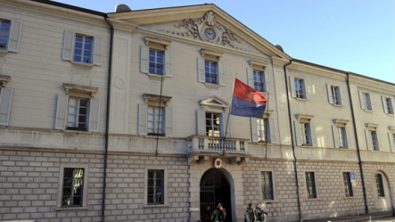
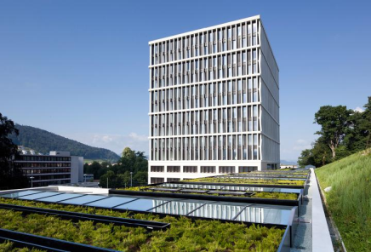
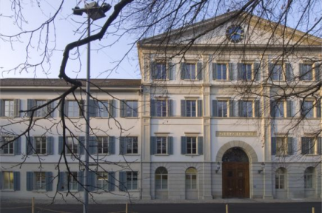

Federal Supreme Court
Criminal Law Appeal
Public Law Appeal
Civil and Criminal Law Appeal
Subsidiary Constitutional Appeal
Public Law Appeal
Federal Criminal Court
Federal Administrative Court
Civil and Criminal Courts of the Cantons
Administrative Courts of the Cantons

Slide 24
Constitutional Jurisdiction
Art. 190 Cst. Applicable Law
The Federal Supreme Court and the other judicial authorities apply the federal acts and international law.

Slide 25
Table of Contents
  Short History
  The Swiss Constitution
  Federal Authorities
  Swiss Federalism
  Fundamental Rights
  Political Rights
  Judicial System
  Bilateral Relations CH-EU
  Case Study: Expulsion Initiative (“Ausschaffungsinitiative”)

Slide 26
European Free Trade Association (EFTA)
  1960
Free Trade Agreement (FTA)
  1972 (72.5% Yes)
Insurance Agreement
  1989
Rejection to join the European Economic Area (EEA)
  1992 (50.3% No und 16 Cantons)
Bilateral Agreements I (incl. a “Guillotine” clause)
  1999 (67.2% Yes)
Bilateral Agreements II
  2004 (Schengen/Dublin 54.6% Yes)

Slide 27
Bilateral Agreements I
  free movement of persons, technical obstacles to trade, public procurement market, agriculture, research, civil aviation, overland transport
  => mainly economic focus (market access)
Bilateral Agreements II
  Schengen/Dublin, taxation of savings, fight against fraud, processed agricultural products, MEDIA, environment, statistics, pensions, education/vocational training/youth
  political cooperation, improved economic framework conditions
further
  cooperation with EU agencies and participation in EU programs
  enlargement contribution (“Kohäsionsmilliarde”)

Slide 28
Approval of the “Masseneinwanderungsinititave” (Article 121a of the Constitution; s. handout, delivered in class)
  obligation to set up a system of quotas and priority for Swiss workers and to re-negotiate the Agreement on the Free Movement of Persons)
  February 9, 2014 (50.3% Yes and 12 5/2 Cantons)
=> Current efforts
  securing the current set of bilateral agreements, by
    either re-negotiate the Agreement on the Free Movement of Persons (highly unlikely)
    or to “correct” the Peoples’ and the Cantons’ verdict of February 9, 2014
  renewal/modernisation of the institutional framework and negotiations on further agreements (on market access), e.g. electricity, financial services

Slide 29
Policy of autonomous adaptation
Federal Council 1988/1993
„Unser Ziel muss sein, in Bereichen von grenzüberschreitender Bedeutung (und nur dort) eine grösstmögliche Vereinbarkeit unserer Rechtsvorschriften mit denjenigen unserer europäischen Partner zu sichern. (…) Es geht bei diesem Streben nach Parallelität nicht darum, das europäische Recht automatisch nachzuvollziehen, wohl aber darum, zu verhindern, dass ungewollt und unnötigerweise neue Rechtsunterschiede geschaffen werden, welche die grundsätzlich angestrebte gegenseitige Anerkennung der Rechtsvorschriften auf europäischer Ebene behindern.“ (Integrationsbericht 1988)
twofold purpose
examination by the administrative bodies («Europakapitel», cf. Art. 141 Abs. 1 ParlG)
spill over-effect

Slide 30
Table of Contents
  Short History
  The Swiss Constitution
  Federal Authorities
  Swiss Federalism
  Fundamental Rights
  Political Rights
  Judicial System
  Bilateral Relations CH-EU
  Case Study: Expulsion Initiative (“Ausschaffungsinitiative”)

Slide 31
Chronology
28.11.2010 Approval by a majority of the people (52.9 %) and the Cantons (17 ½)
2013-2015 Governmental proposal for the implementation of the initiative; debate and approval of the implementing legislation by the Parliament
Art. 121 sect. 3-6 Cst.
(…)
³ Irrespective of their status under the law on foreign nationals, foreign nationals shall lose their right of residence and all other legal rights to remain in Switzerland if they:
are convicted with legal binding effect of an offence of intentional homicide, rape or any other serious sexual offence, any other violent offence such as robbery, the offences of trafficking in human beings or in drugs, or a burglary offence; or
have improperly claimed social insurance or social assistance benefits.
(…)

Slide 32
Compatibility with the BV and International Law?
Conflict with the Constitution? e.g.:
  fundamental rights
  principle of proportionality (Article 5 BV)
Conflict with the European Convention on Human Rights? e.g.:
  principle of non-refoulement
  right to respect private and family life
  principle of proportionality
Conflict with the Agreement on the Free Movement of Persons with the EU? e.g.:
  principle of proportionality (prohibition of “automatism”)
Federal Supreme Court (BGE 139 I 16; 12 October 2012)
  no direct applicability of Art. 121 sect. 3-6 Cst.
  relevance of Article 5 BV (principle of proportionality)
  in principle: primacy of ECHR (obiter dictum!)

Slide 33
Governmental Proposal and Implementing Law
Governmental proposal
  Expulsion only in serious cases (minimum custodial sentence: 6 months)
  No “automatic” expulsion when fundamental rights are affected
  Possibility of conflicts in individual cases remains
Implementing legislation adopted – after long and controversal debates – by Parliament (11 March 2015)
  Minimal consideration of the principle of proportionality (Article 5 BV) (“Härtefallklausel”; Article 66a(2) of the Penal Law)
Notes:
Bundesrätin Sommaruga erwähnt folgende bestehende mögliche Konfliktfälle:
Ausweisung eines europäischen Bürgers wegen Sozialhilfebetrugs. Das Freizügigkeitsabkommen verlangt für eine rechtmässige Ausweisung die Prüfung des Vorliegens einer gegenwärtigen, tatsächlichen und schweren Gefährdung der öffentlichen Ordnung, was im Falle eines Sozialhilfebetruges kaum angenommen werden kann.
Das Prinzip der Verhältnismässigkeit staatlicher Massnahmen könnte im Falle einer Verurteilung eines amerikanischen Geschäftsmannes wegen ungetreuer Geschäftsführung zu einer bedingte Strafe von über 6 Monaten verletzt sein, da in einem solchen Fall die Zukunftsprognosen als gut eingeschätzt werden und daher eine Ausweisung nicht notwendig machen.

Slide 34
«Durchsetzungsinitiative»
see handout (delivered in class)
declaration of validity by the Parliament, but not with respect to the sentence defining ius cogens (Article 197 Ziff. 9(1) IV 2nd sentence BV), based on Article 139(3) BV
the People and the Cantons will vote on this initiative in 2016

Slide 35
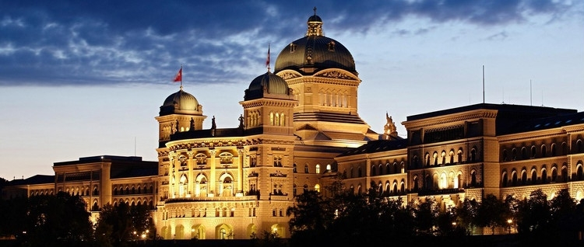
Thank you for your attention!

